Slide 1
"Financial Horizons: Maximizing Resources“ All Funds Budgeting Dr. Lillian Wanjagi Vice Chancellor for Business & Finance Sandra G Williams Associate Vice Chancellor for Budgets & Financial Planning

Slide 2
"Financial Horizons“ Maximizing Resources?
Maximizing resources is broadly defined as increasing or optimizing resources for a program or initiative. Blending Funding – Blended funds (pooled funds) involve combining funds from several sources into a single pool from which allocations and disbursements are made.

Slide 3
What is the All-Funds Budget?
An initiative by the UNC System to encourage best practices in budgeting across the System by requiring increased transparency for fund types that have historically not been part of the Board of Governor’s annual review.
Forward‐looking plan of all expected revenues and expenses.
Generally cash‐based and includes inter‐departmental transactional activity.
Increased focus on unrestricted fund sources and related uses.
Accommodates strategic planning and provides transparency in allocation decisions.

Slide 4
Why Develop an All-Funds Budget?
Better align resources with strategic priorities
Promote stewardship and financial sustainability
Better understand the impact of discrete decisions on the broader financial picture
Improve transparency and campus engagement
Strengthen the fiduciary responsibility of the Boards of Trustees
G.S. 116-1(b) – “…In the fulfillment of this mission, the university shall seek an efficient use of available resources to ensure the highest quality in its service to the citizens of the State.”

Slide 5
This is Not an Accounting Exercise
The AFB is intended to:
Facilitate planning and the strategic resource allocation decisions
Help institutions think about the big picture (avoid not being able to “see the forest for the trees”)
Help identify disconnects within the institutions
Promote conversation and understanding of the institution’s financial position, its approach to resource allocation, and the tradeoffs it faces

Slide 6
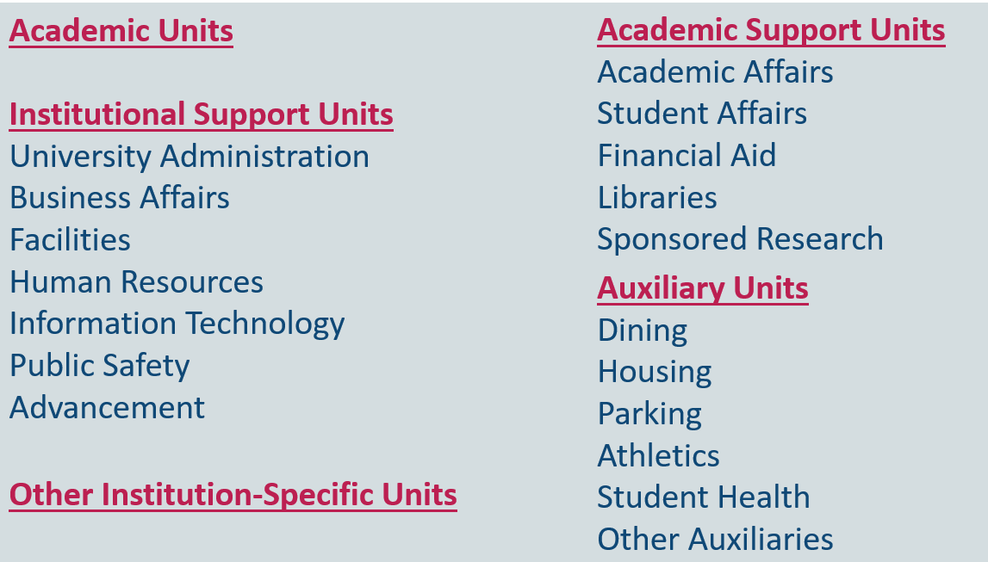
AFB Components – Standard Units
Each institution is required to budget for a standard set of organizational units.

Slide 7
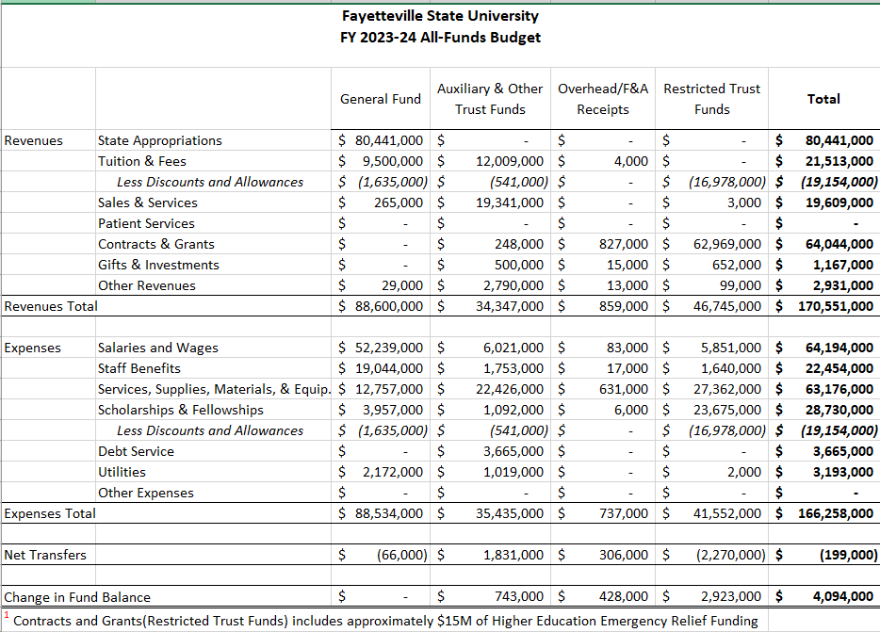
Summary – All Funds Budget (FY 2024)

Slide 8
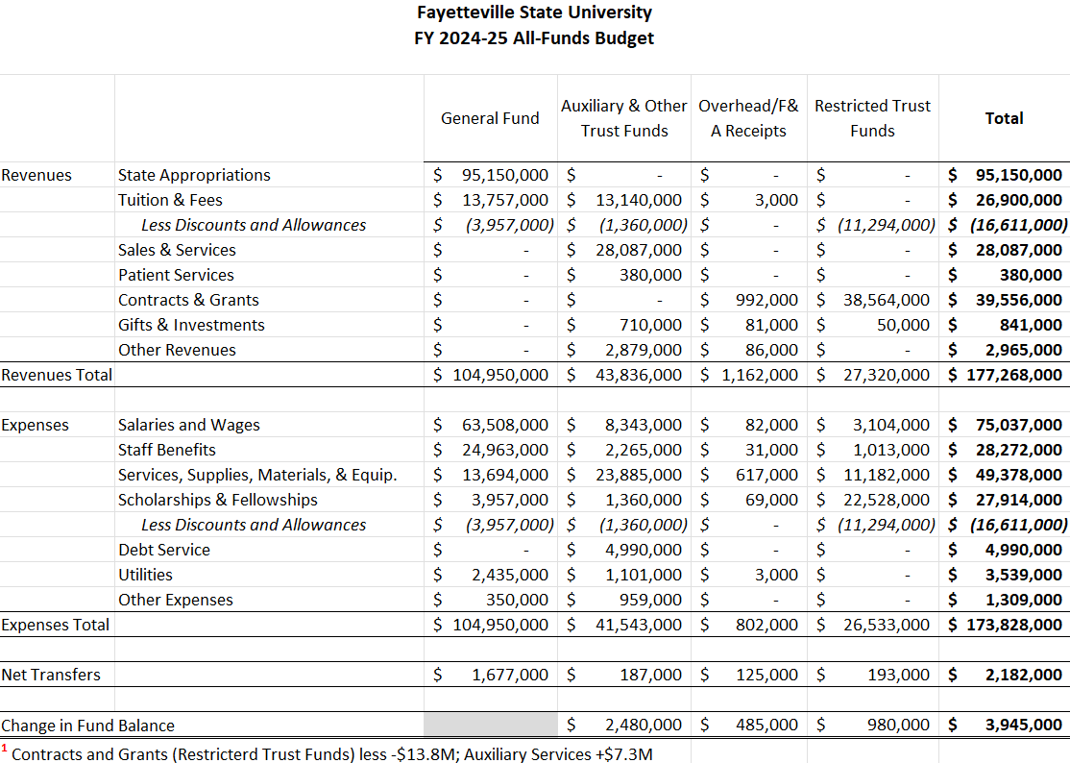
Summary – All Funds Budget (FY 2025)

Slide 9
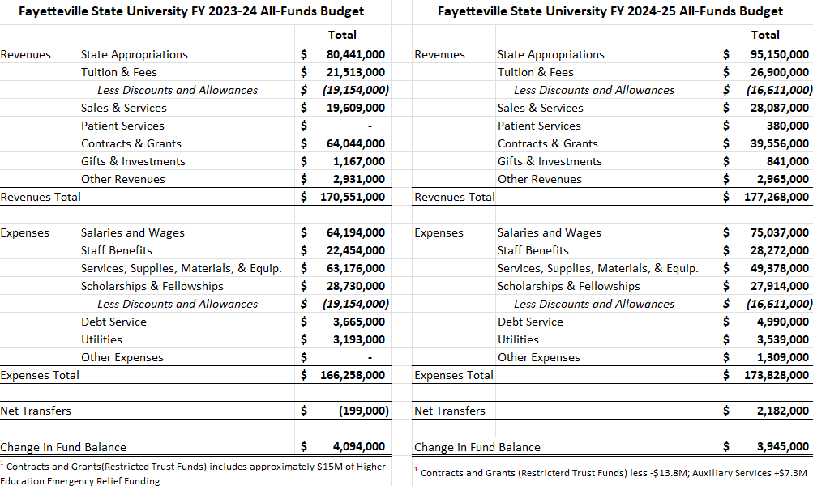

Slide 10
New FY2024-25 Allocation
FY2024-25 Performance-Weighted Enrollment Funding - $3,968,640
2023 Enrollment Change = $2,695,822 (Recurring)
FY2022 Performance Funding = $1,272,818 (Non-recurring)
School of Risk Management = $2,500,000
Sexual Assault Nurse Examiners (SANE) = $450,000 (remaining balances from initial authorization)
FSU Innovation & Entrepreneurship HUB = $500,000 (remaining balances from initial authorization)
NC Collaborative Grants – TBD (new cycle July 1, 2024).

Slide 11
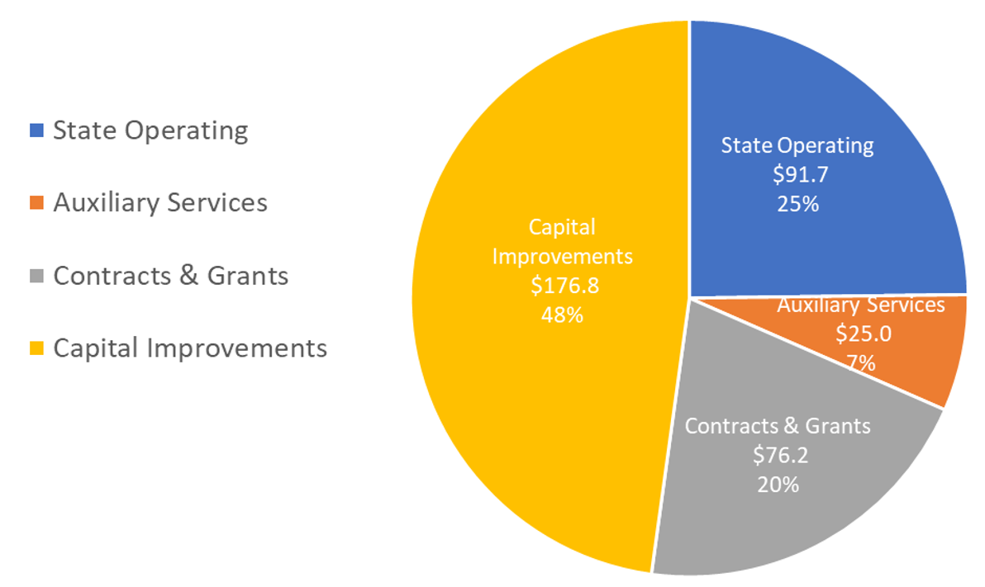
2024 BUDGET UPDATE = $353.7M

Slide 12
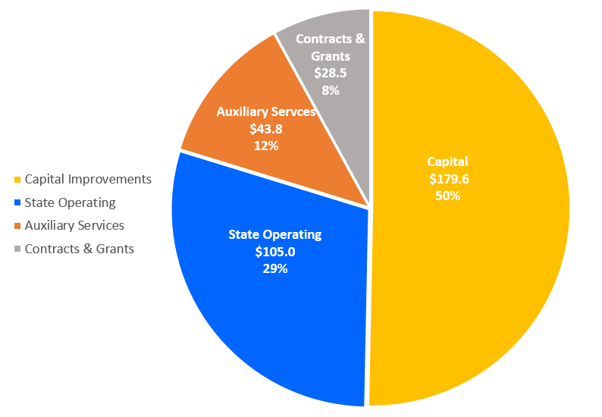
2024-25 BUDGET UPDATE = $356.9M

Slide 13
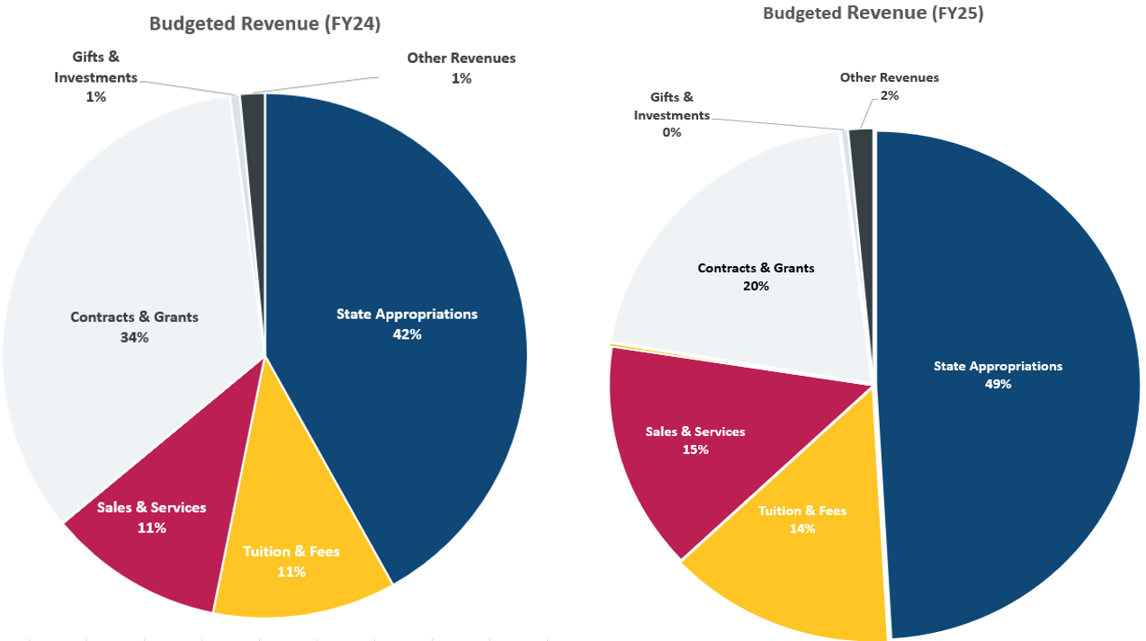
Revenue Comparison FY2024 vs FY2025

Slide 14
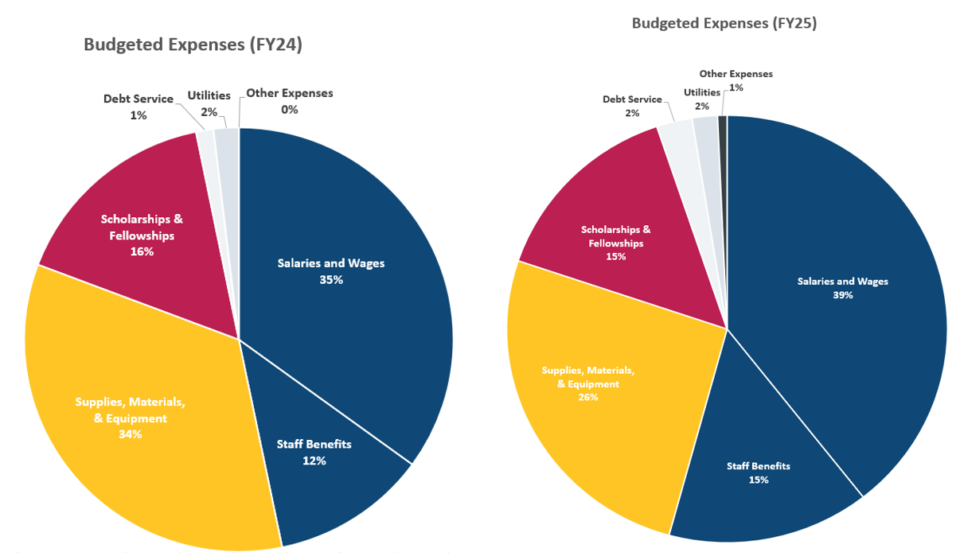
Expenses Comparison FY2024 vs FY2025

Slide 15
Next Steps
Administration recommends BOT approval of the All-Funds Budget for the 2024-25 fiscal year.
The All-Funds Budget is due to UNC System on May 1, 2024.
UNC System will be present at the next Board of Governors for approval on May 22-23, 2024.

Slide 16
QUESTIONS?

