Slide 1
Instructions On How To Complete Your SAP Appeal
After successfully creating your UNCFSU Student Forms Account you can view all SAP Appeal Tasks on the main page of the student forms portal.

Slide 2
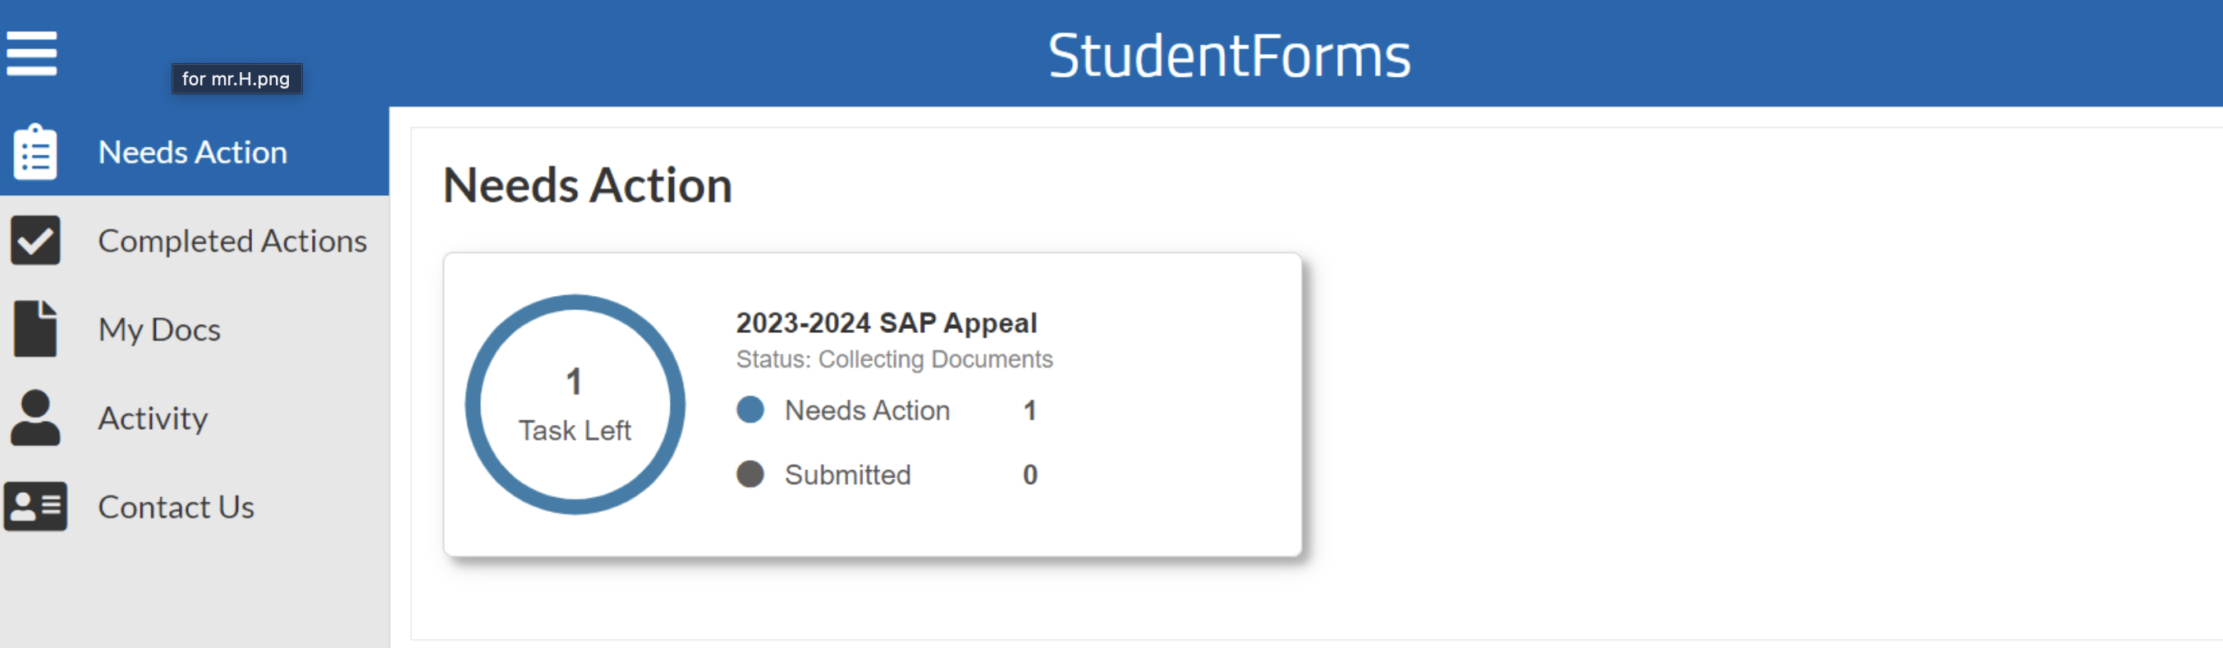
How to submit your Satisfactory Academic Progress Appeal
Click on the Needs Action tab to access your SAP appeal.

Slide 3
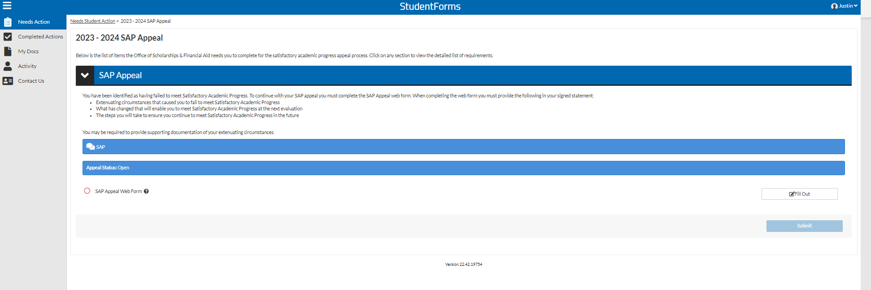
How to submit your Satisfactory Academic Progress Appeal
Initiate the SAP Appeal Web Form by clicking the “Fill Out” button.

Slide 4
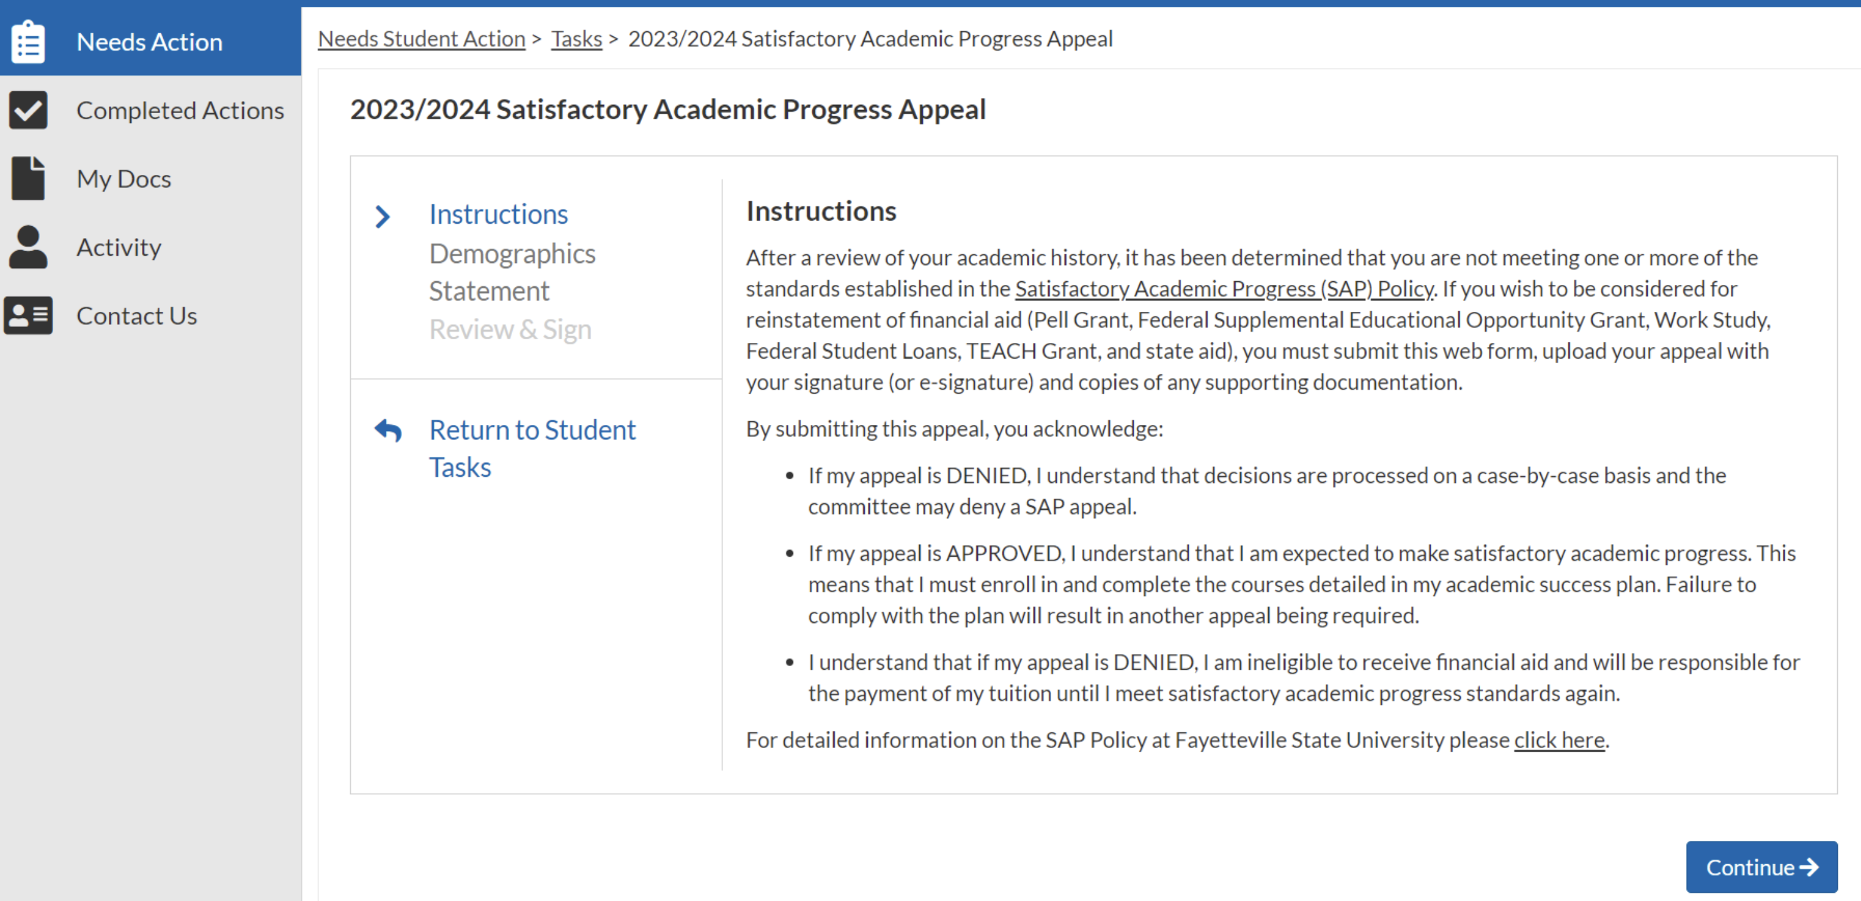
How to submit your Satisfactory Academic Progress Appeal
Carefully review the appeal instructions!

Slide 5
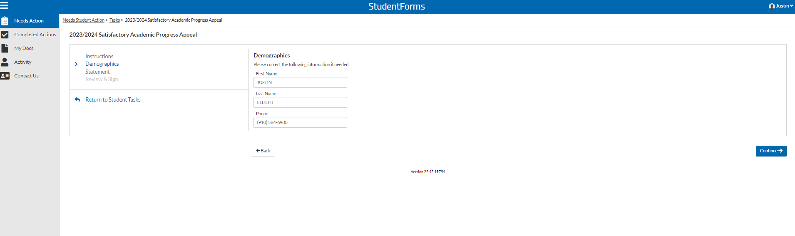
How to submit your Satisfactory Academic Progress Appeal
Demographic information must match exactly with your FAFSA!

Slide 6
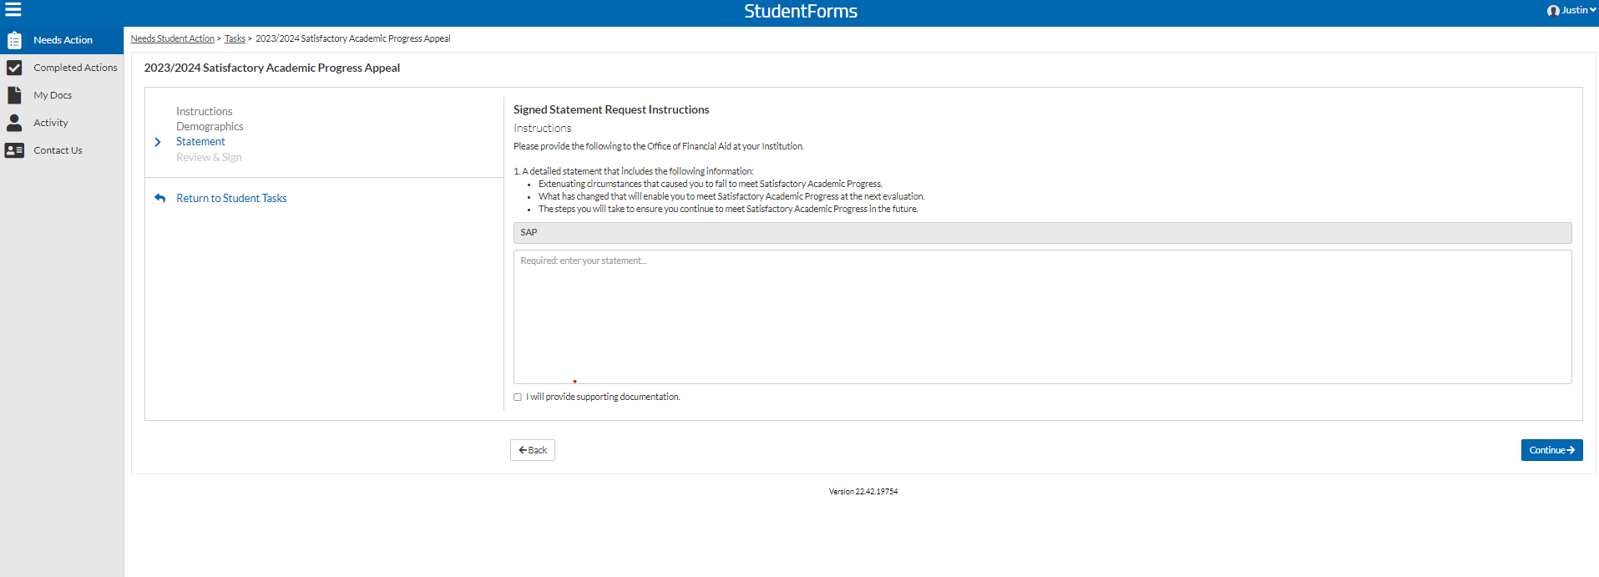
How to submit your Satisfactory Academic Progress Appeal
Review statement instructions and type your statement.
Ensure the box is checked to indicate you are providing documentation.

Slide 7
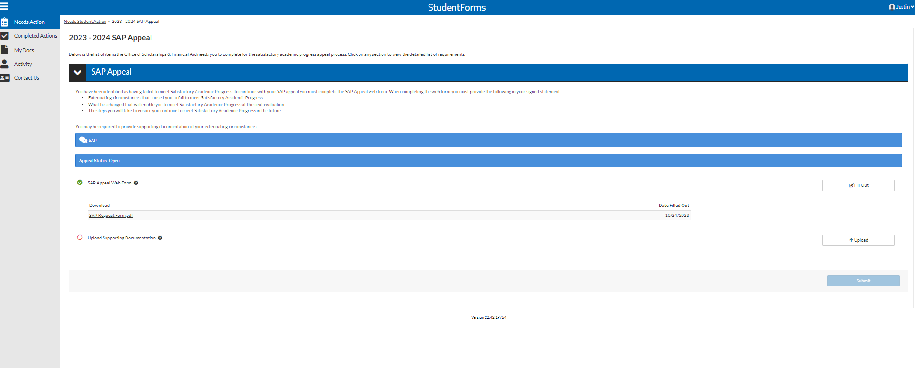
How to submit your Satisfactory Academic Progress Appeal
After filling out the appeal web form, upload your documentation.

Slide 8
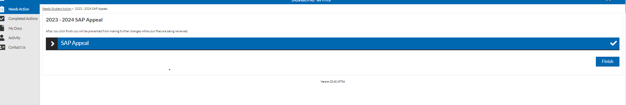
How to submit your Satisfactory Academic Progress Appeal
Ensure that you complete the last step and submit your appeal!

Slide 9
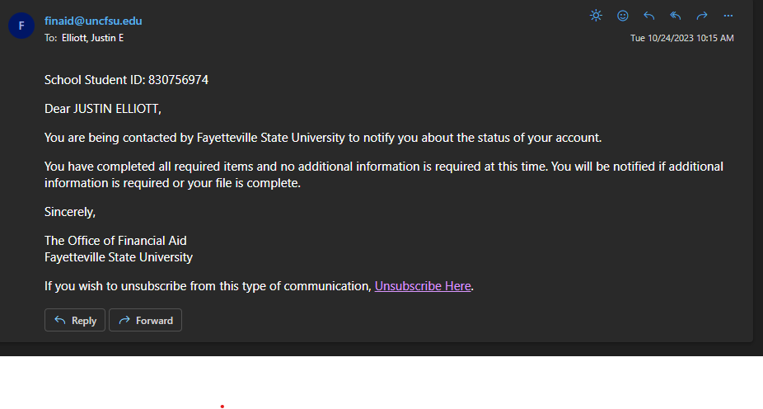
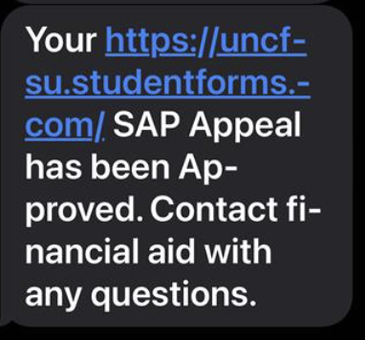
How to submit your Satisfactory Academic Progress Appeal
After your appeal is submitted you will be notified via email and text! Your appeal decision will be made within fifteen business days.

Slide 10

For Questions Contact Us!
Office of Scholarships & Financial Aid
General Office Email: finaid@uncfsu.edu
SAP Committee Email: fsu-sap@uncfsu.edu
Phone: 910-672-1325
Office Hours:
Monday-Friday
8am-5pm

