Slide 1
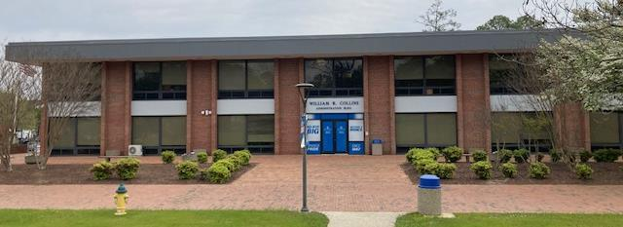
BCSSE and NSSE Reports 2023
Office of Institutional Effectiveness, Research, and Planning
April 2024

Slide 2
BCSSE and NSSE
Beginning College Survey of Student Engagement
(BCSSE)
Surveys First-Year Students, including 18-24-year-olds, Transfer Students, and Adult Learners as they begin instruction at FSU.
National Survey of Student Engagement
(NSSE)
Surveys First-Year Students and Seniors about their instructional and campus experiences at FSU.

Slide 3
Objectives
BCSSE Overview – Student Expectations
NSSE Overview – How Are We Doing?
Group
College
Department
Major
Comparison with Other Institutions
High Impact Practices
Gains and Satisfaction
Opportunities for Growth
What can we do with the information?
Requests of Academic Departments
Based on data and FSU Strategic Plan

Slide 4
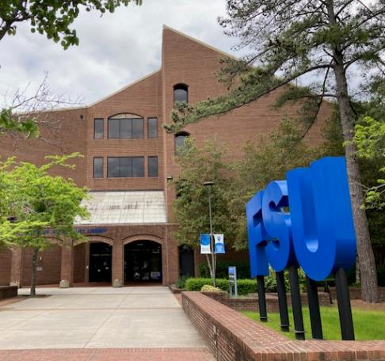
Beginning College Student Survey of Engagement (BCSSE)
Student Expectations
Student Concerns
Student Nonacademic Responsibilities (Work, Family, etc.)
Briefly review BCSSE student expectations and concerns.
Review relevant NSSE responses to these items.

Slide 5
Beginning Students’ Top Expectations
On the BCSSE, First-Year students, Transfer students, and Adult Learners shared their top expectations for the campus:
Student Expectations
Importance of Campus Environment
Expected Discussions with Diverse Others
Expected Engagement in Collaborative Learning
Expected Engagement with Faculty

Slide 6
NSSE Results for Top Expectations
On the NSSE, First-Year students and seniors shared their impressions in each area.
The change in average scores from 2019 to 2023 is shown in the table.
Student Expectations | First-Year | Seniors
Importance of Campus Environment | 0 | +0.1
Expected Discussions with Diverse Others | +0.1 | +0.1
Expected Engagement in Collaborative Learning | -0.1 | -0.2
Expected Engagement with Faculty | +0.4 | +0.2
Scores moved in a positive direction. Students would like more collaborative learning.

Slide 7
NSSE Results for Top Expectations
Comparison of NSSE results with External Peers and HBCUs:
FSU scores were greater than (+), less than (-), or equal to (=) institutional peers and HBCUs.
Student Expectations | First-Year | Seniors
Importance of Campus Environment | + | =
Expected Discussions with Diverse Others | + | +
Expected Engagement in Collaborative Learning | = | -
Expected Engagement with Faculty | + | -
First-year students’ scores equaled or exceeded peer institutions. Seniors would like more collaborative learning and engagement with faculty, especially mentoring.

Slide 8
Beginning College Student Concerns
On the BCSSE, students reported concerns about maintaining positive mental health and avoiding mental and emotional exhaustion.
The NSSE addresses this with questions about campus support for overall well being (including mental health).
BCSSE: Percentage of students stating their level of concern was (Very Much) or (Quite a bit).

Slide 9
Beginning College Student Responsibilities
On the BCSSE, students shared whether they were working or caring for dependents.
The NSSE asks students if the campus helps them manage their nonacademic responsibilities.

Slide 10
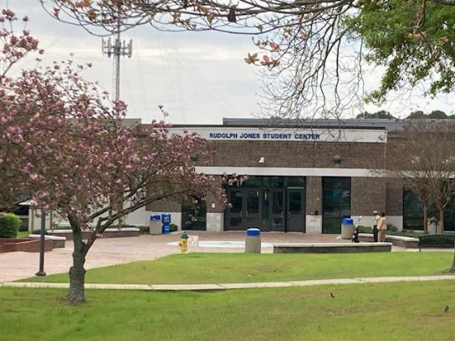
NSSE: Learning, Engagement, and Campus Experience: How Are We Doing?
Outcomes by Group
Outcomes by College
Opportunities for Growth
NSSE Survey responses

Slide 11
NSSE Outcomes by Group
Groups
Survey Items
Adult Learners
Military Students
18-24-Year-Old Students
Students Working 20+ Hours per Week
Students Caring for Dependents
Demographic Groups
Distance Learners
First-Generation College Students
First-Year Students
Seniors
Support for Overall Well Being
Nonacademic Responsibilities
Quality of Interactions
Effective Teaching Practices
Supportive Campus Environment
Mentoring
Research with Faculty
High Impact Practices

Slide 12
Campus Support for Overall Well Being (NSSE Survey Items)
Two Survey Items:
Overall Well Being (Mental and Physical Health)
Graphs display percent of students giving ratings of 3 or 4.
Managing Nonacademic Responsibilities (Work, Family, Military Deployment, etc.)
Items rated from 1 – 4 (Very little, Some, Quite a bit, Very much)

Slide 13
Support for Overall Well Being
Adult learners differed others in reports of campus support for their well being.
On a scale of 1-4, responses included 3 (Quite a bit) and 4 (Very Much).

Slide 14
Support for Overall Well Being
Most students reported campus support for overall well being, with variance for Hispanic or Latino(a) students.
On a scale of 1-4, responses included 3 (Quite a bit) and 4 (Very Much).
51 respondents (out of more than 600) were Hispanic or Latino(a).

Slide 15
Support for Overall Well Being
Female students were more likely to report campus support for overall well being.
Percentages represent students who responded, “Very Much” or “Quite a bit,” on a scale of 1-4.

Slide 16
Support for Overall Well Being
Students who work off campus (20+ hours) and students caring for dependents reported higher rates of campus support for overall well being than first-generation college students.
On a scale of 1-4, responses included 3 (Quite a bit) and 4 (Very Much).

Slide 17
Support for Overall Well Being
Ratings vary based on campus housing status.
Percentages represent students who responded, “Very Much” or “Quite a bit,” on a scale of 1-4.
4 students reported being homeless or in transition.

Slide 18
Supportive Campus Environment (NSSE Survey Items)
Eight Survey Items:
Overall well being, academic and nonacademic support, socialization, diverse contacts, activities, and events
Graphs display average ratings from 0-60.
Items rated from 1 – 4 (Very little, Some, Quite a bit, Very much)

Slide 19
Supportive Campus Environment
First-year students and seniors’ scores (on a 60-point scale) were higher than peer institutions but have room for growth.
Scored on 60-point scale (e.g., Very little = 0; Some = 20; Quite a bit = 40; Very much = 60), and the rescaled items are averaged across every item in the Engagement Indicators (EI). Items include well-being, nonacademic support, tutoring, campus activities, diverse contacts, etc. Compare averages for Southeast Public Institutions (FY 35.4, S 33.2), Carnegie Peers (FY 34.7, S 32.7), and All U.S. Institutions Administering the NSSE (FY 34.6, S 32).

Slide 20
Supportive Campus Environment
First-generation first-year students and first-generation seniors’ scores were higher than peer institutions but have room for growth.
Scored on 60-point scale (e.g., Very little = 0; Some = 20; Quite a bit = 40; Very much = 60), and the rescaled items are averaged across every item in the Engagement Indicators (EI). Items include well-being, nonacademic support, tutoring, campus activities, diverse contacts, etc. Compare averages for Southeast Public Institutions (FY 35.4, S 33.2), Carnegie Peers (FY 34.7, S 32.7), and All U.S. Institutions Administering the NSSE (FY 34.6, S 32).

Slide 21
Supportive Campus Environment
Total scores were higher than peer institutions but have room for growth. One group (White students) were majority adult learners (65%).
Scored on 60-point scale (e.g., Very little = 0; Some = 20; Quite a bit = 40; Very much = 60), and the rescaled items are averaged across every item in the Engagement Indicators (EI). Items include well-being, nonacademic support, tutoring, campus activities, diverse contacts, etc. Compare averages for Southeast Public Institutions (FY 35.4, S 33.2), Carnegie Peers (FY 34.7, S 32.7), and All U.S. Institutions Administering the NSSE (FY 34.6, S 32).

Slide 22
Nonacademic Responsibilities
Adult learners and military students reported a need for more help in managing nonacademic responsibilities (work, family, deployment, etc.).
On a scale of 1-4, responses included 3 (Quite a bit) and 4 (Very Much).

Slide 23
Nonacademic Responsibilities
Students who work off campus (20+ hours), students caring for dependents, and first-generation college students, may need help managing nonacademic responsibilities.
On a scale of 1-4, responses included 3 (Quite a bit) and 4 (Very Much).

Slide 24
Nonacademic Responsibilities
Ratings vary based on campus housing status. Distance and commuting students may need more support.
On a scale of 1-4, responses included 3 (Quite a bit) and 4 (Very Much).
4 students reported being homeless or in transition.

Slide 25
Quality of Interactions (NSSE Survey Items)
Items measured interactions with:
Administration (Admissions, Financial Aid, Registrar, etc.)
Graphs display percent of students giving ratings of 4 or above.
Faculty
Advisors
Other Students
Student Affairs Staff (Career Services, Housing, etc.)
Items scored from 1 (poor) – 7 (excellent)

Slide 26
Quality of Interaction with Administration
Administrative staff includes Admissions, Financial Aid, Registrar, etc.).
Most, especially transfer students, reported high quality interactions with administration.
On a scale of 1-7 (poor to excellent), percentage of students reporting scores above 4.

Slide 27
Quality of Interactions with Administration
Most students working off campus (20+ hours) and students caring for dependents reported high quality interactions with administration.
First-generation college students report a desire for improved interactions with administration.
On a scale of 1-7 (poor to excellent), percentage of students reporting scores above 4.

Slide 28
Quality of Interactions with Administration
Student reports of interactions with administration differed by race.
On a scale of 1-7 (poor to excellent), percentage of students reporting scores above 4.

Slide 29
Quality of Interactions with Administration
Ratings for interactions with Administration are similar for groups other than unhoused.
On a scale of 1-7 (poor to excellent), percentage of students reporting scores above 4.
4 students reported being homeless or in transition.

Slide 30
Quality of Interactions with Faculty
Most adult learners, military students, 18-24-year-olds, and transfer students reported high quality interactions with faculty, with little variance among groups.
On a scale of 1-7 (poor to excellent), percentage of students reporting scores above 4.

Slide 31
Quality of Interactions with Faculty
Most students working off campus (20+ hours), students caring for dependents, and first-generation college students reported high quality interactions with faculty.
On a scale of 1-7 (poor to excellent), percentage of students reporting scores above 4.

Slide 32
Quality of Interactions with Faculty
Most first-year students and seniors reported high quality interactions with faculty.
On a scale of 1-7 (poor to excellent), percentage of students reporting scores above 4.

Slide 33
Quality of Interactions with Faculty
First-generation college students constituted 48% of NSSE respondents, 341 of 714.
On a scale of 1-7 (poor to excellent), percentage of students reporting scores above 4.

Slide 34
Quality of Interactions with Faculty
Interactions with faculty had minor variations by race.
On a scale of 1-7 (poor to excellent), percentage of students reporting scores above 4.

Slide 35
Quality of Interactions with Faculty
Ratings for interactions with faculty are similar, whether students on campus, commuters, online, or unhoused.
On a scale of 1-7 (poor to excellent), percentage of students reporting scores above 4.
4 students reported being homeless or in transition.

Slide 36
Student-Faculty Interaction (Mentoring) by Race
First-year scores were higher than peer institutions while seniors’ scores were lower.
Scored on 60-point scale (e.g., Very little = 0; Some = 20; Quite a bit = 40; Very much = 60), and the rescaled items are averaged across every item in the Engagement Indicators (EI). Items include well-being, nonacademic support, tutoring, campus activities, diverse contacts, etc. Compare averages for Southeast Public Institutions (FY 22.2, S 24.6), Carnegie Peers (FY 22.5, S 26.4), and All U.S. Institutions Administering the NSSE (FY 21.6, S 23.7).

Slide 37
Quality of Interactions w/Student Affairs Staff
Student Affairs staff received the highest ratings of all employees from this group, especially military students.
On a scale of 1-7 (poor to excellent), percentage of students reporting scores above 4.

Slide 38
Quality of Interactions w/Student Affairs Staff
Most students working off campus (20+ hours), students caring for dependents, and first-generation college students reported high quality interactions with Student Affairs staff.
On a scale of 1-7 (poor to excellent), percentage of students reporting scores above 4.

Slide 39
Quality of Interactions with Student Affairs Staff
Ratings for interactions with Student Affairs staff differ for distance learners and students on campus or unhoused.
On a scale of 1-7 (poor to excellent), percentage of students reporting scores above 4.
4 students reported being homeless or in transition.

Slide 40
Quality of Interactions with Advisors
Ratings for interactions with advisors are similar, whether students on campus, commuters, online, or unhoused.
On a scale of 1-7 (poor to excellent), percentage of students reporting scores above 4.
4 students reported being homeless or in transition.

Slide 41
Quality of Interactions with Advisors
Most, especially military students, reported high quality interactions with advisors.
On a scale of 1-7 (poor to excellent), percentage of students reporting scores above 4.

Slide 42
Quality of Interactions with Advisors
Most students working off campus (20+ hours), students caring for dependents, and first-generation college students reported high quality interactions with advisors.
On a scale of 1-7 (poor to excellent), percentage of students reporting scores above 4.

Slide 43
Quality of Interactions with Other Students
Most students reported high quality interactions with one another.
On a scale of 1-7 (poor to excellent), percentage of students reporting scores above 4.

Slide 44
Quality of Interactions with Other Students
Most students working off campus (20+ hours), students caring for dependents, and first-generation college students reported high quality interactions with their peers.
On a scale of 1-7 (poor to excellent), percentage of students reporting scores above 4.

Slide 45
Quality of Interactions with Other Students
Ratings for interactions with other students are similar, whether students on campus, commuters, online, or unhoused.
On a scale of 1-7 (poor to excellent), percentage of students reporting scores above 4.

Slide 46
Overall Campus Interaction by Race
Ratings of campus interactions (faculty, staff, administration, and students) varied by year and group, comparable to peer institutions. Seniors’ ratings were higher.
Scored on 60-point scale (e.g., Very little = 0; Some = 20; Quite a bit = 40; Very much = 60), and the rescaled items are averaged across every item in the Engagement Indicators (EI). Items include well-being, nonacademic support, tutoring, campus activities, diverse contacts, etc. Compare averages for Southeast Public Institutions (FY 42.6, S 42.9), Carnegie Peers (FY 43.2, S 43.5), and All U.S. Institutions Administering the NSSE (FY 43, S 43).

Slide 47
Effective Teaching Practices (NSSE Survey Items)
Items measured whether instructors:
Clearly explained course goals
Taught course sessions in an organized way
Used examples or illustrations
Provided feedback on draft or work in progress
Provided prompt feedback
Graphs display average scores given by each group, from 0-60.

Slide 48
Effective Teaching Practices
First-year students (except for NSSE institutions) and seniors’ scores exceeded peer institutions but have room for growth.
Each EI is scored on a 60-point scale. To produce an indicator score, the response set for each item is converted to a 60-point scale (e.g., Very much=4, Quite a bit=3, Some=2, Very little=1), and the rescaled items are averaged. Compare to Southeast Public (FY 37.9, S 40.2), Carnegie (FY 38.1, S 40.6), and All U.S. Institutions Administering the NSSE (FY 38.4, S 40).

Slide 49
Effective Teaching Practices
Scores from first-generation first-year students were comparable to peers. Scores from first-generation seniors exceeded peers but have room for growth.
Each EI is scored on a 60-point scale. To produce an indicator score, the response set for each item is converted to a 60-point scale (e.g., Very much=4, Quite a bit=3, Some=2, Very little=1), and the rescaled items are averaged. Compare to Southeast Public (FY 37.9, S 40.2), Carnegie (FY 38.1, S 40.6), and All U.S. Institutions Administering the NSSE (FY 38.4, S 40).

Slide 50
Effective Teaching Practices
First-year students on campus differed in their views of teaching practices. Scores equaled or exceeded peer institutions but have room for growth.
Each EI is scored on a 60-point scale. To produce an indicator score, the response set for each item is converted to a 60-point scale (e.g., Very much=4, Quite a bit=3, Some=2, Very little=1), and the rescaled items are averaged. Compare to Southeast Public (FY 37.9, S 40.2), Carnegie (FY 38.1, S 40.6), and All U.S. Institutions Administering the NSSE (FY 38.4, S 40).

Slide 51
Effective Teaching Practices
Scores nearly equaled or exceeded peer institutions but have room for growth. There is little variation by group.
Each EI is scored on a 60-point scale. To produce an indicator score, the response set for each item is converted to a 60-point scale (e.g., Very much=4, Quite a bit=3, Some=2, Very little=1), and the rescaled items are averaged. Compare to Southeast Public (FY 37.9, S 40.2), Carnegie (FY 38.1, S 40.6), and All U.S. Institutions Administering the NSSE (FY 38.4, S 40).

Slide 52
NSSE Outcomes by Dept and College
Groups
Survey Items
Academic Departments
Broadwell College of Business and Economics
College of Education
College of Health, Science, and Technology
College of Humanities and Social Sciences
Majors
Support for Overall Well Being
Nonacademic Responsibilities
Quality of Interactions
Mentoring
Research with Faculty
Diverse Perspectives in Class
Encouraged Contact with Diverse Others

Slide 53
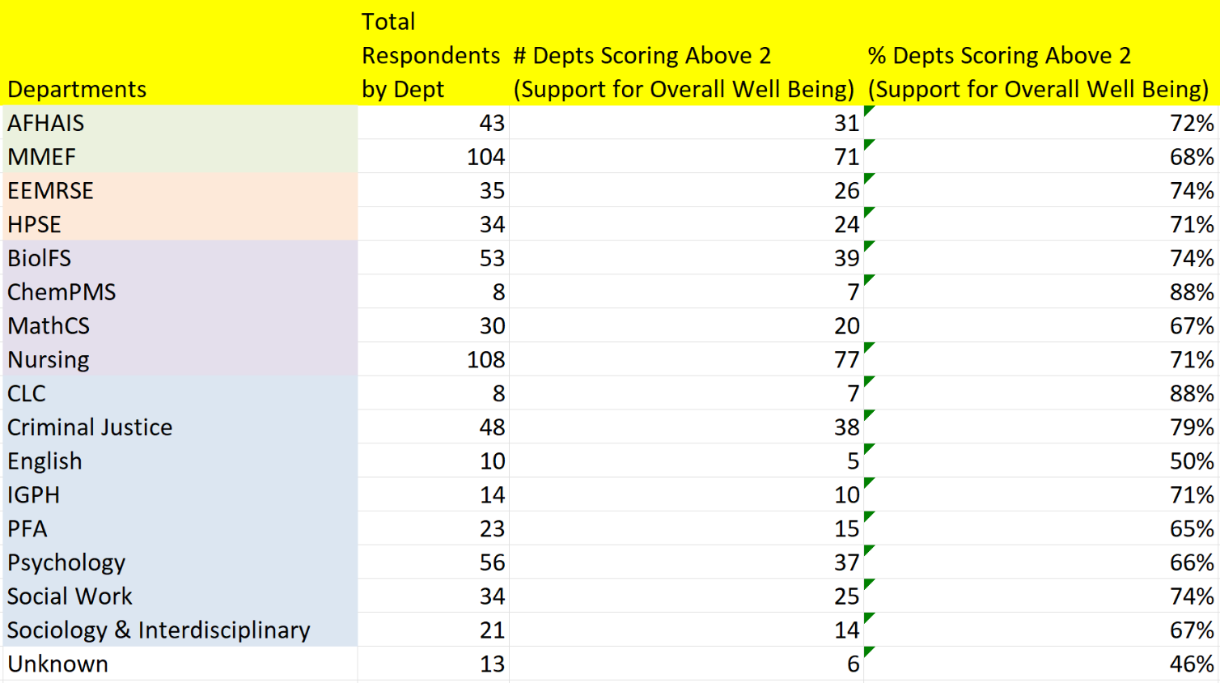
Dept. Outcomes for Support for Overall Well Being
Chart displays # of respondents per dept., and the # and percentage of students reporting scores above 2 (out of 4). Some departments do not have enough respondents to make conclusions, unless combined into colleges.

Slide 54
Support for Overall Well Being
Most students reported campus support for overall well being.
Notice the unknown category, representing up to 73 undeclared majors (depending on responses).
On a scale of 1-4, responses included 3 (Quite a bit) and 4 (Very Much).

Slide 55
Help Manage Nonacademic Responsibilities
Students reported a desire for more support as they manage nonacademic responsibilities.
On a scale of 1-4, responses included 3 (Quite a bit) and 4 (Very Much).

Slide 56
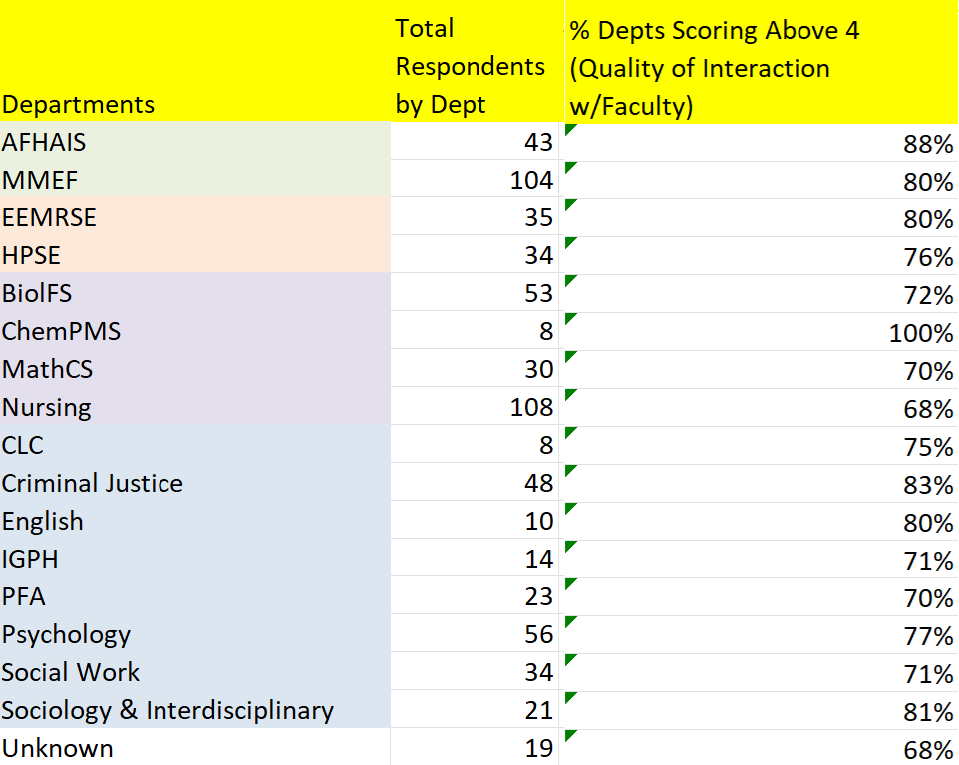
Dept. Outcomes for Quality of Interactions with Faculty
Chart displays # of respondents per dept., and the # and percentage of students reporting scores above 4 (out of 7). Some departments do not have enough respondents to make conclusions, unless combined into colleges.

Slide 57
Quality of Interaction with Faculty
Most students reported high quality interactions with faculty.
On a scale of 1-7, percentage of students reporting scores above 4.

Slide 58
Quality of Interaction with Administration
Most students reported high quality interactions with administration.
On a scale of 1-7, percentage of students reporting scores above 4.

Slide 59
Quality of Interaction with Student Affairs
Most students reported high quality interactions with Student Services staff (Student Affairs, Career Services, Housing, etc.).
Notice the scores from unknown (undeclared majors).
On a scale of 1-7, percentage of students reporting scores above 4.

Slide 60
Quality of Interaction with Advisors
Most students reported high quality interactions with advisors.
On a scale of 1-7, percentage of students reporting scores above 4.

Slide 61
Quality of Interaction with Students
Most students reported high quality interactions with peers.
On a scale of 1-7, percentage of students reporting scores above 4.

Slide 62
Mentoring (NSSE Survey Items)
Four items measured faculty mentoring:
Spoke with faculty about career
Questions scored from 1-4, (1) Never, (2) Sometimes, (3) Often, or (4) Very Often
Worked with faculty on activities other than coursework
Discussed topics with faculty outside of class
Discussed academic performance with faculty

Slide 63
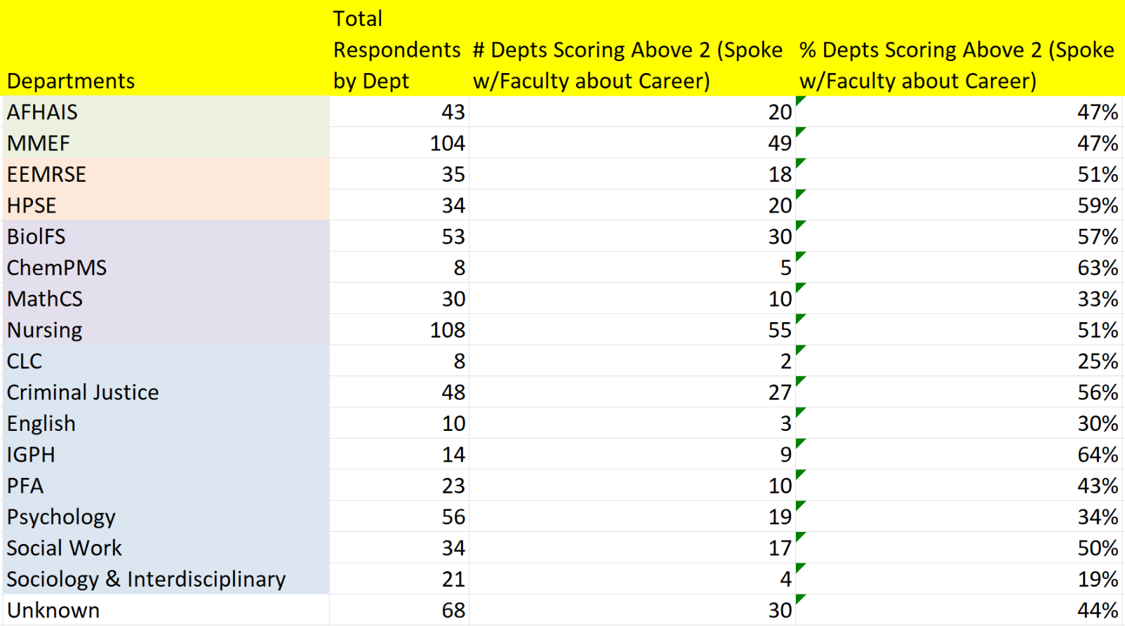
Dept. Outcomes for Faculty Mentoring (Career)
Chart displays # of respondents per dept., and the # and percentage of students reporting scores above 2 (out of 4). Some departments do not have enough respondents to make conclusions, unless combined into colleges.

Slide 64
Mentoring
Students may benefit from more conversations with faculty about career preparation.
On a scale of 1-4, responses included 3 (Often) and 4 (Very Often).

Slide 65
Mentoring
Students may benefit from more activities with faculty other than coursework.
On a scale of 1-4, responses included 3 (Often) and 4 (Very Often).

Slide 66
Mentoring
Students may benefit from discussing topics with faculty outside of class.
On a scale of 1-4, responses included 3 (Often) and 4 (Very Often).

Slide 67
Mentoring
Students may benefit from discussing academic performance with faculty.
On a scale of 1-4, responses included 3 (Often) and 4 (Very Often).

Slide 68
Research and Diversity (NSSE Survey Items)
Research with a Faculty Member
Survey item measured High Impact Practice, research with faculty
Diverse Perspectives (in class)
Encouraged Contact w/Diverse Others
Graphs show students who have done or plan to do research with faculty (score of 3 or 4).
Graphs show students who scored 3 (often) or 4 (very often)

Slide 69
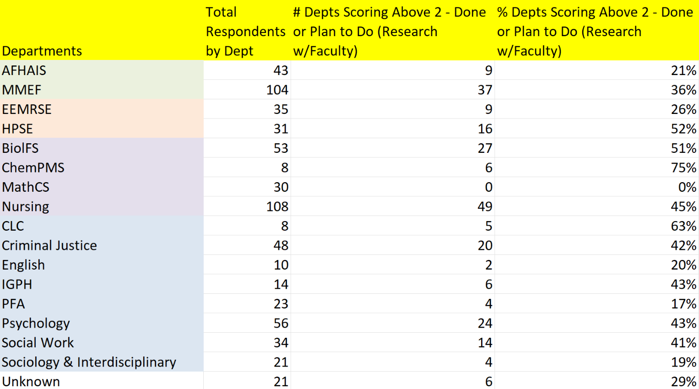
Dept. Outcomes for Research with Faculty Member
Chart displays # of respondents per dept., and the # and percentage of students reporting scores above 2 (out of 4). Some departments do not have enough respondents to make conclusions, unless combined into colleges.

Slide 70
Research with Faculty
Students may benefit from conducting research, projects, shows, or performances with faculty.
On a scale of 1-4, responses included 3 (Plan to do) and 4 (Done).

Slide 71
Diverse Perspectives
Students reported the extent to which they included diverse perspectives in course discussions and assignments.
On a scale of 1-4, responses included 3 (Often) and 4 (Very Often).

Slide 72
Encouraged Contact with Diverse Others
Students reported the extent to which the campus encouraged contact with diverse others.
On a scale of 1-4, responses included 3 (Often) and 4 (Very Often).

Slide 73
NSSE Outcomes by Major
Groups
Survey Items
Arts and Humanities
Biological Science
Physical Science
Social Science
Business
Education
Health Professions
Social Services Professions
Quality of Interactions with Faculty
Effective Teaching Practices
Supportive Campus Environment

Slide 74
Frequency of Interaction with Faculty by Major – First Year Students
Most FY ratings of interaction with faculty exceeded institutional peers.
Student-Faculty Interaction | N
Arts & hums. | 17
Bio. sci. | 24
Phys. sci. | 27
Social sci. | 26
Business | 68
Education | 32
Health prof. | 89
Social service prof. | 71
Total | 365
Scored on 60-point scale (e.g., Never = 0; Sometimes = 20; Often = 40; Very often = 60), and the rescaled items are averaged across every item in the EI. For comparison, view the averages for Southeast Public Institutions (22.2), Carnegie Peers (22.5), and All U.S. Institutions Administering the NSSE (21.6).

Slide 75
Frequency of Interaction with Faculty by Major - Seniors
Most seniors’ ratings of interaction with faculty were lower than institutional peers.
Student-Faculty Interaction | N
Arts & hums. | 14
Social sci. | 45
Business | 60
Education | 19
Health prof. | 37
Social service prof. | 31
Total | 219
Scored on 60-point scale (e.g., Never = 0; Sometimes = 20; Often = 40; Very often = 60), and the rescaled items are averaged across every item in the EI. For comparison, view the averages for Southeast Public Institutions (24.6), Carnegie Peers (26.4), and All U.S. Institutions Administering the NSSE (23.7).

Slide 76
Effective Teaching Practices by Major – First Year Students
FY ratings of effective teaching were comparable to institutional peers.
Effective Teaching Practices | N
Arts & hums. | 17
Bio. sci. | 24
Phys. sci. | 28
Social sci. | 27
Business | 68
Education | 33
Health prof. | 90
Social service prof. | 73
Total | 372
Scored on 60-point scale (e.g., Very little = 0; Some = 20; Quite a bit = 40; Very much = 60), and the rescaled items are averaged across every item in the EI. For comparison, view the averages for Southeast Public Institutions (37.9), Carnegie Peers (38.1), and All U.S. Institutions Administering the NSSE (38.4).

Slide 77
Effective Teaching Practices by Major – Seniors
Most seniors’ ratings of effective teaching exceeded institutional peers.
Effective Teaching Practices | N
Arts & hums. | 14
Social sci. | 45
Business | 60
Education | 19
Health prof. | 37
Social service prof. | 32
Total | 219
Scored on 60-point scale (e.g., Very little = 0; Some = 20; Quite a bit = 40; Very much = 60), and the rescaled items are averaged across every item in the EI. For comparison, view the averages for Southeast Public Institutions (40.2), Carnegie Peers (40.6), and All U.S. Institutions Administering the NSSE (40).

Slide 78
Supportive Campus Environment by Major – First Year Students
Most FY ratings of campus environment exceeded institutional peers.
Supportive Environment | N
Arts & hums. | 16
Bio. sci. | 24
Phys. sci. | 27
Social sci. | 25
Business | 66
Education | 32
Health prof. | 87
Social service prof. | 73
Total | 362
Scored on 60-point scale (e.g., Very little = 0; Some = 20; Quite a bit = 40; Very much = 60), and the rescaled items are averaged across every item in the EI. For comparison, view the averages for Southeast Public Institutions (35.4), Carnegie Peers (34.7), and All U.S. Institutions Administering the NSSE (34.6).

Slide 79
Supportive Campus Environment by Major – Seniors
Most seniors’ ratings of campus environment exceeded institutional peers.
Supportive Environment | N
Arts & hums. | 14
Social sci. | 43
Business | 57
Education | 19
Health prof. | 37
Social service prof. | 32
Total | 214
Scored on 60-point scale (e.g., Very little = 0; Some = 20; Quite a bit = 40; Very much = 60), and the rescaled items are averaged across every item in the EI. For comparison, view the averages for Southeast Public Institutions (33.2), Carnegie Peers (32.7), and All U.S. Institutions Administering the NSSE (32).

Slide 80
Comparison with Other Institutions
Southeast Public Institutions
Carnegie Peer Institutions
All U.S. Institutions that Administered the NSSE

Slide 81
Faculty Interaction and Teaching (Mentoring) – First Year (2023)
Comparisons show difference in percentage points between FSU and other institutions.
Student-Faculty Interaction (Mentoring)
FSU first-year students gave higher ratings for faculty mentoring than other institutions.
In 2019, first-year students reported higher scores for 3a. (60) and 3d. (50). They reported lower scores for 3b. (35) and 3c. (41).

Slide 82
Faculty Interaction and Teaching (Mentoring) – Seniors (2023)
Comparisons show difference in percentage points between FSU and other institutions.
Student-Faculty Interaction (Mentoring)
In 2019, Seniors reported higher scores for 3a. (40), 3b. (30) and slightly lower scores for 3c. (29), 3d. (38).
Seniors’ total ratings of mentoring activities are lower than reported in 2019. The ratings in 2023 are lower than first-year students’ ratings and currently below peers.

Slide 83
Faculty Interaction and Teaching (Instruction) – First Year (2023)
Comparisons show difference in percentage points between FSU and other institutions.
Effective Teaching Practices (Course Climate)
In 2019, first-year students reported similar scores for 5a. (72), 5b. (65), 5c. (67), 5d. (72), 5e. (64).

Slide 84
Faculty Interaction and Teaching (Instruction) – Seniors (2023)
Comparisons show difference in percentage points between FSU and other institutions.
Effective Teaching Practices (Course Climate)
In 2019, Seniors reported lower ratings for 5a. (78), 5b. (74), 5c. (71), 5d. (64), and 5e. (69). Ratings of effective teaching practices improved in 2023.
In 2023, Seniors’ total ratings are higher than first-year students’ ratings and higher than peer institutions.

Slide 85
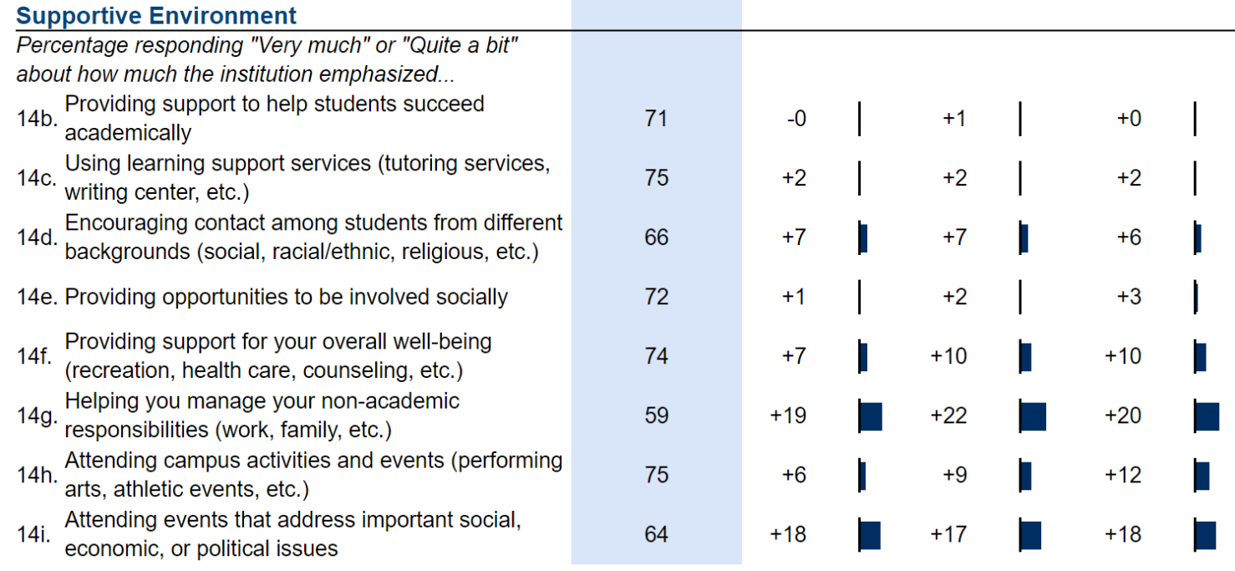
NSSE Supportive Environment – FY (2023)
Comparisons show difference in percentage points between FSU and other institutions.
In 2019, first-year students reported lower scores for 14b. (70), 14.c. (74), 14d. (60), 14e. (68), 14f. (69), 14g. (54), 14h. (67), 14i. (55). Item 14g (helping manage non-academic responsibilities; possibly including adult learners and military) exceeded peer institutions by 11 and 12 points in 2019.
In 2023, first-year students’ ratings improved further, relative to peers.

Slide 86
NSSE Supportive Environment – Seniors (2023)
Comparisons show difference in percentage points between FSU and other institutions.
In 2019, Seniors reported lower scores for 14c. (68), 14d. (62), 14e. (67), 14f. (61), 14g. (40), 14h. (57), and 14i. (50). Only 14b. (72) was higher. Most responses were higher than peer institutions.
Seniors’ ratings of supportive environment increased (14f, 14g, 14h, and 14i by more than 10 points) since 2019 and exceeded peer institutions.

Slide 87
Comparison with Other Institutions
FSU average scores were significantly higher than comparison institutions
Supportive environment – Overall well being
Support of nonacademic responsibilities
Students felt valued by the institution
Quality of interactions – FSU ratings were similar to comparison institutions.
FSU students’ average ratings for quality of interactions with Student Affairs staff were higher than comparison institutions.
Seniors’ ratings for quality of interactions with administration were higher than comparison institutions.

Slide 88
High Impact Practices (HIPs)
Service-Learning (the most frequently reported HIP for FSU)
Internship or Field Experience
Senior Culminating Experiences
Research w/Faculty Member
Study Abroad
* Student images generated by artificial intelligence.

Slide 89
High Impact Practices Highlights
In 2019 and 2023, first-year students’ responses for Service-Learning (Done or Plan to Do) exceeded peers.
In 2019, seniors’ responses for Service-Learning (Done or Plan to Do) exceeded peers. In 2023, they equaled U.S. institutions and exceeded Southeast Public and Carnegie institutions.
2023 Seniors’ results shown.

Slide 90
High Impact Practices Highlights
In 2019 and 2023, first-year students’ responses for Internships or Field Experience (Done or Plan to Do) exceeded peers.
In 2019, seniors’ responses for Internships or Field Experience (Done or Plan to Do) exceeded peers. In 2023, their responses declined.
2023 Seniors’ results shown.

Slide 91
High Impact Practices
By spring of their senior year, 31% of students had participated in some form of internship, co-op, field experience, student teaching, or clinical placement, and 5% had studied abroad.
66% of first-year students and seniors said at least some of their courses included a community-based service-learning project.
10% of first-year students and 14% of seniors worked on a research project with a faculty member.
Seniors were less likely to report participation in every HIP (other than Service-Learning) than students at comparison institutions.

Slide 92
NSSE Gains & Satisfaction
86% of seniors and 77% of first-year students rated their overall experience at FSU as “Excellent” or “Good.”
89% of seniors would “Definitely” or “Probably” attend FSU again, compared to 83% for Southeast Public Institutions.
Highest perceived gains
Thinking critically and analytically
Writing clearly and effectively
Analyzing numerical and statistical information

Slide 93
Opportunities for Growth
What can we do with this information?

Slide 94
Opportunities for Growth
Overall Well Being
Activities and Outreach
Quality of Interactions
High Impact Practices
Undeclared Majors
Student Suggestions

Slide 95
Opportunities – Overall Well Being
Offer reasonable accommodations where possible to help students manage nonacademic responsibilities (work, family, military deployments, etc.),
This may be especially helpful for adult learners and military students.
Male students may need more support for overall well being.
FSU Strategic Plan 1.2: Increase retention rates
2.6: Enhance the educational experiences and support for military connected students, adult learners, and transfer students.

Slide 96
Opportunities – Activities and Outreach
Increase outreach and orientation for first-generation college students.
Improving interactions and outreach to distance learners may increase student engagement and academic performance.
The Office of Faculty Development offers support in best practices for online learning.
FSU Strategic Plan 1.2: Increase retention rates
1.3: Increase 4-year graduation rates and degree efficiency rates
2.6: Enhance the educational experiences and support for military connected students, adult learners, and transfer students.

Slide 97
Opportunities – Activities and Outreach
Activities that increase engagement with faculty may be helpful for adult learners, military students, first-year students, distance learners, and first-generation college students.
Greater engagement with peers may be especially powerful, given that most groups gave other students the highest ratings for quality of interaction.
FSU Strategic Plan 1.2: Increase retention rates

Slide 98
Opportunities – Activities and Outreach
Example: Eclipse Event
Sharing
Collaboration
Scientific Principles
Positive Interaction
Fun

Slide 99
Opportunities – Activities and Outreach
Activities that increase engagement for first-year students with advisors and their peers may increase satisfaction.
This may be more important for first-year students and first-generation college students, who reported lower ratings for quality of interaction than other groups.
Socialization and engagement may be important for these groups.
While most groups gave the highest ratings for the quality of interactions with other students,
Only 48% of first-year students gave high ratings of interactions with their peers. Create opportunities for them to engage with others.
FSU Strategic Plan 1.2: Increase retention rates

Slide 100
Opportunities – Quality of Interactions
Most students reported high quality interactions with administration, faculty, Student Services staff, advisors, and other students.
Most groups reported higher scores for effective teaching practices. They want more interactions (mentoring) with faculty.
Increasing or improving faculty mentoring could benefit students. Expressions of interest in faculty mentoring are a nationwide phenomenon, as measured by the NSSE.
FSU Strategic Plan 2.1: Infuse high-impact practices and professional skills into curricular and co-curricular activities

Slide 101
Opportunities – Quality of Interactions
Most groups gave high ratings for the quality of interactions with advisors.
53% of first-year students gave high ratings of advisors.
60% of seniors gave high ratings of advisors.
Student Affairs staff and FSU students received the highest ratings for quality of interactions. Activities that leverage engagement with Student Affairs staff and students may increase satisfaction, particularly among adult learners and military students.
FSU Strategic Plan 3.2: Implement a customer care strategy that promotes the highest standards of service and increases campus engagement

Slide 102
Opportunities – Quality of Interactions
First-year students may be encountering diverse perspectives in class but not engaging with diverse others as much as they would like.
Increase outreach to students who are minorities among the FSU population (global education, cultural events, Spanish Club, etc.).
Seniors appear to have a positive view of their learning experiences, while believing that collaborative learning and student-faculty (mentoring) interaction could improve.
FSU Strategic Plan 1.6: Expand and increase student-faculty collaborative research, scholarship, and creative activities
2.3: Develop innovative cultural and global learning opportunities and programming

Slide 103
Opportunities – High Impact Practices
First-year students’ responses about their plans to participate suggest a demand for HIPs. Their plans to participate in Internship or Field Experience, Study Abroad, and Culminating Senior Experience exceeded the responses of first-year students from comparison institutions.
Expand service-learning, which was the most common HIP reported, followed by Senior Culminating Experiences (theses, research projects, etc.).
Expand research or projects with faculty members.
FSU Strategic Plan 2.1: Infuse high-impact practices and professional skills into curricular and co-curricular activities

Slide 104
Opportunities – Undeclared Majors
Undeclared majors (classified as unknown in the graphs) reported lower levels of engagement in most questions, except quality of interaction with Student Affairs staff.
During meetings to evaluate Operational Plans and Assessment Reports (OPARs), multiple Department Chairs noted lower retention rates among students who waited longer to declare a major.
Undeclared majors appear to be having a different campus experience than declared majors.
Encouraging students to declare a major sooner could increase retention and engagement with faculty, advisors, and students in their programs.
FSU Strategic Plan 1.2: Increase retention rates

Slide 105
Opportunities – Student Suggestions (Campus)
More connections/activities with alumni working in professions (Career days meeting w/ professional community members)
More programs to engage online learners (mentoring, online job fairs, etc.).
24/7 online tutoring option (Upswing) was very helpful.
Please provide digital textbook options instead of physical books. (New Follett plan may meet this request.)
FSU Strategic Plan 1.2: Increase retention rates

Slide 106
Opportunities – Student Suggestions (Colleges)
Check up on students about their mental health, just as faculty would check up on assignments. – Counseling and Personal Development Center
Positive, supportive attitudes from professors can go a long way toward alleviating student stress and improving learning.
More out-of-campus involvement (service-learning, field trips related to major – like Museum of Art, etc.). More campus activities may relieve stress.
FSU Strategic Plan 1.2: Increase retention rates
2.6: Enhance the educational experiences and support for military connected students, adult learners, and transfer students.

Slide 107
Opportunities – Student Suggestions (Colleges)
Provide instruction on writing academic papers (APA, MLA, etc.) – Direct students to FSU Writing and Communication Center
More profession-related clubs and organizations.
Programs for life skills that connect students with mentors. “Teach me about life.”
Students expressed deep appreciation for advisors and faculty mentors.
FSU Strategic Plan 1.2: Increase retention rates

Slide 108
Opportunities – Student Suggestions (Colleges)
BCBE: Offer more certifications. For example, Quickbooks certification is required for employment by some accounting firms.
BCBE: Please teach Excel sooner. (Direct students to modules on Canvas.)
COE: Please teach student teachers scenarios about how to deal with families.
Any: Some staff may need more time to fully attend to students.
FSU Strategic Plan 1.2: Increase retention rates
2.6: Enhance the educational experiences and support for military connected students, adult learners, and transfer students.

Slide 109
Requests of Academic Departments
Requests are based on BCSSE and NSSE data, along with FSU Strategic Priorities.

Slide 110
Requests Based on FSU Strategic Priorities
Increase use of collaborative learning experiences
Encourage research/projects with faculty
Improve student interaction with faculty
FSU Strategic Priority 1 (Academic Excellence)
Goal 6: Expand and increase student-faculty collaborative research, scholarship, and creative activities.
1.6.1: Increase scores on NSSE that indicate student-faculty collaborations on research, scholarship, and creative activities.
1.6.2: Increase the number of collaborations reflected in department OPARs and by campus programs.
In 2023, 40% of item respondents indicated plans or completion of research w/faculty. 63% indicated plans or completion for capstone experience (internship, project, senior show, senior recital, etc.)

Slide 111
Requests Based on FSU Strategic Priorities
Encourage faculty mentoring of students (career preparation, discussions about academic performance, etc.)
Expand access or awareness of High Impact Practices (HIPs), particularly for upper-level students.
Encourage students to declare major sooner.
FSU Strategic Priority 2 (Student Engagement, Career Development)
Goal 1: Infuse high-impact practices and professional skills into curricular and co-curricular activities
2.1.1: 70% of students will indicate experiencing high-impact practices in curricular and co-curricular activities.

Slide 112
Requests Based on FSU Strategic Priorities
Activities that increase student interaction with diverse others, such as events with international students, could be helpful.
FSU has supported joint events/travel for honor students and international students.
FSU Strategic Priority 2 (Student Engagement, Career Development)
Goal 3: Develop innovative culture and global learning opportunities and programming.
2.3.1: 80% of students will indicate involvement or exposure in cultural opportunities.

Slide 113
NSSE Response Rates
FSU’s overall response rate of 30.8% exceeds the national average of 23.3% for all institutions.
 | NSSE 2017 | NSSE 2018 | NSSE 2019 | NSSE 2023
First-year | 18% | 44% | 42% | 58%
Senior | 23% | 37% | 27% | 19%

Slide 114
Opportunities for Test Administration
Start earlier so the survey doesn’t conflict with exam week.
Administer surveys in Freshman Seminar courses. This raised the first-year response rate.
If possible, administer surveys in participating senior classes.
Send survey notifications to students via text messages earlier. The survey can be taken on mobile devices.
Ask Office of Strategic Communication to update graphic images announcing the NSSE. Use them in emails, freshman and senior course Canvas sites, and (if possible) text messages.

Slide 115
Thank You
If you have questions or comments, please share them with the FSU Office of Institutional Effectiveness, Research, and Planning (IERP).
*Student images were generated using artificial intelligence (Craiyon AI).

