Slide 1
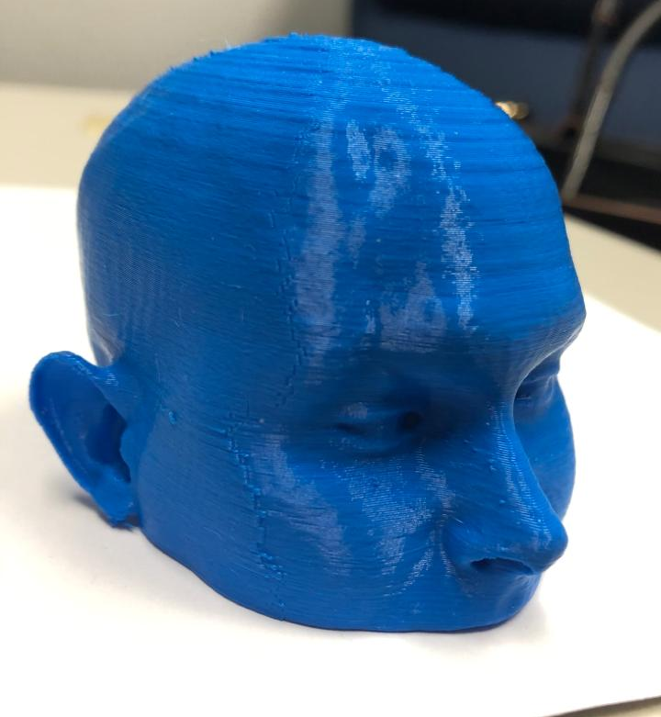
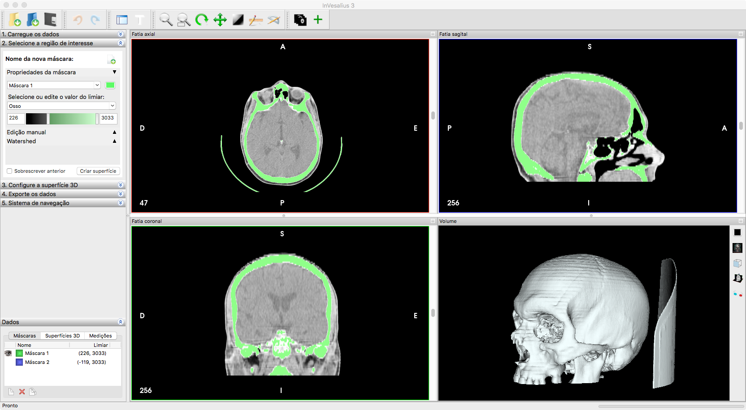
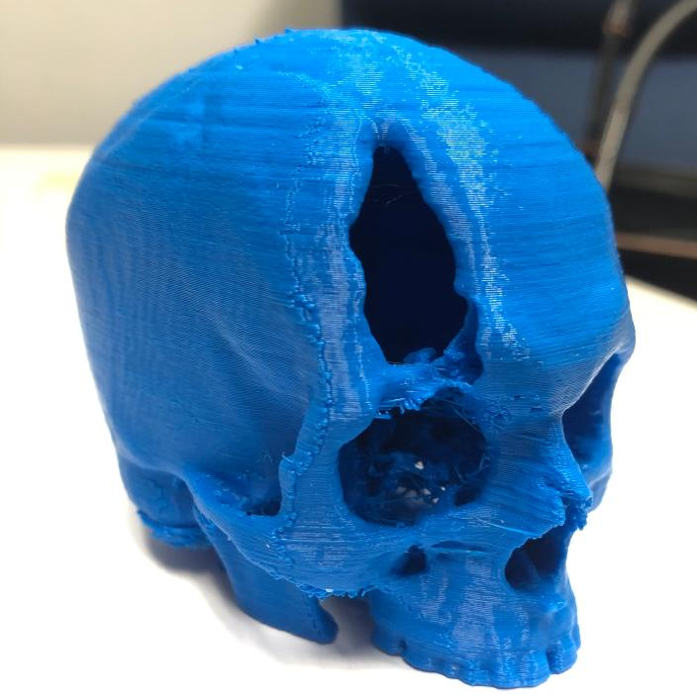
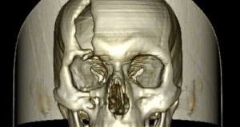
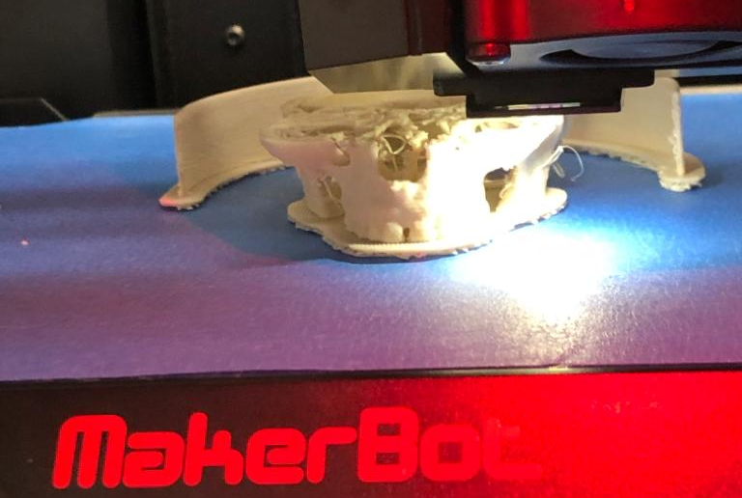
3D Printing and Medical Education
U. S. Army Contracting Command
Award Number W9111QY-19-P-0178
Duran/Padilla/Adivar/Ila

Slide 2
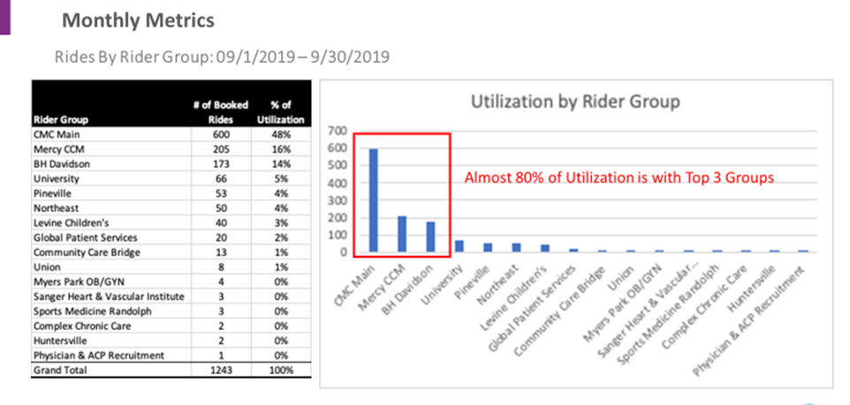
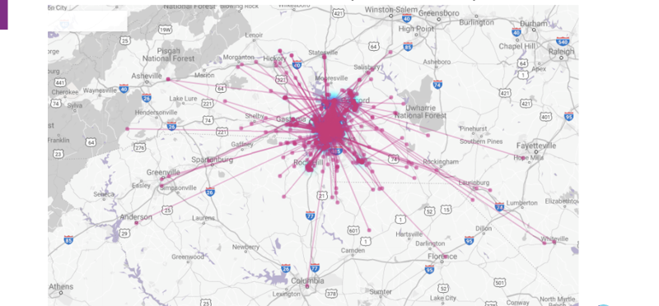
NCDOT TCE2020-02
NC Transportation Center of Excellence on Mobility and Configuration
NCA&T, UNC, FSU, NCSU
Theme3: Transit and Mass Role in Improving Economic and Healthcare Access for Underserved Populations
FSU Researchers: Burcu Adivar (Co-PI) Trung Tran (Co-PI)

Slide 3
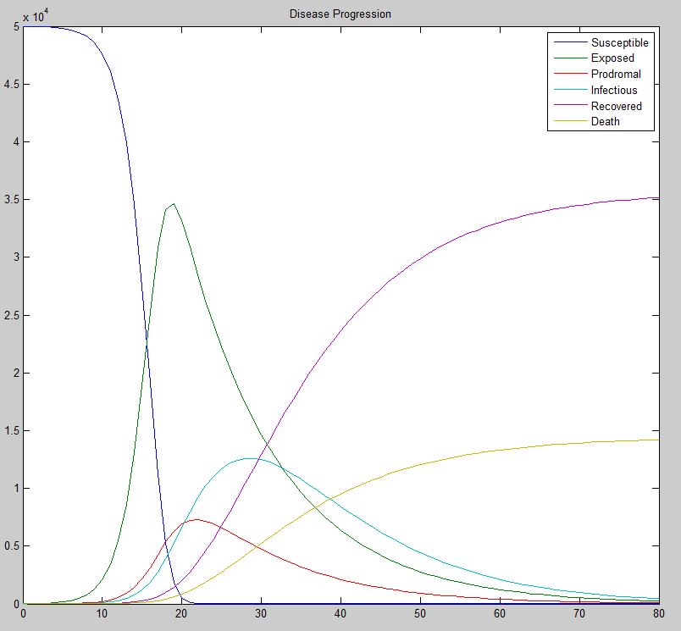
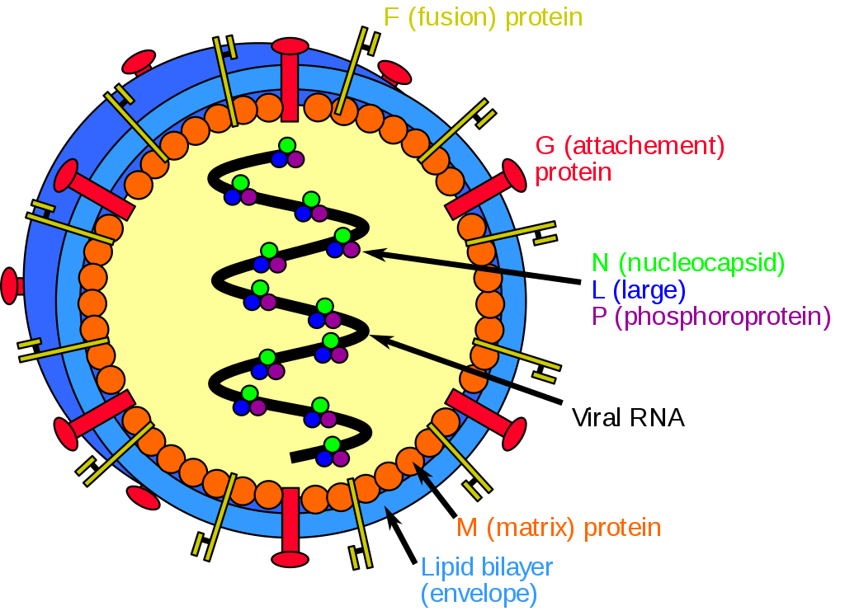
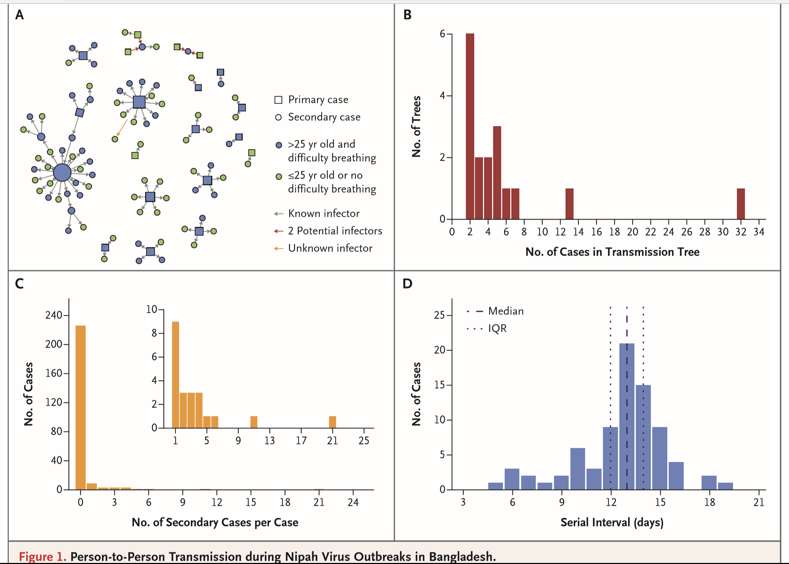
Epidemiological Modeling of a Potential Biological Weapon Attack: Nipah Virus by
Burcu Adivar, Carla Raineri Padilla, Deanna Duran, Matthew Hull
Presented at Womack Army Medical Center
XIII Annual Research Symposium
2 May 2019

Slide 4

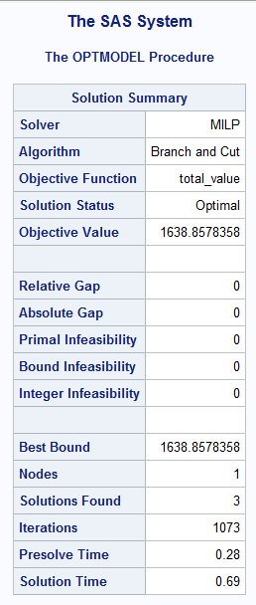
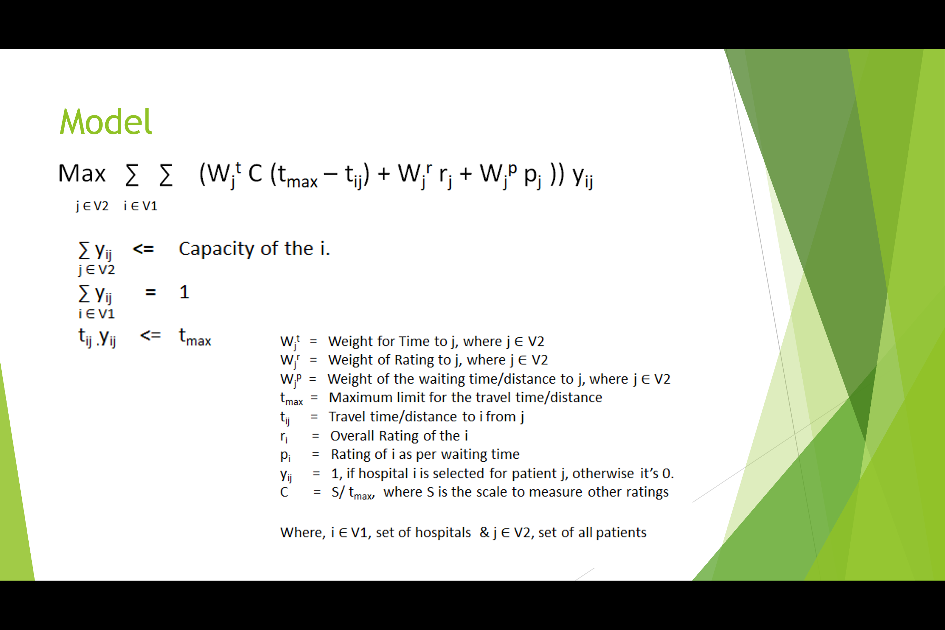
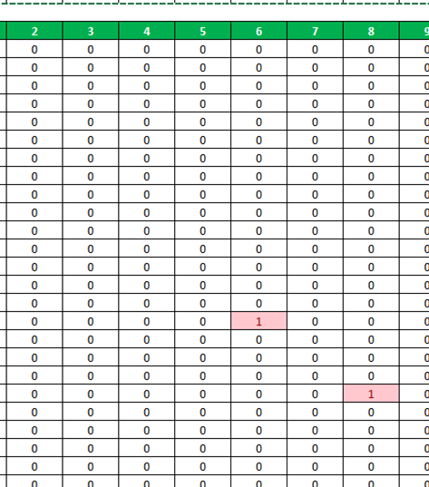

Medical Provider Recommendation Engine
BIDA 650 Business Analytics Project
MBA Team: Adrian Blue, Tuhin Dasgupta, Alex Harris
Supervisor: Dr. Burcu Adivar

Slide 5

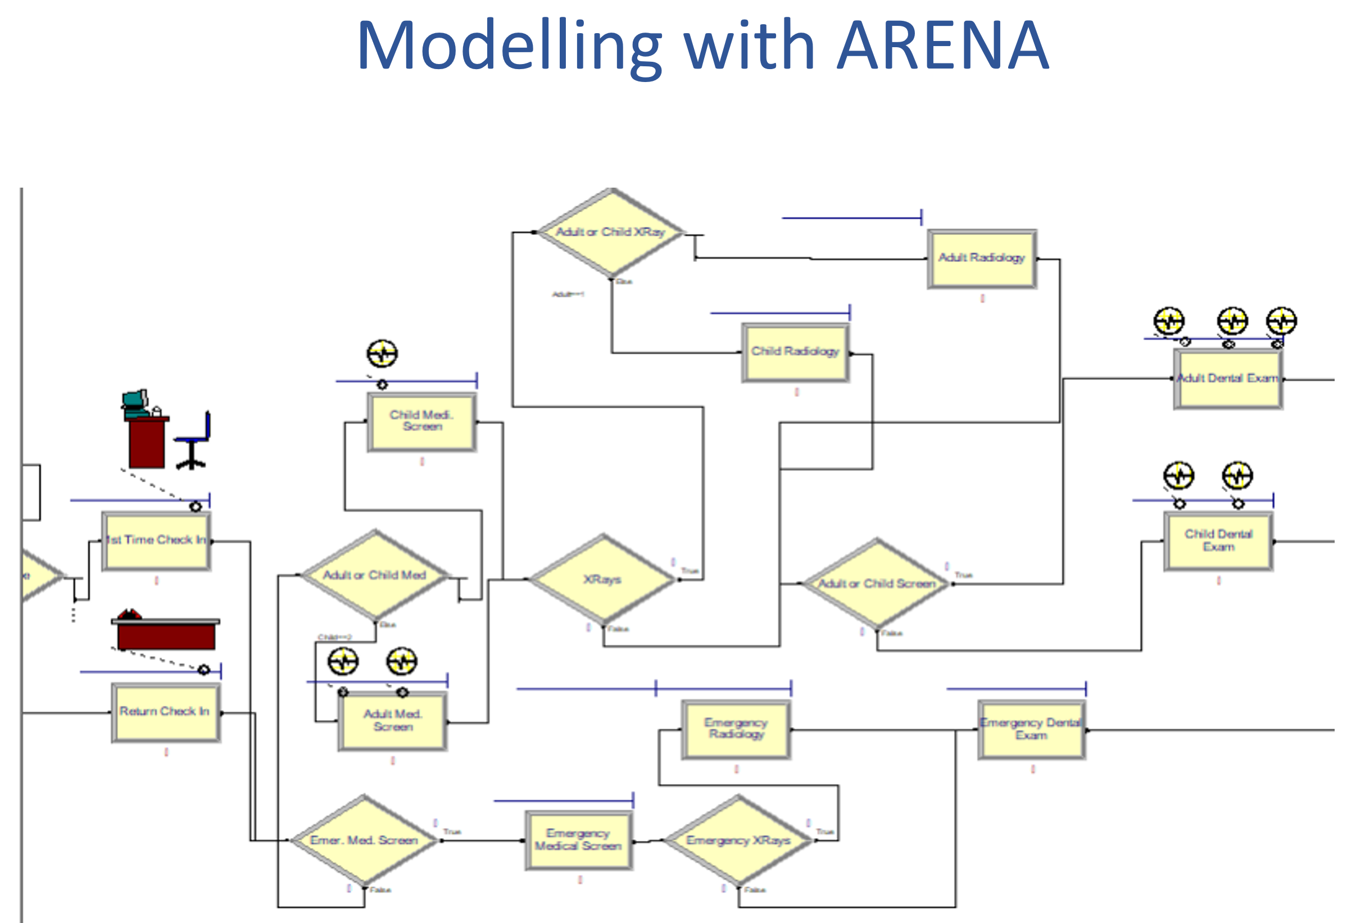
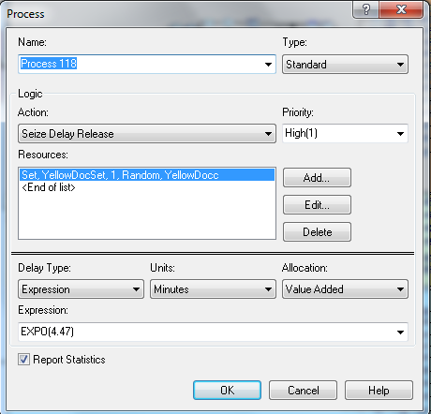
We have analyzed 12 scenarios with varying level of resources
After evaluating the results, we suggested increasing the number of
General dentists
Pediatric dentists
Medical assistance
For 45% reduction in waiting times

