Slide 1
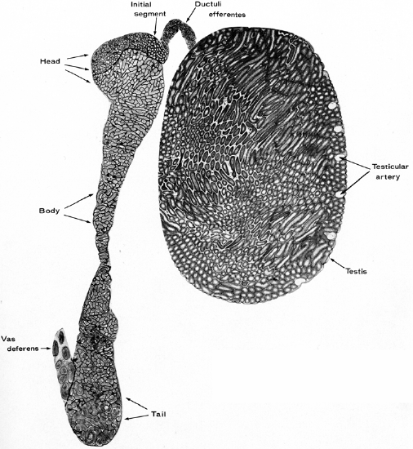
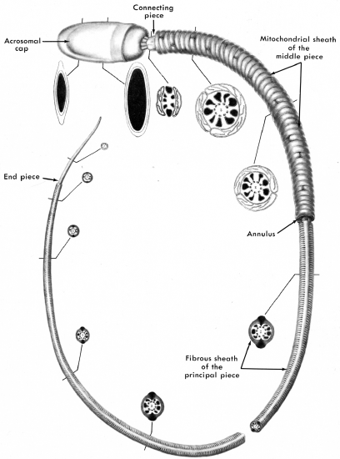
Title- Role of Epididymis in the recognition and Elimination of Defective Spermatozoa- Subir K Nagdas-snagdas@uncfsu.edu
Background
Funded by NIH grant 6/2018 to 5/2022
The epididymis has two main region-specific functions. The caput and corpus regions provide a luminal environment that promotes the maturation of spermatozoa. The cauda region provides a luminal environment that maintains the viability of stored spermatozoa.
Nevertheless, a nonviable sperm population is present in the cauda epididymidis of many species. Degenerating spermatozoa release enzymes, that could have detrimental effects on the viability of neighboring cells, and they are source of autoantigens, that induce an autoimmune response if they escape the blood-epididymis barrier.
Does the epididymis have specialized protective mechanism(s) to segregate the viable sperm population from defective spermatozoa?
Outcome: Anti-sperm antibodies are not uncommon in men; they develop for reasons that are not understood, and they are a source of infertility that is difficult to correct. What are the protective strategies of the epididymis that could prevent these negative impacts on male fertility? Completion of the proposed studies will provide new insights into the mechanisms by which the potentially unique epididymal protein functions in the recognition and elimination of defective spermatozoa, and the proposed studies have the potential application for fertility regulation and/or improvement.

Slide 2
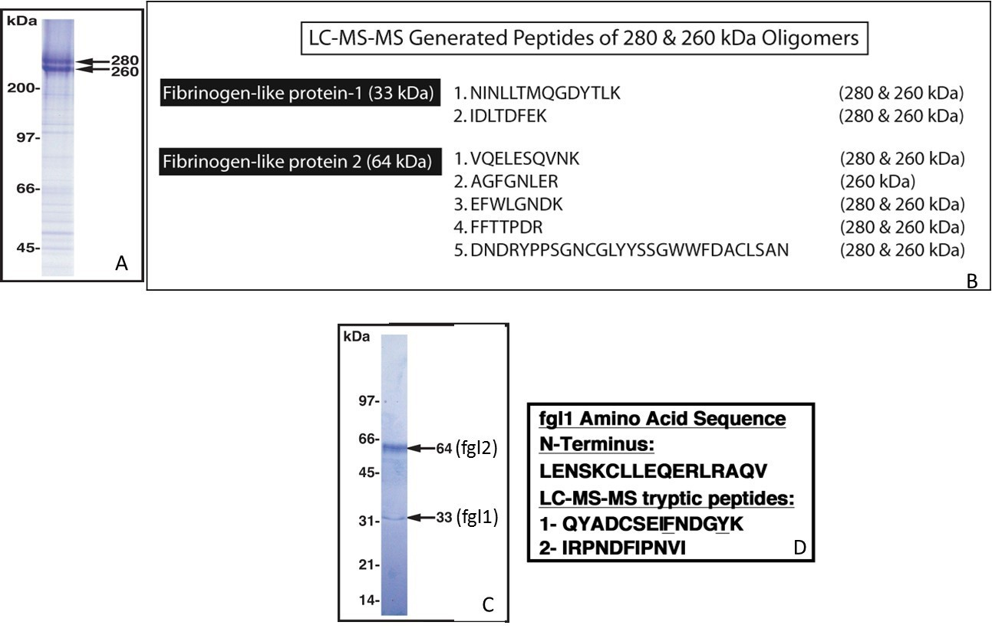
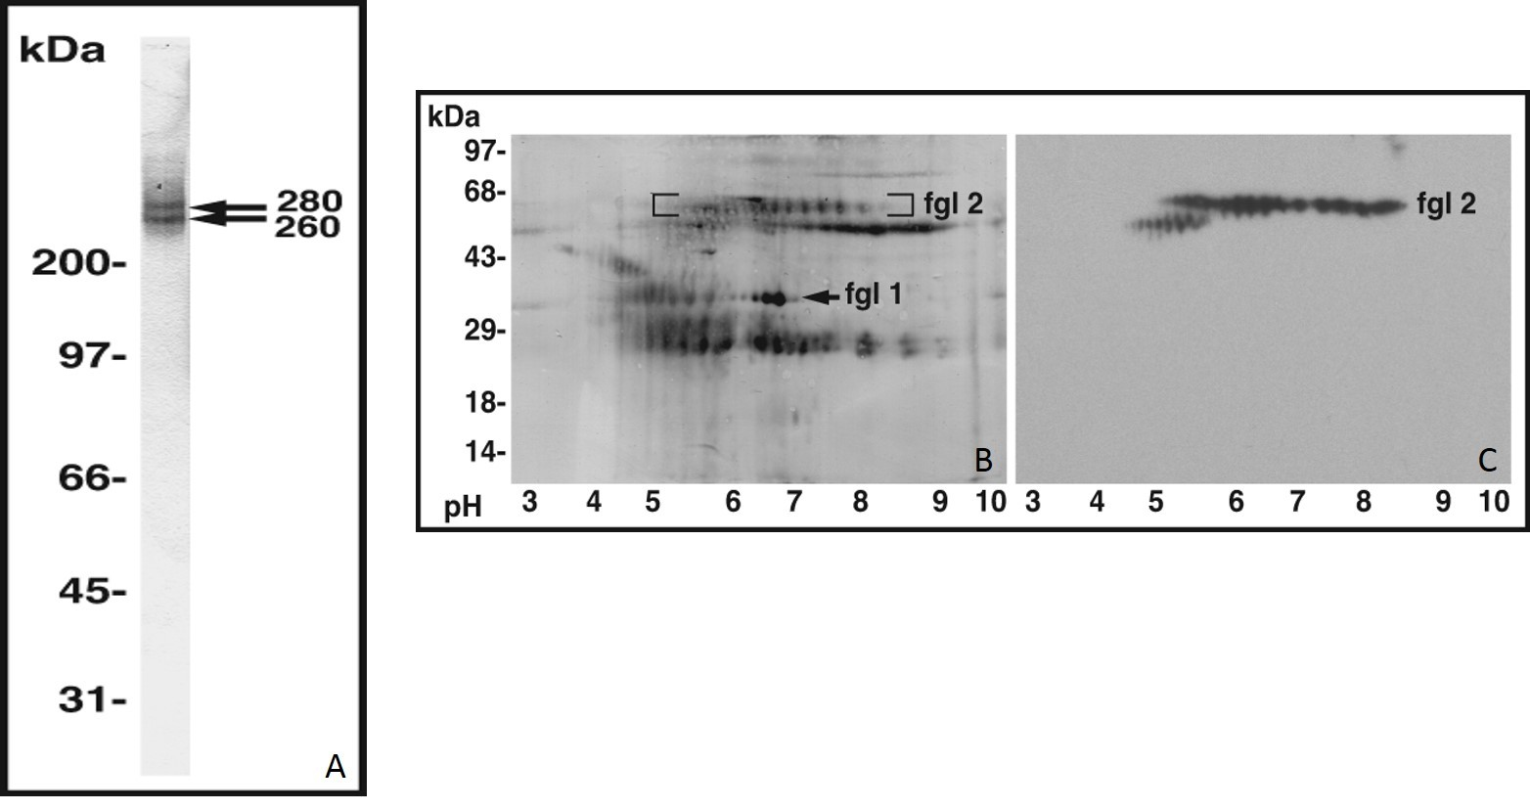
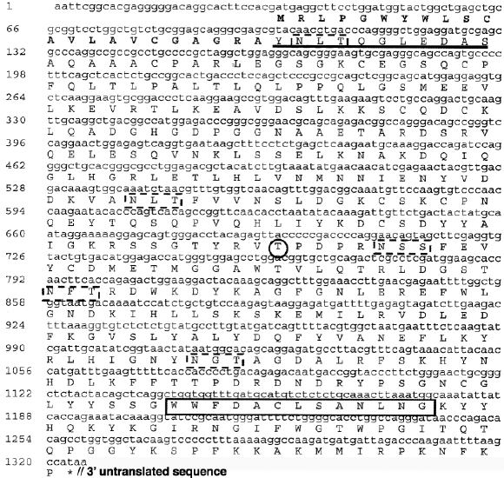
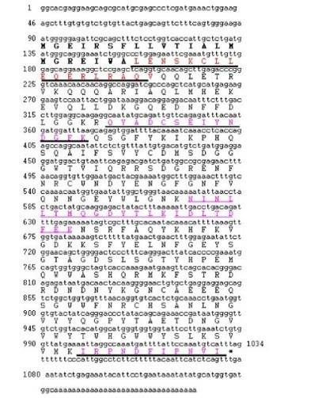
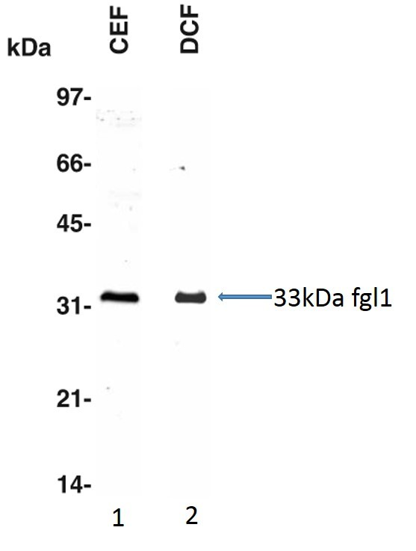
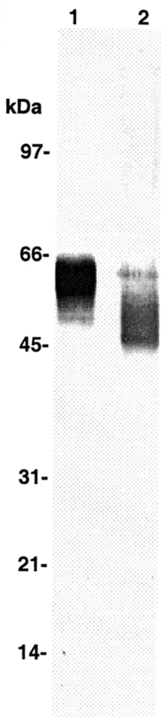
Full Length Sequence of fgl2
Full Length Sequence of fgl1

Slide 3
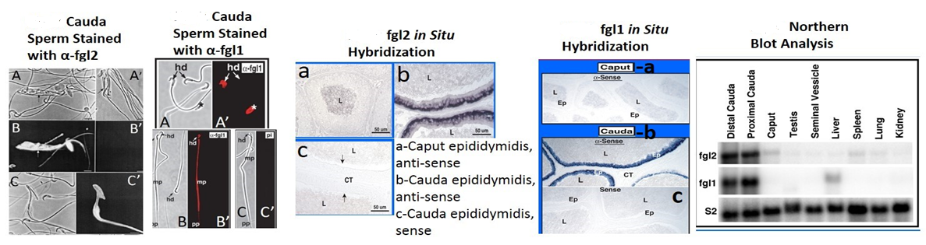
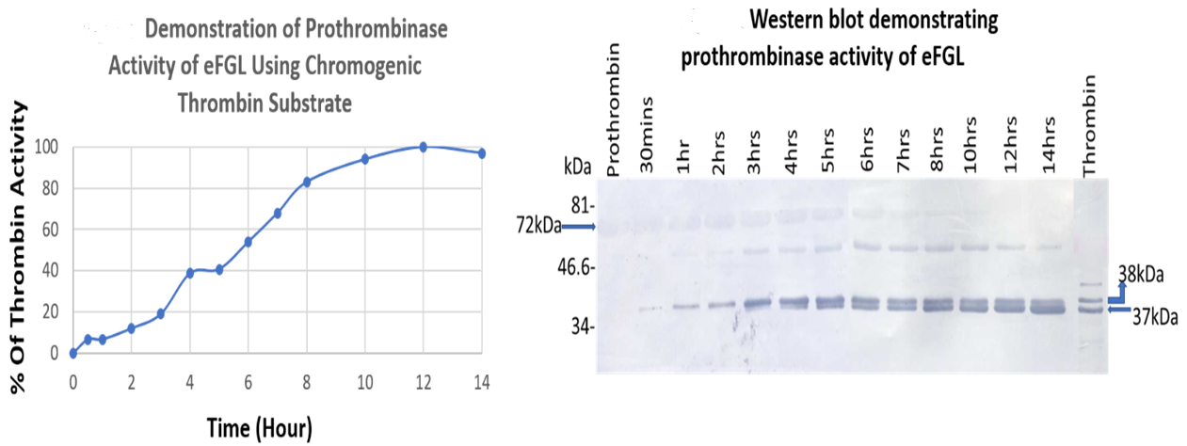
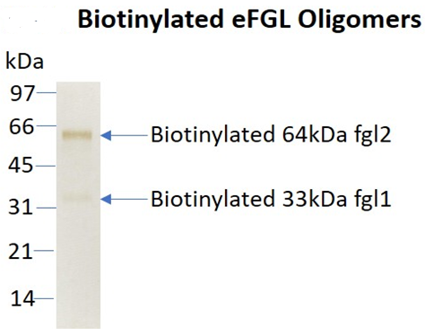

Slide 4
Conclusions
Both luminal fluid and sperm-associated high molecular weight oligomers (260/280kDa) are composed of two disulfide-linked subunits: a 64kDa polypeptide identified as fibrinogen-like protein-2 (fgl2); and a 33kDa polypeptide identified as fibrinogen-like protein-1 (fgl1). Immunocytochemical studies revealed that both fgl1 and fgl2 selectively bind to defective spermatozoa in the cauda epididymidis.
This study is the first to show a functional interaction between fgl1 and fgl2. This specific binding and polymerization of fgl1/fgl2 oligomers onto defective spermatozoa may represent one mechanism to shield the viable sperm population and/or the epididymal epithelium from degenerating spermatozoa.
Future Plans and Directions
1. Isolation of the 260/280 kDa oligomers (eFGL) from the cauda epididymal luminal contents. The purified native eFGL will be utilized to identify and to characterize the organelle-specific sperm ligands.
2. To elucidate the mechanism of binding/polymerization of eFGL, and its subunits (fgl1 and fgl2), to sperm ligands. Is it an enzymatic or non-enzymatic process? Does this interaction involve post-translational modification(s) of eFGL or sperm ligands?
3. To examine sperm morphology and the sperm storage function of cauda epididymidis in fgl2 null mice. To determine whether serum from fgl2 null animals exhibits elevated levels of anti-sperm antibodies. This will test our hypothesis that the polymerization of the death cocoon onto defective spermatozoa prevents release of sperm autoantigens.
4. Quantitative estimation of seminal plasma eFGL levels from infertile patients by ELISA. Clinically, this assay could be a biochemical marker to examine male infertility.

