Slide 1
Fayetteville State University Office of Sponsored Research and Programs & Research Office (OSRP/RO)
Present
Sponsored Research
at FSU

Slide 2
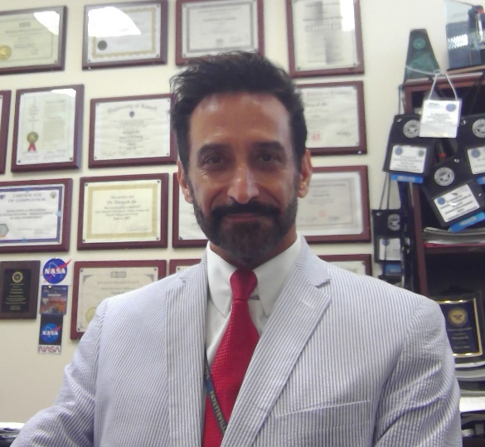
The Research Office
Dr. Daryush ILA
Associate Vice Chancellor for Research
& Tech Transfer Officer
Notes:
Purpose – Introduce OSRP Staff

Slide 3
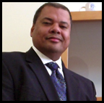
The Office Of Sponsored Research and Programs
Dr. A. Leslie Evelyn
Director of Sponsored Research
Shenetta Dudley
Pre-awards Administrator
Dwane Hodges
Budget Officer/ Grant Dev. Spec.
Notes:
Purpose – Introduce OSRP Staff

Slide 4
Basic Types of Sponsored Funding
Grant - Money given by a federal, state, or local government agency, or by a private business, foundation or individual, to fund a project.
Contract - A formal agreement between two parties whereas goods or services are provided at an agreed upon price.
Cooperative Agreements - Similar to a grant, except after the award is given the funding institution assists and/or participates in project activities with the grant recipient.
Notes:
Purpose – Short review of funding types

Slide 5
Pre-Awards Administration
Mrs. Shenetta Dudley
x-1570
sdudley@uncfsu.edu
Instructions and guidelines for submissions.
Proposal development and compliance
Grants.gov and NSF Fastlane submissions
Registering Individuals with agencies and search engines
Notes:
Purpose – Introduce Pre-Awards Administration

Slide 6
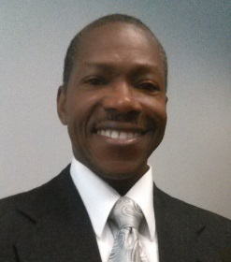
Budget Development
Mr. Dwane Hodges
x-1645
dhodges1@uncfsu.edu
Budget development and cost itemization
Preview RFPs. Preparing synopses of application information
Develop and revise budget templates
Preview/Review proposed budgets
Notes:
Purpose – Introduce Budget Development

Slide 7
Director
Dr. Leslie Evelyn
1644
aevelyn@uncfsu.edu
Point of Contact for:
Contracts
Teaming Agreements
Non-Disclosure Agreements
Memoranda of Understanding
Notes:
Purpose – Introduce Post-Awards Administration

Slide 8
Compliance
Oversee Compliance with funding agencies
(NSF, NIH, NEA, ARO, Gates Foundations, etc.)
Oversee Compliance with regulatory agencies
(Dept. of State, EPA, OSHA, Dept. of Commerce, DHS,
DHHS, CDC, NRC, Dept. of Justice, etc.)
Notes:
Purpose – Introduce Compliance

Slide 9
Non-financial Post-Awards Administration
Meet with PIs for post-award or new award orientation
Assist with post award reporting, compliance, and close-out
Conduct compliance reviews of grant award project reports
Assist with grant award modifications
Notes:
Purpose – Introduce Post-Awards Administration

Slide 10
financial Post-Awards Administration
Ms. Chrystal Cooper-Johnson
X-1073
Ccooper3@uncfsu.edu
Meet with PI’s for Post- Award or New Award Orientation
Provide fiscal management of sponsored projects (include financial reporting, financial administration & financial regulation compliance)
Provide non-financial management (award set up and close out)
Provide audit preparation (transactional requests, audit questionnaires, and participate in audit interview with PI)
Notes:
Purpose – Introduce Post-Awards Administration

Slide 11
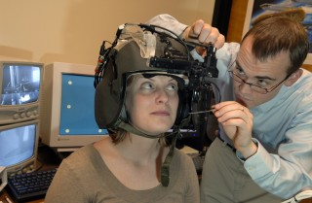
Institutional Review Board (IRB) Structure
“I am in favor of animal rights as well as human rights. That is the way of a whole human being.” ― Abraham Lincoln
FSU-IRB
OSRP
HRRC
HRS
ETHICS
IACUC
HRRC: Human Rights in Research Committee
IACUC: Institutional Animal Care and Use Committee
HRS: Hazardous Materials Research and Safety Committee
ETHICS: Ethical Conduct Committee
Notes:
Purpose – Stress the importance of ethical and safe research.

Slide 12
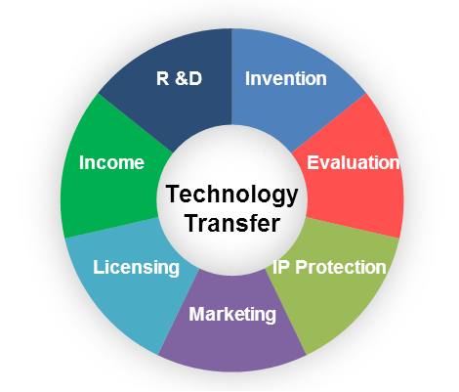
“Exploration is the engine that drives innovation. Innovation drives economic growth. So lets all go exploring” – Edith Widder
Dr. Daryush Ila
x-2417
dila@uncfsu.edu
TECHNOLOGY TRANSFER
Does your innovative idea meet these criteria?
1. Is it novel?
2. Is there a need?
3. Is there a potential market?
Notes:
Purpose – Introduce the area of Tech Transfer

Slide 13
“It’s fun to do the impossible” - Walt disney
INNOVATION
PROTOTYPING: From Mental Images. to Digital Images, to Tangible Images.
Notes:
Purpose – Introduce the area of Tech Transfer

Slide 14
Export Control & itar (International Traffic in Arms Regulations)
Dr. Daryush Ila
x-2417
dila@uncfsu.edu
Why are Exports Controlled?
Release of Technology
National Security
Visual inspection
Oral exchange
Application of Knowledge
Foreign Policy
Non-proliferation
Notes:
Purpose – Examine the importance of Export Controls

Slide 15
“The race is not always to the swift nor the battle to the strong, but that's the way to bet.” - Damon Runyon
Opportunity Search Engines
Revising Unfunded Proposals
Budget Development 101
OSRP Training (2020-2021):
Note: You can register for training through the
Office of Faculty Development calendar
Proposal Development for Research
Fundamentals of Proposal Writing
Institutional Review Board (IRB) Compliance
Grants.gov & NSF Fastlane
RAMSeS Proposal Reporting System
Export Control and ITAR
Whitepapers & Quad-Charts
Notes:
Purpose – Give a short review of the workshops that will be provided by OSRP in 2014-2015

Slide 16
“Don't fear failure so much that you refuse to try new things. The saddest summary of a life contains three descriptions: could have, might have, and should have” – Louis E. Boone
PLANNING TO SUBMIT A PROPOSAL?
Send your intent to submit to Mrs. Shenetta Dudley at sdudley@uncfsu.edu, along with the proposal announcement or a link to the announcement.
Faculty and staff must attend training sessions!!!! (our records indicate that those who do not attend training have difficulty submitting proposals).
For more information, please visit the FSU website at www.uncfsu.edu/research.
You can also call Mrs. Dudley at extension x-1570, or visit our offices located in rooms 309, 310, and 339 of the Broadwell College of Business and Economics.
We look forward to working with you in the near future, and we wish you a productive and successful school year.

