Slide 1
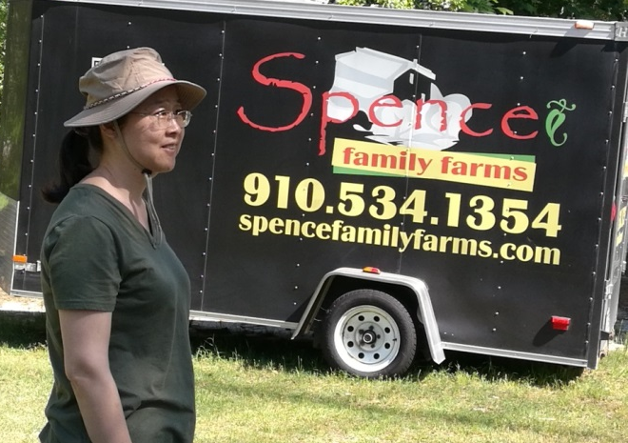
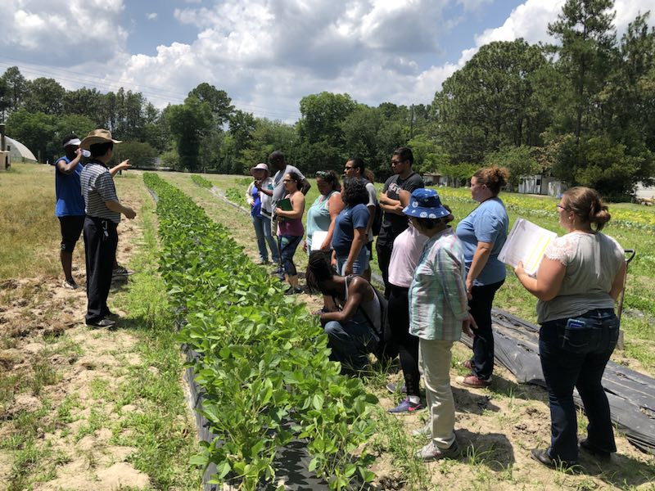
Mapping QTL and Selection of Lines with High Essential Amino Acids in Soybean (Glycine max L.)
Dr. John Yuan and Dr. Abdelmaijd Kassem
Department of Biological and Forensic Sciences

Slide 2
Soybean [Glycine max (L.) Merrill] is very important crop in North Carolina.
Nine essential amino acids [Phenylalanine (Phe), Valine (Val), Threonine (Thr), Tryptophan (Trp), Methionine (Met), Leucine (Leu), Isoleucine (Ile), Lysine (Lys), and Histidine (His)] can’t be de novo synthesized by human or animal cells and these amino acids must be obtained from diet.
The objectives of this study are to define the quantitative trait loci (QTL) for essential amino acids’ contents in soybean seeds in ‘Forrest” by “Williams 82’ recombinant inbred line (RIL) population based on a high-resolution genetic map and thereby select elite lines with high essential amino acids’ contents for community.

Slide 3
Preliminary data
Distribution of protein content in soybean seeds of FxW82 RIL population
Distribution of oil content in soybean seeds of FxW82 RIL population

Slide 4
Correlation among essential amino acids and other quality traits in soybean seeds of FxW82 RIL population (2018, Spring Lake, NC)
One more year phenotypic data is needed to map QTL for essential amino acids and elite lines selection.

