Slide 1
Quotes & Paraphrases
Support your arguments through research.
Blog.cometdocs.com

Slide 2
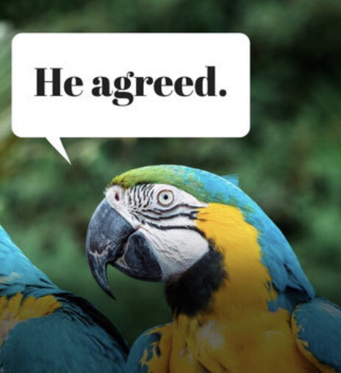
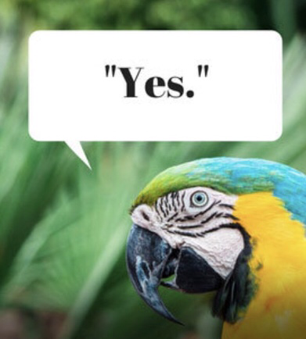
QUOTES
PARAPHRASE
To repeat or copy the words of a person, book or other
source.
Must be cited
Quotation marks needed
To restate a passage in other words.
Must be cited
No quotation marks

Slide 3
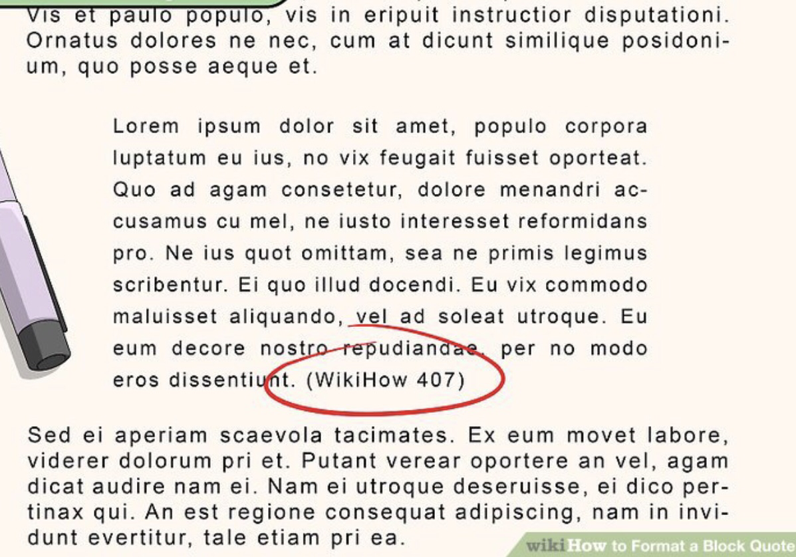
Quoting = copying a passage of someone else’s words and crediting the source.
Quotes must be enclosed in quotation marks
or
formatted as block quotes.

Slide 4
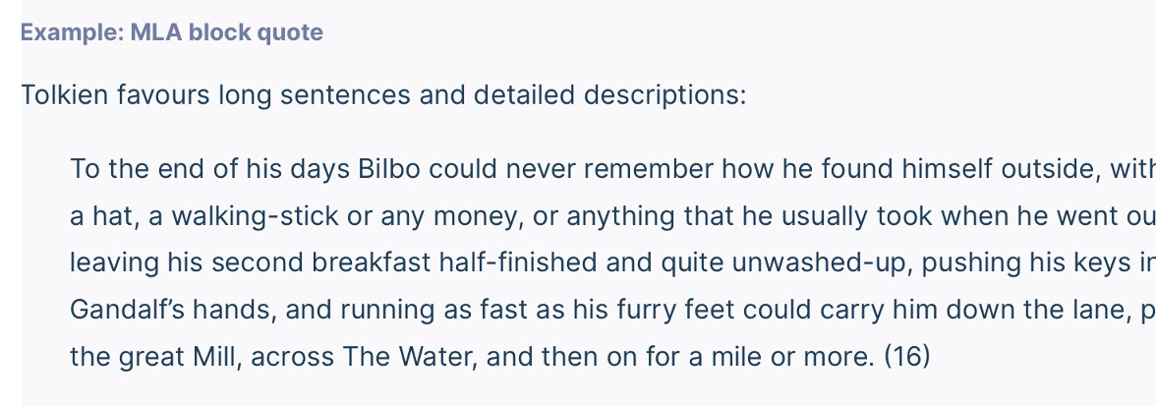
Introduce w sentence & colon.
Cite at end.
About Block Quotes
APA: longer than 40 words
MLA:longer than 4 lines
CMS: longer than 100 words

Slide 5
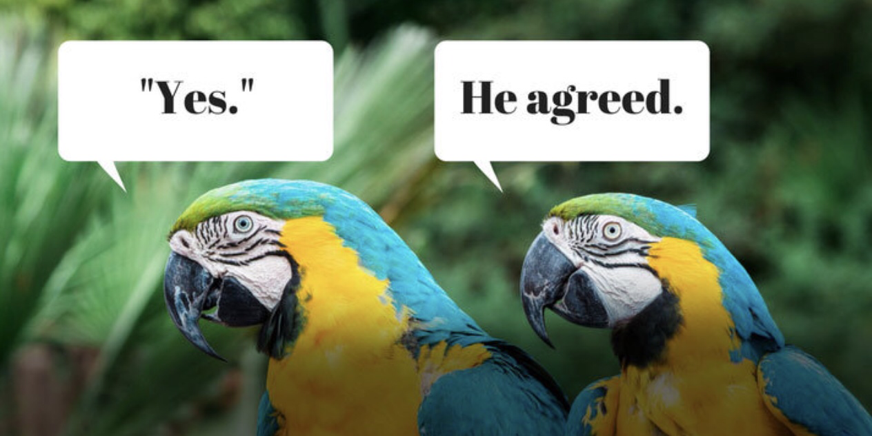
Paraphrasing
Paraphrasing is putting someone else’s ideas in your own words.
Don’t use sentences or phrases identical to the original.
Always cite the source.
Using synonyms, changing sentence structure are helpful.
Try writing your paraphrase without looking at the original.

Slide 6
Example “A well-regulated militia, being necessary to the security of a free state, the right of the people to keep and bear arms shall not be infringed.”
Quote
Paraphrase
“A well-regulated militia, being necessary to the security of a free state, the right of the people to keep and bear arms shall not be infringed”(The Constitution of the United States, 1789, p. 11).
The U.S. Constitution guarantees the right of citizens to arm themselves (The United States Constitution, 1789).
I stock Getty images

Slide 7
Another Paraphrase Example
Original
Paraphrase
Pinterest.com
Biblegateway.com

Slide 8
Both need citations

Slide 9
In-Text Citations
APA: (Last name, year, p.#).
Evolution is a process that “can act only by very short and slow steps” (Darwin, 1859, p.510).
Darwin (1859) writes that evolution “can act only by very short and slow steps” (p.510).
MLA: (last name, #).
Evolution is a process that “can act only by very short and slow steps” (Darwin 510).
Darwin writes that evolution “can act only by very short and slow steps” (510).
CMS: author-date style: (last name, year, #). (Darwin, 1859, 510). note style: author, title, # 1. Darwin, The Origin of the Species, 510

Slide 10
Ways to Introduce Quotes
A full sentence followed by a colon.
The setting emphasizes deception: "Nothing is as it appears" (Smith 1).
Pierce ends the poem on an ironic note: "To every woman a happy ending" (25).
Begin a sentence with your own words, then complete it with quoted words.
Hamlet's task is to avenge a "foul and most unnatural murder" (Shakespeare 925).
To quote a critic or researcher, you can use an introductory phrase naming the source, followed by a comma. According to Smith, "[W]riting is fun" (215). In Smith's words, " . . . In Smith's view, " . . .

Slide 11
Words to Introduce Quotes
Says reveals agrees notes expresses refutes believes states
Denies observes endorses acknowledges
Comments thinks Rejects relates
Suggests admits declares points out
Compares discusses confirmed mentions

Slide 12
Changing a Quote
Shorten it ellipsis show that words have been omitted ex: “Evolution … can only act by … slow steps” (Darwin 510).
Add something bracket the added word/words ex: “Just 3% of [Switzerland’s] population is working poor” (Womak, 2016, p.27).
Show an error bracket [sic] after the error ex: Nowak (2019) wrote that “people have an obligation to care for there [sic] pets” (p. 52).
Infrastructure-intelligence.com

Slide 13
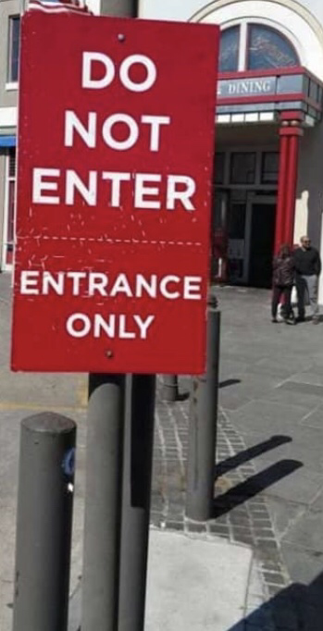
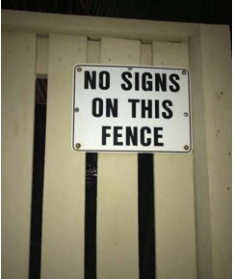
Other Uses for Quotation Marks
Titles of short works like short stories, essays, songs, poems, articles.
Use italics for longer works like books, plays, magazines.
Ironic usage, when a word is intended to mean it’s opposite.
My “friend” stabbed me in the back. (So-called friend)
acid cow.com
ruin my week.com

Slide 14
Last Words
Quote accurately
Paraphrase originally
Cite everything
I got it now!
Memebaby2019.blogspot.com

