Slide 1

Verbs
How to Correctly Use Them

Slide 2

Parts of speech Refresher
Remember that there are eight parts of speech, so the VERB is only one of the parts.
1. Noun
2. Pronoun
3. Verb
4. Adverb
5. Adjective
6. Preposition
7. Conjunction
8. Interjection

Slide 3
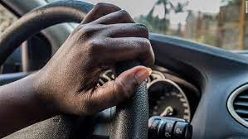
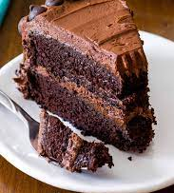
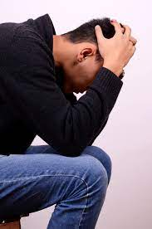
Verbs do one of three things:
1. Verbs are the part of speech that show action like study, read, write, jump. A complete sentence MUST have a verb.
Did you drive the car last night?
2. Verbs appeal to the senses like smell, touch, sight, sound.
I smell something good.
3. Verbs demonstrate a state of being such as seems, is, are, appears.
He appears to be somewhat depressed.

Slide 4
Read the sentences and find the verb(s).
1. There is a strain of measles that lasts only three days.
2. Some of the land is far too hilly to farm.
3. When everyone has arrived, explain the situation.
4. As the runners approached the line, we saw runner number two fall.
5. Everyone applauded when Patrice finished her recitation.
6. Do you think that we can work together?

Slide 5

PRINCIPLE PARTS OF THE VERB
The four principal parts with examples are:
1. Present Tense (I walk today.)
2. Past Tense ( Yesterday I walked.)
3. Past Participle (I had walked that city block last week.)
4. Present Participle (I am walking, but I prefer driving.)

Slide 6
Regular and irregular Verbs
1. Regular verbs do not change their spelling to form past and past participle (add ed)
Examples:
Present Past Past Participle Present Participle
talk talked had talked have/has talked
2. Irregular verbs CHANGE their spellings----
Examples:
Present Past Past Participle Present Participle
write wrote had written have/has written

Slide 7
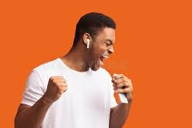
CONJUGATED VERBS
Conjugated verbs communicate a lot of detail—such as:
Person (first, second or third person—I, you, he/she/it, we, you, they)
I sing, you sing, he/she/it sings, we sing, you sing, they sing
2. Number (about how many people participated)
He sings. (one) They sing. ( two +)
Tense (time of the action— “has” (time is now) “had” (time in the past).
He has three little dogs.
He had three little dogs.

Slide 8
CONJUGATED VERBS, cont.
Aspect states to what degree an action is completed. a. simple (nothing is done to the base verb), b. progressive ( adds “ing”) shows an action that is in progress, and c. perfect ( adds past tense of “to have” + the past tense of the verb) tells that an action is complete
a. Simple—I sing todah.
b. Progressive—I am singing now, so stop your noise.
c. Perfect—I had sung that aria before.
5. Mood (Stative mood makes a statement—Interrogative mood asks questions— Conditional mood poses hypothetical scenarios and the outcomes that depend on them—often the sentence will begin with the word “IF”).
Voice (active or passive)—The secretary read the minutes. (active) [Active voice is preferred].
The minutes were read by the secretary. (passive) [This voice is used when taking minutes of a meeting].

Slide 9

REGULAR AND Irregular VERBS
REGULAR VERBS do not change their spelling to form the past and past participle.
Present Past Past Participle Present Participle
Talk Talked Had talked Have/Has talked
Jump Jumped Had jumped Have/Has jumped
IRREGULAR VERBS DO change their spelling to form the past and past participle.
Present Past Past Participle Present Participle
Write Wrote Had written Have/Has written
Am Were Had been Have/Has been
Drive Drove Had driven Have/Has driven

Slide 10


LINKING VERBS
These verbs connect the subject to a part in the predicate. They are called “state of being” verbs.

Slide 11
LINKING VERBS, Cont.
Example of a linking verb used in a sentence:
Sherry was afraid.
The linking verb above is “was”. It connects the subject, Sherry, to the predicate “afraid”, and gives more details about Sherry.
(Unfortunately, the linking verb most used in English is a very irregular verb, and it is the verb “to be”. It is not conjugated regularly as: I be, you be, he/she/it bees, and so forth).
Present Tense Past Tense Past Participle Present Participle
I am I was I had been I am being
You are You were You had been You are being
He/she/it is He/she/it was He/she/it had been He/she/it is being
We are We were We had been We are being
You are You were You had been You are being
They are They were They had been They are being

Slide 12
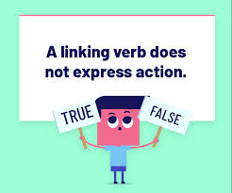
LINKING VERBS, Cont.
Here is a list of some linking verbs:
Appear
Feel
Look
Seem
Sound
Taste
Become
Grow
Smell

Slide 13

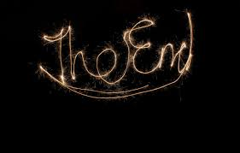
This is not all there is to learn about verbs, but it is a good refresher.

