Slide 1
APA Formatting

Slide 2
What is APA Formatting?
American Psychological Association style of writing
Most often used in the social sciences (Psychology, Sociology, Humanities, etc.)
Was recently updated to the 7th edition

Slide 3
APA 6th vs 7th Edition
Change | 6th Edition | 7th Edition
Running Head | Required | Not required
Use of “retrieved from” | … Springer Publishing Company. Retrieved from https://www.springer.com/gp/book/9783319644097 | ….Springer Publishing Company. https://www.springer.com/gp/book/9783319644097
Publication location | Required for students and professionals | Not required for students
Capitalization of Ethnic and Racial Groups | Not specified | Ethnic and racial groups are capitalized
Notes:
Always ask your professor which format they prefer.

Slide 4
General APA Guidelines
Font: 11 pt Calibri, 11 pt Arial, and 12 pt Times New Roman
Double spaced
1” margins on all sides
Running head with page number
Paper should include 4 major sections:
- Title Page
- Abstract (if required by professor)
- Main Body
- References
Notes:
APA doesn’t specify a single or set of fonts, but we recommend any Sans Serif (Calibri, Arial, Lucida Sans Unicode) or Serif fonts (Times New Roman, Georgia, Computer Moderna)

Slide 5
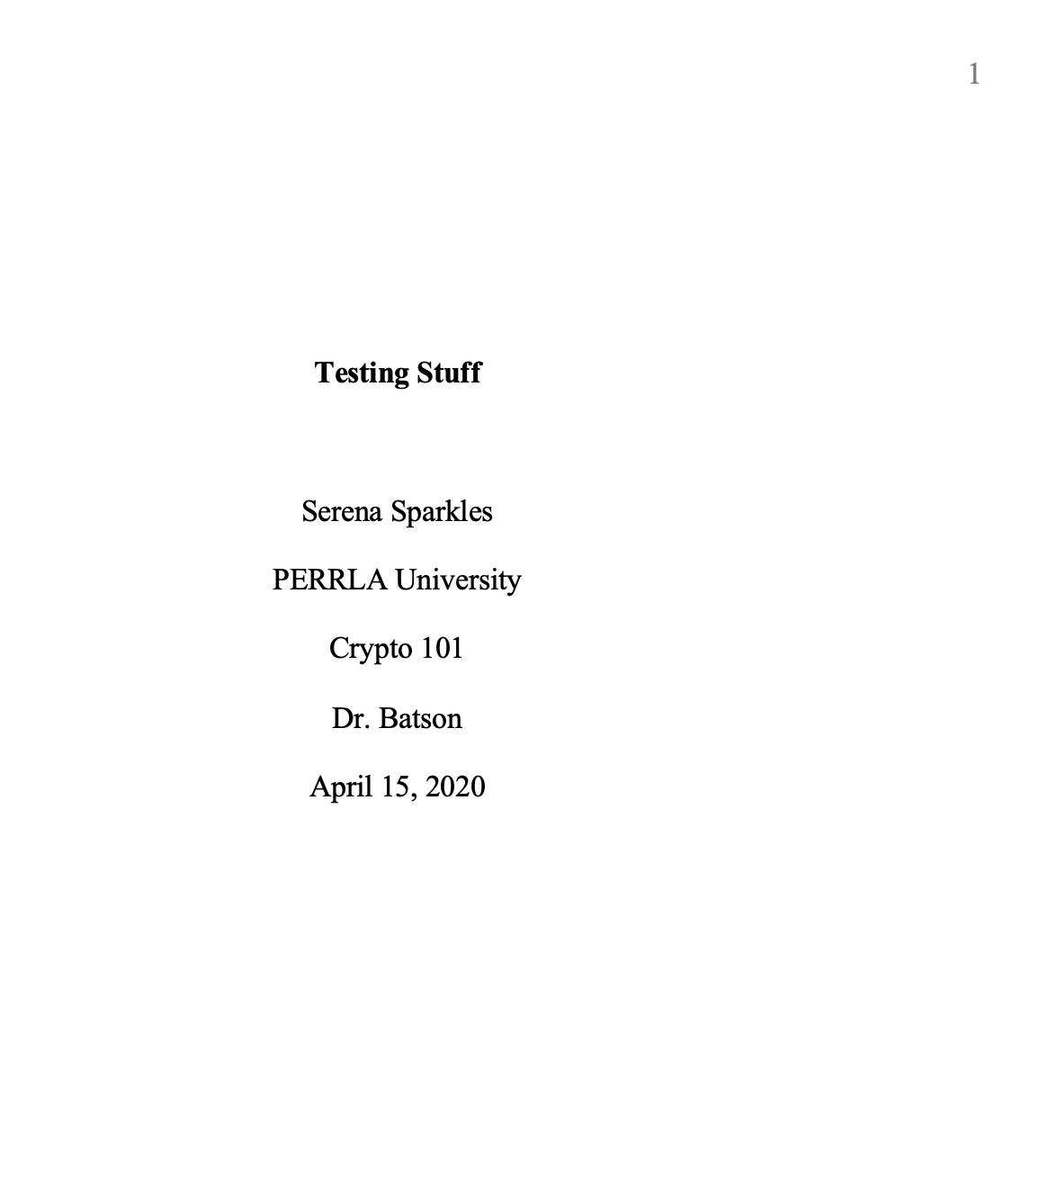

Title Page
Running head: TESTING STUFF
Title
Your name
Your school (FSU)
Course name and number
Professor’s name
Due date of paper
Page number in top right-hand corner
Running head

Slide 6
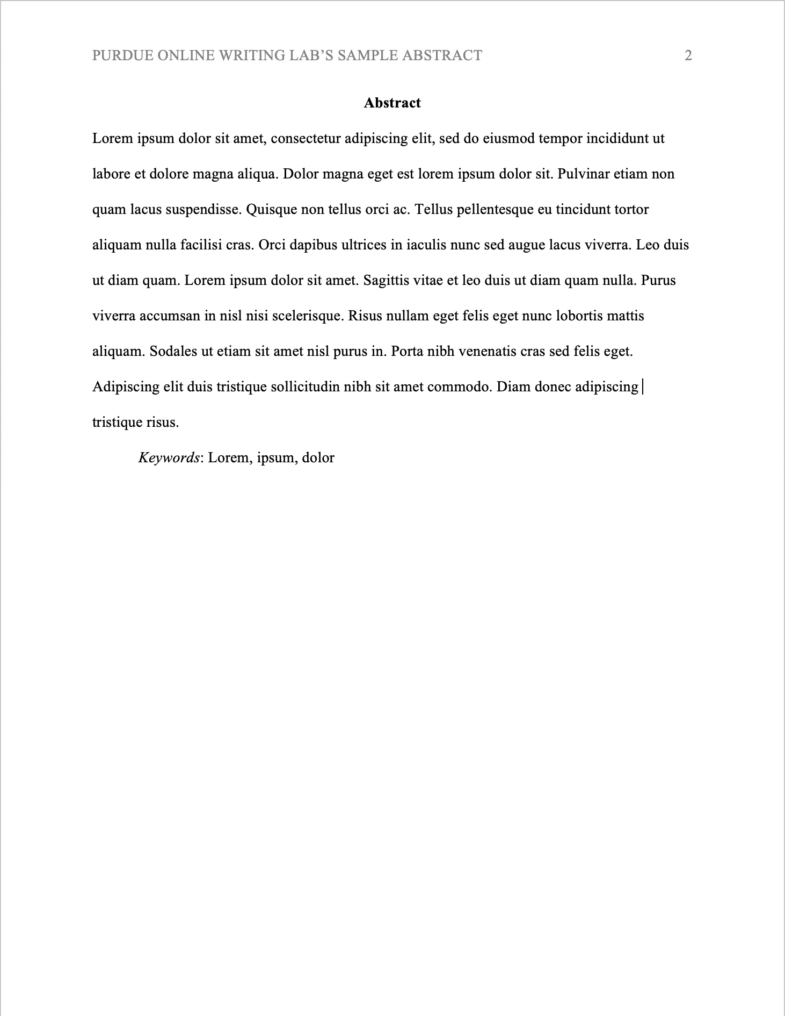
Abstract
Used in research papers
Concise summary of key points of your research
Single paragraph
Double spaced
250 words or less
Keywords
Notes:
Abstracts are typically used in scholarly journal articles and not usually required for student papers, but always check your rubric or ask the instructor to make sure that it is required.
The abstract on a new page directly after the title page.
If you want to include keywords, you will indent like you were starting a new paragraph, then type Keywords in italics followed by the colon and then list your keywords
Key words help researchers find your work if it were to be published in a database

Slide 7
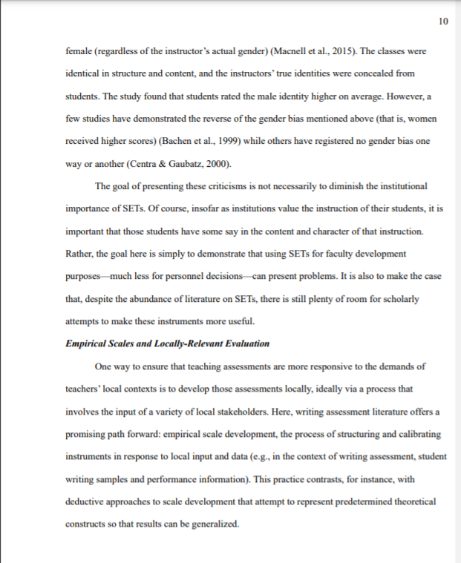
Body of the paper
TEACHING METHODS
Running head: Needs to be in the top-left corner of the paper. Needs to be in all caps.
Subheadings: Must be bolded, and flush to the left-hand side or centered. Should only be used when discussing a separate topic.
Page numbers: Need to be on the right-hand corner of the paper.

Slide 8
Reminder: On the first page of your written text, make sure to rewrite your title (and center it) before your introduction.

Slide 9
In-text Citations
Quote
(Author's last name, year of publication, pages directly cited)
"…."(Smith, 2019, pp. 199-201)
Paraphrasing
(Author's last name, year of publication"
…(Smith, 2019).
Notes:
All ways ask your professor which version they prefer!

Slide 10
In-text Citations
According to Smith (2019), “APA formatting is not hard if you know what you are doing” (p. 89).
If you mention the author’s name in your paper, the in-text citation needs to look like this….
Notes:
All ways ask your professor which version they prefer!

Slide 11
In-text citations for three or more authors:
Fanon et al. (2019) once stated…
(Fanon et al., 2019).

Slide 12
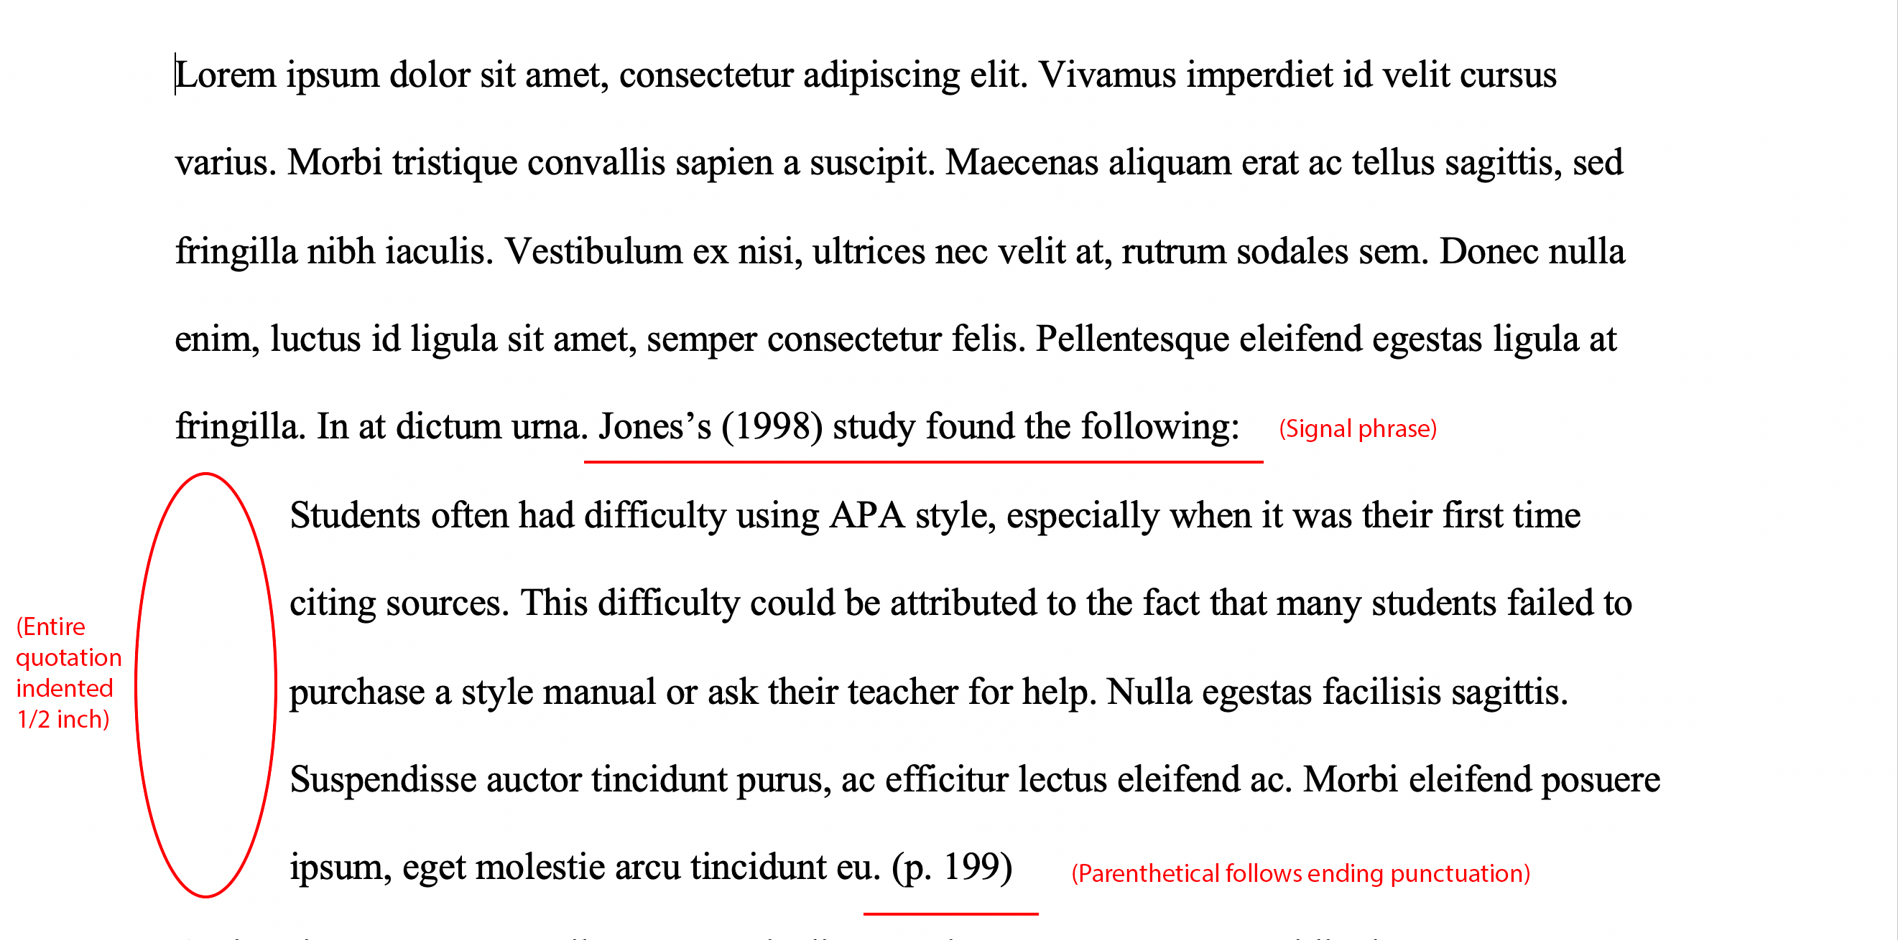
Block Quotes
Use for direct quotes 40 words or longer
Notes:
For quotes longer than 40 words, you will need to use a block quote, which is a free standing paragraph.
- for block quotes you omit the quotation marks and indent the paragraph ½ inch

Slide 13
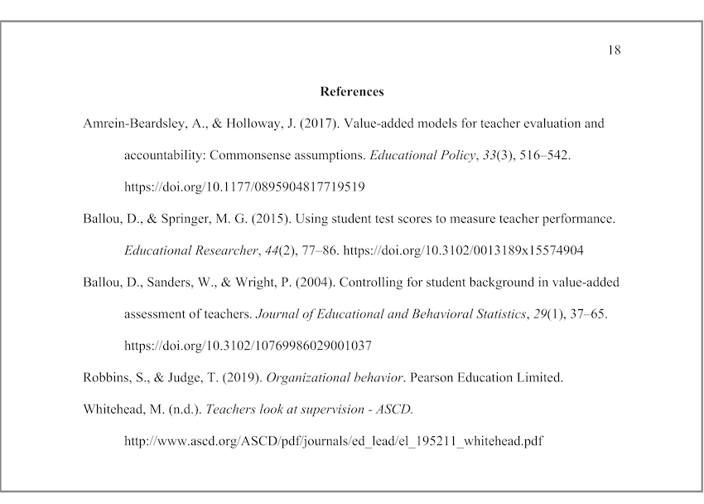


Reference Page
List references on a new page
"References" is centered and bolded
Double spaced
Alphabetized by last name of author
Hanging Indent
Notes:
List your references on a new page after writing your paper
The title "References" should be centered and typed in boldface
References should be double spaced
For multiple sources from the same author, list the entries in chronological order (So put the oldest work first, then end with the most recent)
Every reference should have a hanging indent

Slide 14
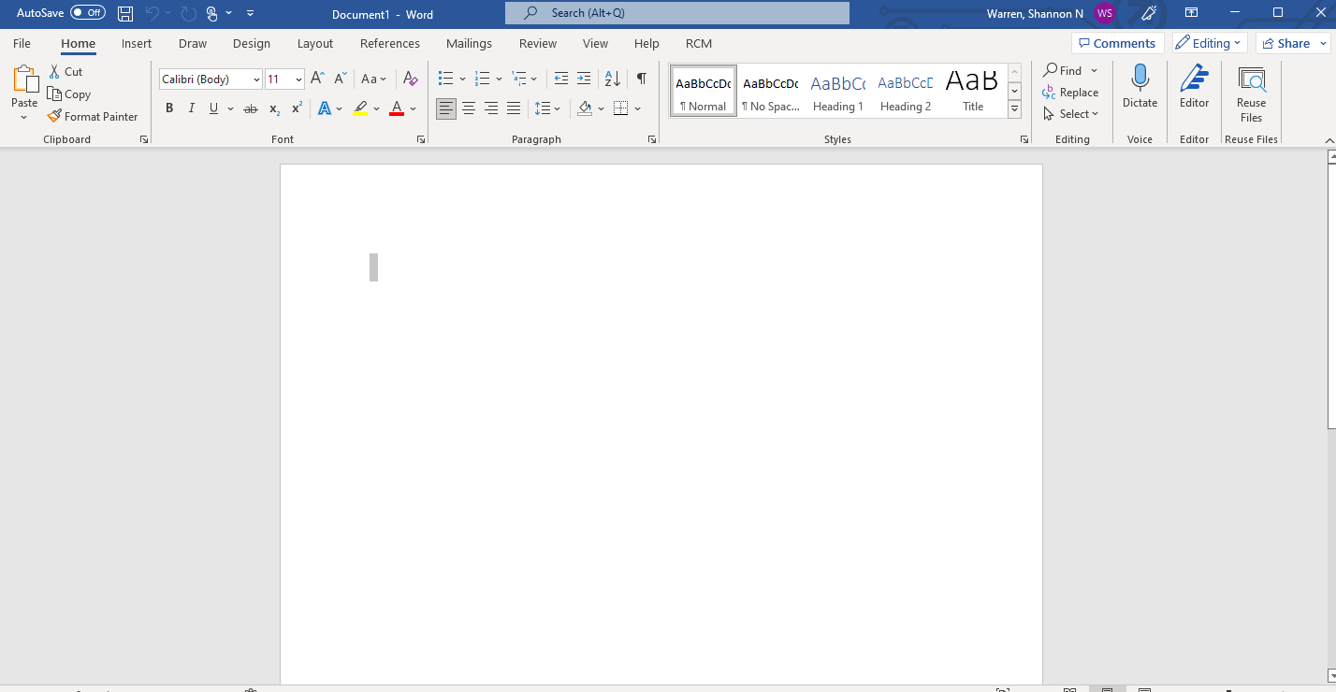
To make a hanging indent, highlight your source, go to the home tab and then click here.

Slide 15
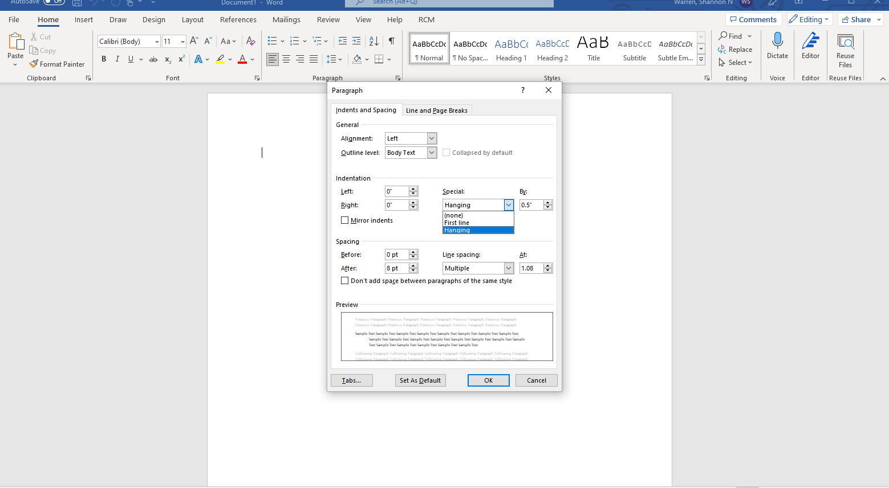
Next, go to “special” and click on “hanging.” Make sure to hit ok.

Slide 16
References Basics
Put the last name of the author first, then followed by their initials.
Ex: Smith, J.Q
Capitalize only the first letter of the first word of a title and subtitle
Ex: Ugly love: A novel
Notes:
When capitalizing titles, capitalize only the first letter of the first word of a title and subtitle and the first word following a color or a dash.

Slide 17
Referencing Authors
1 Author
(Ahmed, 2012)
Ahmed, S. (2012). On being included: Racism and diversity in institutional life. Duke University Press.
2 Authors
(Soto & John, 2017)
Soto, C. J., & John O.P. (2017)….
3+ Authors
(Nguyen et al., 2019)
Nguyen, T., Carnevale, J. J., Scholer, A. A., ...
Notes:
For 1 author: Last name, followed by author initials
For 2 authors: List their last names separated by the & sign in parenthetical citations and in the reference section list by their last names and initials, separating names with a comma
For 3 or more authors: List the last name of the first author followed by "et al." In parenthetical citations, then list all the authors in the reference section in the order they appear in the work.

Slide 18
Referencing Authors cont.
Unknown Author
(Merriam-Webster's, 2003)
Merriam-Webster's collegiate dictionary (11th ed.). (2003)...
Multiple Works by Same Author
(Urcuioli, 2011)
(Urcuioli, 2015)
Urcuioli, P. J. (2011). ...
Urcuioli, P. J. (2015). ..
Group Author
(Bureau of International Organizational Affairs [BIOA], 2018)
(BIOA, 2018)
Bureau of International Organization Affairs. (2018). ..

Slide 19
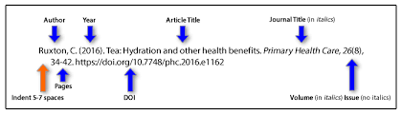
Citing Books and Academic articles
Capitalize all major words in titles of journals and books
Italicize titles of books and journals
Ex: Stoneman, R. (2008). Alexander the Great: A life in legend. Yale University Press.
Don't italicize, underline, or put quotes around the titles of shorter works like journal articles and essays
Notes:
When capitalizing titles, capitalize only the first letter of the first word of a title and subtitle and the first word following a color or a dash.

Slide 20
Citing a Website
Last name, F.M. (Year, Month, Date). Title of page. Site name. URL
Ex: Price, D. (2018, March 23). Laziness does not exist. Medium. https://humanparts.medium.com/laziness-does-not-exist-3af27e312d01
If the website was written by an organization, use the name of the group as the author.
If the page's author is not listed, start with the title instead.
Ex: Tuscan white bean pasta. (2018, February 25). Budgetbytes. https://www.budgetbytes.com/tuscan-white-bean-pasta/
Notes:
I

Slide 21
Citing Youtube Video
Person or group who uploaded video. (Date of publication). Title of video [Video]. Website host. URL.
Ex: Tasty. (2018, March 7). 7 recipes you can make in 5 minutes [Video]. Youtube. https://www.youtube.com/watch?v=9_5wHw6l11o

Slide 22
Using Purdue Owl APA
Purdue Owl APA is a great source for finding information regarding APA citation and formatting.
APA Style Introduction // Purdue Writing Lab

Slide 23
As always, you can visit the Writing Center in-person, online, or through Upswing!
Writing Center: 9 am – 5 pm (Mon.-Thur.)
9 am – 1 pm (Fri.)
HTC 216 B
Make an appointment through Upswing or walk-in
Upswing: Meet virtually or submit an assignment.
Available 24/7

Slide 24
Questions?
Thank you!

