Slide 1

All About MLA Citation
UNCFSU Writing Center

Slide 2
What is MLA?
MLA or Modern Language Association citations are used by those in the humanities and the social sciences.
Currently, MLA is in the 9th edition.
While there are other citation formats (APA, Chicago, Harvard, etc.) MLA is one of the easier citation methods. Therefore, practicing with MLA can help you to understand what citation is all about.
While citation machines help, they are not 100% correct. Even if you use a citation machine, you should always manually check your citations.

Slide 3
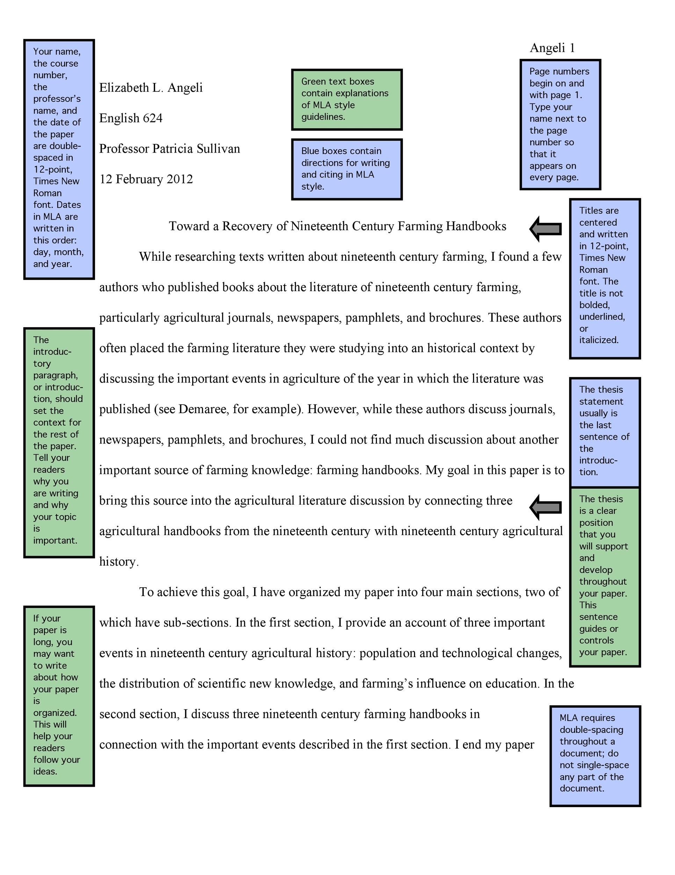
MLa Formatting
An MLA paper should be formatted as follows:
  The font should be in Times New Roman, 12-point font.
  All text should be double-spaced.
  1-inch margins around the page.
  Name, course, professor's name, and date should be in the left-hand corner on the first page.
  Last name and date should be in the right-hand corner.
  Should have a title that is centered.

Slide 4
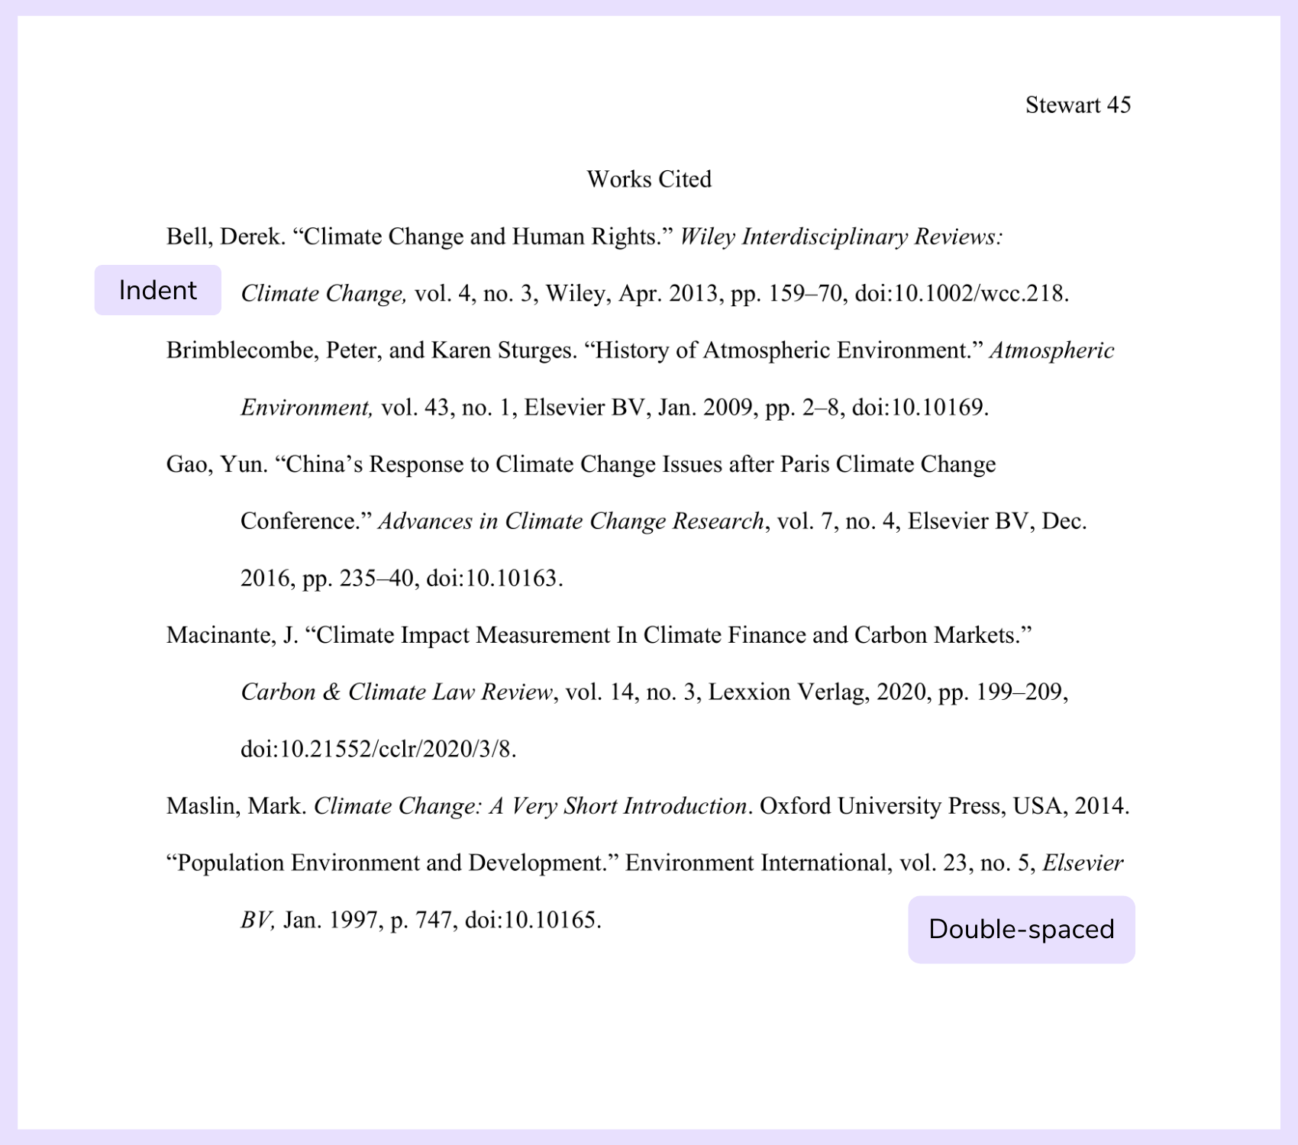
Works Cited
An MLA page has a works cited page which is where all the sources that you used are listed.
The works cited page needs to be formatted as follows:
  Times New Roman, 12-point font, double-spaced.
  Must have a title that is centered.
  The title MUST be labeled as Works Cited.
  All sources should be in alphabetical order.
  All sources should have a hanging indent. Here is a link on how to create a hanging indent in Microsoft Word: Create a hanging indent (microsoft.com)
  Don't worry about how to cite your sources! That is covered later in this presentation.

Slide 5
In-text citations
In-text citations are citations found within the body of the text. You utilize in-text citations for:
  Paraphrases
  Quotes
  Summaries
The purpose of in-text citations are to give credit where it is due.
Typically, in text citations look like this:
“Those who say it can’t be done are usually interrupted by others doing it” (Baldwin 96).
What are the two components of the in-text citation?

Slide 6
In-text citations
Not all in-text citations look the same. Here are some ways that in-text citations can change:
The most inspiring line in James Baldwin's Notes of a Native Son has to be when he explains that, "Those who say it can’t be done are usually interrupted by others doing it” (96).
In Notes of a Native Son, the author describes how people with no drive to facilitate change will find themselves overcome by those with the willingness to challenge current systems, whether for good or evil (Baldwin 96).
However, there are some exceptions to this rule...

Slide 7
In-text citations
Some exceptions to the author-page number rule is when:
  There is no author.
  There are multiple authors.
  Two or more authors have the same last name.
  There is no page number.
According to MLA, here is what you would do:
For poetry or script, you use line numbers: “In what distant deeps or skies. / Burnt the fire of thine eyes," they ask in reference to the tiger as they attempt to reconcile their intimidation with their relationship to creationism (lines 5-6).
For no known author: Place the title in quotation marks if it's a short work (such as an article) or italicize it if it's a longer work (e.g. plays, books, television shows, entire Web sites) and provide a page number if it is available. If the title of the work in long, shorten it in the in-text citation.
  Example: We see so many global warming hotspots in North America likely because this region has "more readily accessible climatic data and more comprehensive programs to monitor and study environmental change . . ." ("Impact of Global Warming").

Slide 8
In-text citations
Authors with the same last name: Provide the first initials of each author.
  Example: Although some medical ethicists claim that cloning will lead to designer children (R. Miller 12), others note that the advantages for medical research outweigh this consideration (A. Miller 46).
  Multiple authors: The authors claim that surface reading looks at what is “evident, perceptible, apprehensible in texts” (Best and Marcus 9).
  Citing two works by the same author: include a shortened title for the particular work from which you are quoting to distinguish it from the others. Put short titles of books in italics and short titles of articles in quotation marks.
    Example: Lightenor has argued that computers are not useful tools for small children ("Too Soon" 38), though he has acknowledged elsewhere that early exposure to computer games does lead to better small motor skill development in a child's second and third year ("Hand-Eye Development" 17).
  Indirect sources: An indirect source is a source cited within another source. For such indirect quotations, use "qtd. in" to indicate the source you actually consulted.
    Example: Ravitch argues that high schools are pressured to act as "social service centers, and they don't do that well" (qtd. in Weisman 259).

Slide 9
In-text citations
Multiple citations: To cite multiple sources in the same parenthetical reference, separate the citations by a semi-colon:
  Example: . . . as has been discussed elsewhere (Burke 3; Dewey 21).
For three or more authors: For a source with three or more authors, list only the first author’s last name, and replace the additional names with et al.
  Example: The authors claim that one cause of obesity in the United States is government-funded farm subsidies (Franck et al. 327).
  According to Franck et al., “Current agricultural policies in the U.S. are contributing to the poor health of Americans” (327).

Slide 10
Works cited
At the end of your paper is your works cited. These are the sources that you used in your own paper.
Generally, a MLA works cited citation will contain these components:
  Author. Title. Title of container (do not list container for standalone books, e.g. novels), Other contributors (translators or editors), Version (edition), Number (vol. and/or no.), Publisher, Publication Date, Location (pages, paragraphs URL or DOI). 2nd container’s title, Other contributors, Version, Number, Publisher, Publication date, Location, Date of Access (if applicable).
Also remember your hanging indent!

Slide 11
Works cited- Books
Books:
  Last Name, First Name. Title of Book. City of Publication, Publisher, Publication Date.
  *Note: the City of Publication should only be used if the book was published before 1900, if the publisher has offices in more than one country, or if the publisher is unknown in North America.
  Book with more than one author:
  Gillespie, Paula, and Neal Lerner. The Allyn and Bacon Guide to Peer Tutoring. Allyn and Bacon, 2000.
  Two or more books by the same author:
  Palmer, William J. Dickens and New Historicism. St. Martin's, 1997.
  ---. The Films of the Eighties: A Social History. Southern Illinois UP, 1993.
  Book by a corporate organization:
  American Allergy Association. Allergies in Children. Random House, 1998.
  Book with no author:
  Encyclopedia of Indiana. Somerset, 1993.

Slide 12
Works Cited-Books
An edition of a book:
  Crowley, Sharon, and Debra Hawhee. Ancient Rhetorics for Contemporary Students. 3rd ed., Pearson, 2004.
  A work prepared by an editor:
  Bronte, Charlotte. Jane Eyre, edited by Margaret Smith, Oxford UP, 1998.
  An Anthology, Reference or Collection:
  Last name, First name. "Title of Essay." Title of Collection, edited by Editor's Name(s), Publisher, Year, Page range of entry.

Slide 13
Works Cited- Articles
Academic (scholarly) Articles: These are found in the "Periodicals" section on Purdue Owl
  Author(s). "Title of Article." Title of Journal, Volume, Issue, Year, pages.
  Article in a magazine: Author(s). "Title of Article." Title of Periodical, Day Month Year, pages.
  Anonymous Articles:
  Example: "Business: Global Warming's Boom Town; Tourism in Greenland." The Economist, 26 May 2007, p. 82.

Slide 14
Works Cited – Electronic Sources
Citing an entire website:
  Example: The Purdue OWL Family of Sites. The Writing Lab and OWL at Purdue and Purdue U, 2008, owl.english.purdue.edu/owl. Accessed 23 Apr. 2008.
An E-book:
  Example: Silva, Paul J. How to Write a Lot: A Practical Guide to Productive Academic Writing. E-book, American Psychological Association, 2007.
A YouTube Video:
  Example: McGonigal, Jane. “Gaming and Productivity.” YouTube, uploaded by Big Think, 3 July 2012, www.youtube.com/watch?v=mkdzy9bWW3E.
  Example: “8 Hot Dog Gadgets put to the Test.” YouTube, uploaded by Crazy Russian Hacker, 6 June 2016, www.youtube.com/watch?v=WBlpjSEtELs.

Slide 15
For additional citation help, please visit Purdue Owl Online
Click here to be linked to Pudue Owl: MLAFormattingandStyle Guide // Purdue Writing Lab

