Slide 1
Quoting, Summarizing, and Paraphrasing
presented by the FSU Writing Center team

Slide 2
Why do we quote?
To avoid plagiarism.
If the original work can’t be restated any better.
To introduce important content and ideas into your paper.
If the author’s reputation adds credibility to your paper.

Slide 3
Quotations
Something that a person says or writes that is repeated or used by someone else in another piece of writing or a speech.

Slide 4
Quotations
Example in APA:
King, in one of his most famous speeches, states “I have a dream that my […] children will one day live in a nation where they will not be judged by the color of their skin but by the content of their character” (1963).
Direct words from the text you are quoting.
Depending on your paper’s style guidelines, in text citation must have page number, author(s) last name, and year of publication in parenthesis.
In APA, use p. for one page, pp. for multiples.

Slide 5
Your quote must have quotation marks around the entire quote.
If removing certain unimportant words from a quote, use brackets and ellipses.
The reviewer guide said, “The movie was […] outrageous”
If adding words to make your quote make sense in context, use brackets and simple words.
In rebuttal to Pearson’s study, author Houghton says, “[The] study showed that the substance is cancerous, which is not true.”

Slide 6
Long/Block Quotes
For all major styles, longer quotes must be given new line and different margin standard. Additionally, this type of quote cannot have quotation marks.
APA – minimum 40 words to use a block quote, with 0.5 inch indent.
MLA – minimum 4 lines, with 0.5 inch indent.
Chicago/Turabian – minimum 5 lines or 2 paragraphs, with 0.5 indent.

Slide 7
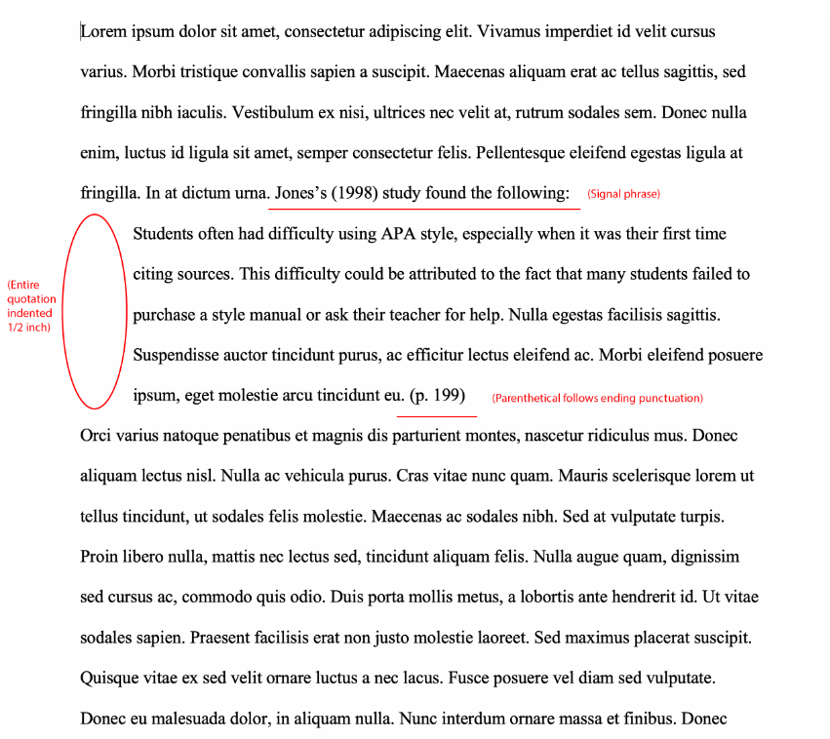
Purdue OWL, 2019, pg. 261-268

Slide 8
Summarization
To express the most important facts or ideas about something or someone in a short, concise, and clear form.

Slide 9
Summarizing Basics
Takes main ideas of the passage and condenses them.
Allows you to reiterate information within your writing.
Helps to understand the content of the work you’re summarizing and prepare you for synthesizing ideas in your own essays.
Used in book synopses, content reviews, abstracts in APA format papers, etc.

Slide 10
Example
Original text
Summarization
Though sometimes failure can feel like the end of the world, there are a lot of big names out there who have failed before in life, gotten back up, and become prominent figures in our culture. Oprah Winfrey was fired from her newscasting job at 22, then went on to start the Oprah Winfrey show (Enochs, 2016). Her success was dependent on that previous failure, as she would not be Oprah if she hadn’t been fired and given the opportunity to become who she is today.
You can’t succeed without failure.

Slide 11
Example of Synopsis
Isabella Swan’s move to Forks, a small, perpetually rainy town in Washington, could have been the most boring move she ever made. But once she meets the mysterious and alluring Edward Cullen, Isabella’s life takes a thrilling and terrifying turn. Up until now, Edward has managed to keep his vampire identity a secret in the small community he lives in, but now nobody is safe, especially Isabella, the person Edward holds most dear. The lovers find themselves balanced precariously on the point of a knife-between desire and danger. Deeply romantic and extraordinarily suspenseful, Twilight captures the struggle between defying our instincts and satisfying our desires (Stephanie Meyer, 2008).
This Photo by Unknown Author is licensed under CC BY-SA-NC

Slide 12
Paraphrasing
To reword someone else’s ideas or writing in your own style, with the same essential meaning.

Slide 13
Paraphrasing Basics
Similiar to summarizing, except it uses your own understanding of the concept without using the original text.
Endorses personalization and individual thought on a subject.
Assists with building upon one idea to branch to another.
Think of the game Telephone, but without messing up the intended meaning.

Slide 14
Example
Original:
Paraphrase:
Always remember to marry for love.

Slide 15
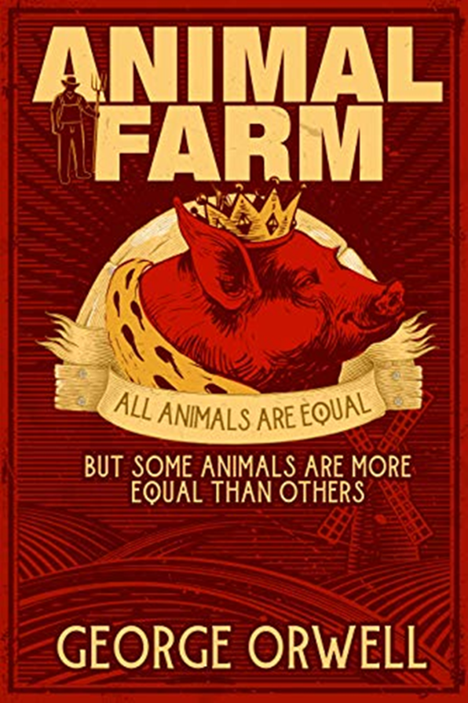
Example
2
Paraphrase
Every living creature has rights, but some have more rights than others.
Original

Slide 16
In conclusion…
Make sure to quote your sources correctly using your paper’s style guidelines.
Paraphrasing is putting other’s words into your own with a personal twist.
Remember to always cite your sources; if using someone else’s idea whatsoever, you must credit them.
Summarization is a condensed version of a source of writing, speech, etc.

Slide 17
References
Enochs, E. (2016, September 19). 7 successful women who were fired & don’t regret it. 7 Successful Women who Overcame Being Fired. https://www.bustle.com/articles/184778-7-successful-women-who-were-fired- dont-regret-it
King, M. L. (1963). Read Martin Luther King Jr.’s “I have a dream” speech in its entirety. National Public Radio. https://www.npr.org/2010/01/18/122701268/i-have-a-dream-speech-in-its-entirety
Meyer, S. (2005).The Twilight series, book 1: Twilight. https://stepheniemeyer.com/project/twilight-book/
Purdue Online Writing Lab. (n.d.). In-text citations: The basics. Purdue Online Writing Lab. https://owl.purdue.edu/owl/general_writing/general_writing_faqs.html

