Slide 1
Learning Styles
Presented by the
Fayetteville State University
Writing and Communication Center

Slide 2
Knowing how to learn and how you learn:
What is a Learning Style?
What is your Learning Style?
What can you do to work with your Learning Style?

Slide 3
What are Learning Styles?
Learning styles are how someone learns, the process of how they study and retain information. There are three different kinds of learning styles commonly used:
Visual learning (seeing something).
Auditory learning (hearing something).
Kinesthetic learning (feeling something).

Slide 5
Some roadblocks to learning styles:
Learning styles can vary from person to person, but there are some reasons that some people do not use certain learning styles.
Example:
Someone who has a visual impairment would not use a visual learning style; someone who has an auditory impairment would not use an auditory learning style…
It is important to remember that everyone is different and has different strengths. What works for one person might not work for another. Someone might have one learning style, someone else might have multiple! The important thing is to find out what works for you.

Slide 6
So.. What is Your learning style?
In the next slides we will break down what characterizes these three learning styles and some study hacks to help with learning in those styles. Keep track of which hacks you think would help you, to see if you can find out what your learning style is.

Slide 7
The “Visual Learner”
Do you picture things in your mind when you read? Or prefer to follow diagrams than written instructions when constructing your furniture from IKEA? If so, you might be a Visual Learner. Visual Learners like outlines and illustrations when instructors are lecturing and create pictures and diagrams to help themselves understand new materials.

Slide 8
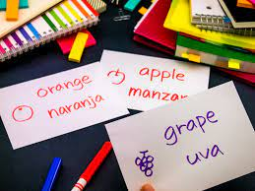
Visual Learner: Studying Hacks
Highlighted flashcards
Colored pens flashcards
Colored flashcards
Notes! Notes! Notes! Visual Learners love notes, organized by color or topic and with pictures and diagrams! Going over these notes time and time again help a visual learner to retain information and apply it to the topics they are learning.

Slide 9
Visual Learner: Studying Hacks
Outlining
Visual Learners make use of outlines for papers. An outline helps to structure thoughts and lead one point into the next.

Slide 10
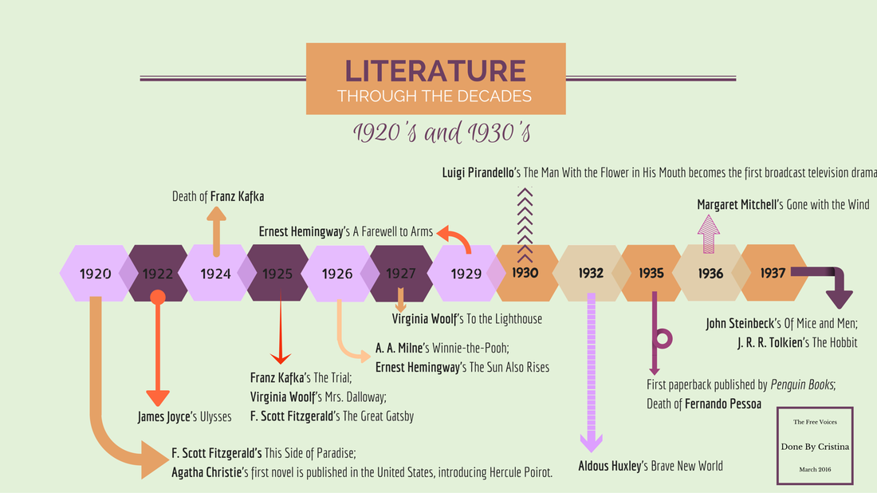
Visual Learner: Studying Hacks
Outline information you need to remember
Outlining papers is one thing, outlining a sequence of events is another. Visual Learners can do a lot with outlines. Outlining a timeline can help keep facts straight.

Slide 11
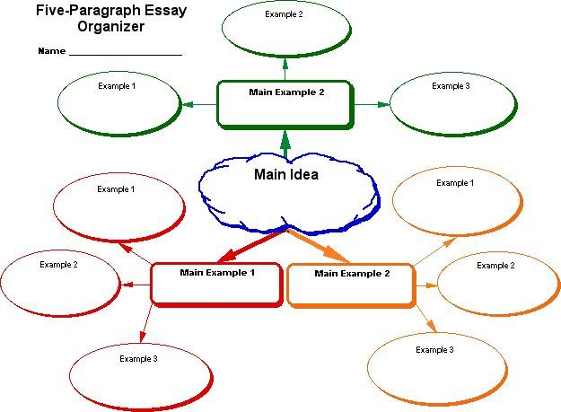
Visual Learner: Studying Hacks
Mind-mapping
Visual Learners make use of mind-mapping. With this method you start with your main topic and then branch out into different examples. This method of mapping helps visual learners to see where things are connected and keep their ideas organized.

Slide 12
Visual Learner: Studying Hacks
Learn by seeing diagrams, so draw and re-draw concepts
Visual Learners like to map out diagrams and draw pictures to help them understand. Don’t be afraid to doodle during class! Just make sure to stay on topic.

Slide 13
Visual Learner: Studying Hacks
Doodling..?
Ah yes.. Remember when your teacher or parent got after you for doodling on your homework? Did you know that doodling is actually a form of paying attention? Or rather, a last-ditch effort to pay attention? Harvard Health Blog suggests that doodling is your brain’s way of trying to stay alert and pay attention. It isn’t a distraction, it’s a tool. Doodling helps with memory recall, stress relief, and focus.

Slide 14
Visual Learner: Studying Hacks
Watch videos of concepts!!
Visual Learners love visuals! It’s in the name! So, watch some stuff! Find documentaries on the topics you are researching or find demonstration videos on YouTube! There is an endless stream of things to watch. And there is no shortage of people willing to explain most topics. See what you can find!

Slide 15
The “Auditory Learner”
Do you prefer verbal instructions over written ones? Do you say things out loud to remember them? If so, you might be an Auditory Learner. Auditory Learners prefer to listen to things rather than read them and remember things better if they hear it.

Slide 16
Auditory Learner: Study Hacks
Use headphones to listen to the lessons!
Watching lectures is a great way to get information. But distractions around you make that information difficult to hear. Wearing headphones while listening to lectures or when in classes online helps to hear the teacher or lecturer clearly.

Slide 17
Auditory Learner: Study Hacks
Listening to music (like white noise) to focus while studying!
Speaking of headphones, listening to white noise or music while studying can help to keep you focused! Whitten wrote in her article that listening to music that you like is linked to lower levels of stress, which make you more comfortable when studying. There is no proof that listening to classical music is better than any other music, but music with lyrics can be distracting to some. So, put on a playlist that keeps you relaxed and motivated, and see how well you are able to study!

Slide 18
Auditory Learner: Study Hacks
Read everything out loud
Auditory Learners learn best when they hear things, so say everything you need to learn out loud! The act of speaking the words and hearing them can help you understand new things. It might be best to have someone else read things to you, but when you don’t have someone available to read your textbook to you, you have yourself. So read out loud!

Slide 19
Auditory Learner: Study Hacks
Talk to someone about what you are learning/ class discussions and study groups
Study groups and group discussions work well as a learning tool for many students, that is why it is encouraged in class. Explaining things to someone else can help you organize your thoughts and understanding of a subject and can help you connect information together that you were unable to before.

Slide 20
Auditory Learner: Study Hacks
Make recordings of lectures (with permission) and recordings of your notes and listen to them.
Listening to everything someone says once is helpful, but do you know what is more helpful? Yeah, being able to listen to what that person said as many times as you need to until you understand! Make sure to get their permission. Listening to recordings of lectures or conversations will help just like listening to someone during those interactions, only you can listen on your own time, at your own pace, and in a distraction free environment.

Slide 21
Auditory Learner: Study Hacks
Listen to videos that explain the concepts
There are a lot of people out there who are experts on topics and will talk for hours about those topics! Find a podcast, or a YouTuber, or an audible book to listen to.

Slide 22
Auditory Learner: Study Hacks
Mnemonic devices to help you remember information
Auditory Learners might find little phrases helpful for remembering information. The Acronym PEMDAS helps with math equations, but someone who does not remember PEMDAS might better remember “Please Excuse My Dear Aunt Sally”. Each word begins with a Letter of PEMDAS. This can be used for many things where order of execution is important.

Slide 23
The “Kinesthetic Learner”
Do you like your lab class better than your lecture class? Do you find it hard to sit still when you’re studying? If so, you might be a Kinesthetic Learner. Kinesthetic Learners prefer to do things, rather than listen or watch. They typically like to learn through trial and error and like to apply new concepts instead of just learn about them.

Slide 24
Kinesthetic Learner: Study Hacks
Use flashcards and arrange them in groups, and put them in places you will see them
Take note Kinesthetic Learners! No, really, take notes! Writing things down physically will help you to remember them. Place them in areas you will see and read them and it will re-enforce those notes in your brain.

Slide 25
Kinesthetic Learner: Study Hacks
Active reading and reacting to your text
Make notes, highlight, write in the margins! Reacting to information as you’re are reading can help you understand information as a Kinesthetic Learner.

Slide 26
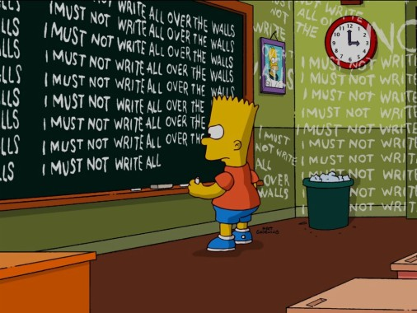
Kinesthetic Learner: Study Hacks
Write down your notes on paper!
Did you know that writing down notes on paper is actually linked to better learning? According to Bergland, in Psychology Today, writing on paper activates the brain “more robustly” than typing notes on a phone or computer. Hand-written notes help with memory recall and are overall more accurate than typed notes.

Slide 27
Kinesthetic Learner: Study Hacks
Get Hands-On experience
Perhaps the best hack for Kinesthetic Learners isn’t even a hack. It is simply hands on experience. Learning how to do something through physical practice and repetition, with instruction, can help information stick. Doing rather than listening to a lecture, or watching a video, is a Kinesthetic Learner’s dream.

Slide 28
Kinesthetic Learner: Study Hacks
Study in short blocks, so you can take frequent breaks
Sitting down and reading for long periods of time can be exhausting. You may not be using much energy, but you are exercising your brain. Make sure to schedule small breaks in your studying so you do not become restless or bored.

Slide 29
There Can Be Overlap!
Not everyone has one learning type, and some people can have a combination of two or more. Note-taking can be Visual and Kinesthetic. Watching a documentary can be Visual and Auditory. There are many different paths to effective studying!
Try out a variety of study hacks to find out which learning styles work best for you.

Slide 30
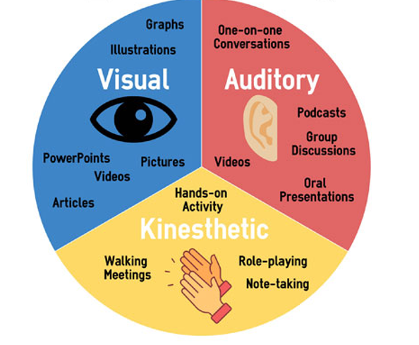
Conclusion: What kind of learner are you?
Visual: You typically like to see things, diagrams, outlines, PowerPoints and notes. You work well with outlines and mind maps to keep you on track in your assignments and take lots of notes.
Auditory: You typically like to hear new information, through lectures or videos. You can best study through listening to recordings or having someone explain things to you in group discussions or one on one.
Kinesthetic: You typically want to do rather than watch or listen. You work best on the job, with hands-on experience. You can best study through writing things down physically and actively reacting to reading and notetaking.

Slide 31
Just Remember!
You are here to learn!
It’s okay to not know things!
You will learn more as you go along!
The important thing is that you keep trying. Submit all assignments as best as you can. A 50/100 is better than a 0/100.
Have a great day!

Slide 32
Works Cited:
“Making the Classroom Work for You.” Excellence, Mastery & Maturity. The First-Year Experience Success Guide for Freshman Seminar, edited by John I. Brooks, 2008, Fayetteville State University, pp. 57-183.
Bergland, Christopher. “4 Reasons Writing Things Down on Paper Still Reigns Supreme” Psychology Today, 19 Mar. 2021. 4 Reasons Writing Things Down on Paper Still Reigns Supreme | Psychology Today
Pillay, Srini.“The ‘thinking’ benefits of doodling”. Harvard Health Blog, 15 Dec. 2016, The "thinking" benefits of doodling - Harvard Health
Whitten, Cheryl. (2021). “Can Music Help You Study?” WebMD, 16 Sep. 2021, 3 Ways Music Can Help With Studying (webmd.com)

