Slide 1
Academic Voice
FSU Writing Center

Slide 2
What is it?
Writing that is done in an academic or scholarly context
Academic Writing includes,
A formal tone
Use of third-person, NOT first-person, perspective
A clear focus on the research
A strong Thesis
Evidence to support your stance
Documented sources

Slide 3
Academic writing doesn't mean "setting aside" your own voice.
"...mastering academic writing does not mean completely abandoning your normal voice for one that’s stiff, convoluted, or pompous, as students often assume. Instead, it means creating a new voice that draws on the voice you already have" (They Say/ I Say 118).
This does NOT mean that you should:
Use any language that you use with friends.
Use this as an excuse to fall into your "comfort zone."
Or to avoid learning new words and forms.
Academic writing is at its best when it combines "everydayspeak" with "academicspeak."

Slide 4
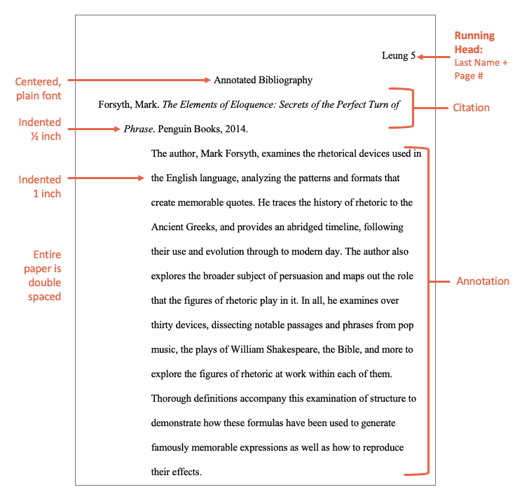
Examples of Academic Writing
Non personal Essay
Research paper
Research proposal
Thesis and dissertation
Lab report
Literature review
Annotated bibliography

Slide 5
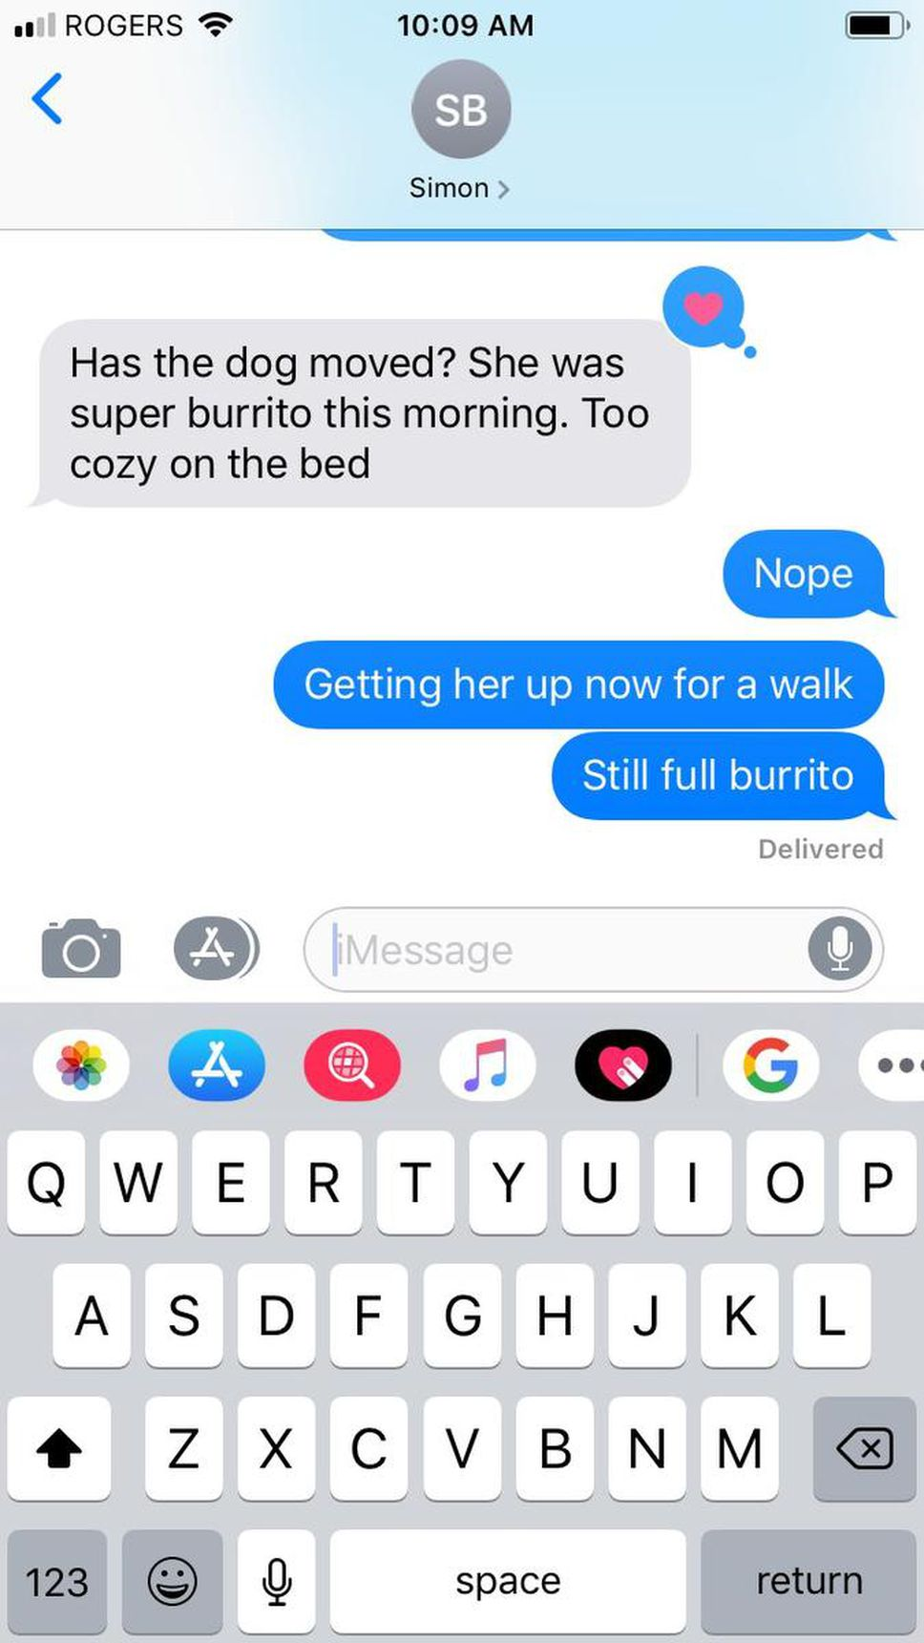
Non-Academic Writing
Any writing that is not intended for an academic audience
Writings that are personal, emotional, or subjective
Contains no sources, are not researched, does not have any type of structure, free flowing in an almost conversational tone
Examples
Text messages
Status updates/ Tweets/ Blogs
Diary/ Journals
Advice Columns

Slide 6
Blend academic and everyday speak
Readers and writers both can benefit from blending everyday speak and academic styles.
Example
It can often make complicated topics easier for readers to understand.
It often helps when trying to discover what you want to say.
It helps to remind us of our audience. What do they know? What don't they know?
Self-translation: The process of clarifying your own complex ideas.

Slide 7
How to blend
Everyday Speak
Scholar X argues, “____ .” In other words,______ .
Academic Blended With Everyday
Instead of “In other words,” try
Essentially, X argues …
X’s point, succinctly put, is that…
Plainly put…

Slide 8
Blended Voice Example
Self Voice
Academic/Source Voice
Blended Voice
“The most pedagogically valid reason that universities may have introduced preliminary year programmes is likely due to the fact that non-native students were often reported to be struggling to meet the linguistic demands of their major. In a study of 113 universities in the USA, Smith and Wesson (2000) found that dropout rates for non-native speakers of English at English-medium universities were as high as 24%. This research stimulated subsequent studies which all found that student concerns over course comprehension were a recurrent factor for these high rates (Davidson, 2001; Lee and Lee, 2004). Indeed, Johnson (2009) argues that such linguistic demands were in fact the primary reason for most cases of non-native dropouts around the turn of the millennium. In relation to this aspect, one significant effect of introducing preliminary-year programmes may be that students are now better prepared for their courses and dropout rates have decreased. In the same study, Johnson (2009) reported a decrease in dropout rates of 57% after the introduction of the preliminary year. Students have also since reported feeling more confident and comfortable with comprehending the concepts of their course (Jones, 2014), which perhaps indicates that extending bachelor’s degree programmes by a year has had a positive effect” (Academic Marker).

Slide 9
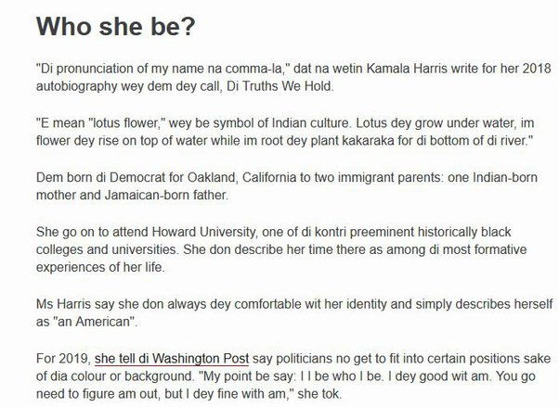
“Bad/Broken English”
Have you ever heard, “S/he speaks broken English?” Did you know there is no such thing?
BAD ENGLISH: An informal term for English that does not measure up to approved norms, because it is ungrammatical, poorly spelt, or uses expletives: ‘What is called “bad English” in the usual sense may be highly effective in the appropriate context’ ( W. Nelson Francis, The English Language, 1967). (Encyclepedia.com)

Slide 10
There is no such thing as “Bad English”
Many people have often heard that those that speak/use anything outside of Standard American English are using “Bad” or “Incorrect” English. However, this is simply NOT true.
There are many different types of “Englishes” that exist across the globe.
Each version of English, whether it be Black English, Asian English or any other type of English, is valid as they all use specific forms of grammar, language use, and stem from various rich cultural heritages.
It is not that any English is “bad”, it is more so that English speakers need to realize when to “code-switch” or use a particular type of English in specific contexts.

Slide 11
Black English Not “Bad English”
"In Black America, the oral tradition has served as a fundamental vehicle for gittin ovah. That tradition preserves the Afro-American heritage and reflects the collective spirit of the race. Blacks are quick to ridicule “educated fools,” people who done gone to school and read all dem books and still don’t know nothin! It is a socially approved verbal strategy for black rappers to talk about how bad they is. Geneva Smitherman, Talkin and Testifyin: The Language of Black America."
-Geneva Smitherman, Talkin and Testifyin: The Language of Black America

Slide 12
Other Examples of Different Englishes
Singlish (Singapore + English)
Paiseh: ‘Shy or Embarrassed’
“I’m paiseh to ask Adam Sandler for a selfie.”
Tinglish (Thailand + English)
“Kids go bad Burger King.” means “The kids were misbehaving at Burger King”
Japlish (Japanese + English)
“I wish to fall in happy drops on your head”. Words to the karaoke version of “Raindrops Keep Fallin’ on my Head.”

Slide 13
Resources
FSU Writing Center (Located in the Helen T. Chick Building)
https://www.uncfsu.edu/academics/colleges-schools-and-departments/university-college/the-student-success-learning-center/writing-and-communication-center
Upswing
https://uncfsu.upswing.io/
Grammarly
https://www.grammarly.com/

Slide 14
References
Academic Marker. (2021, October 31). How can I effectively balance “voice” in my writing? Academic Marker. https://academicmarker.com/skills-practice/writing-skills/balancing-voices/how-can-i-effectively-balance-voice-in-my-writing/
Bullock, R. H., Bertsch, D., Goggin, M. D., &amp; Weinberg, F. (2022). The Norton Field Guide to writing: With readings (E, Vol. 6). W. W. Norton &amp; Company.
Encyclopedia.com. (2023, June 27). ." Concise oxford companion to the English language. . encyclopedia.com. 26 may. 2023 &lt;https://www.encyclopedia.com&gt;. Encyclopedia.com. https://www.encyclopedia.com/humanities/encyclopedias-almanacs-transcripts-and-maps/bad-english
Graff, Gerald and Cathy Birkenstein. They Say/ I Say. 4th ed., w.w. Norton, 2018.
Toleva, G. (2020, August 21). Asian languages mixed with English. Pulse of Asia. https://www.1stopasia.com/blog/asian-languages-mixed-with-english/
Vaghani, D. (2022). Difference between academic writing and non-academic writing. Share and Discover Knowledge on SlideShare. https://www.slideshare.net/DayaVaghani/difference-between-academic-writing-and-nonacademic-writing

